Slide 1

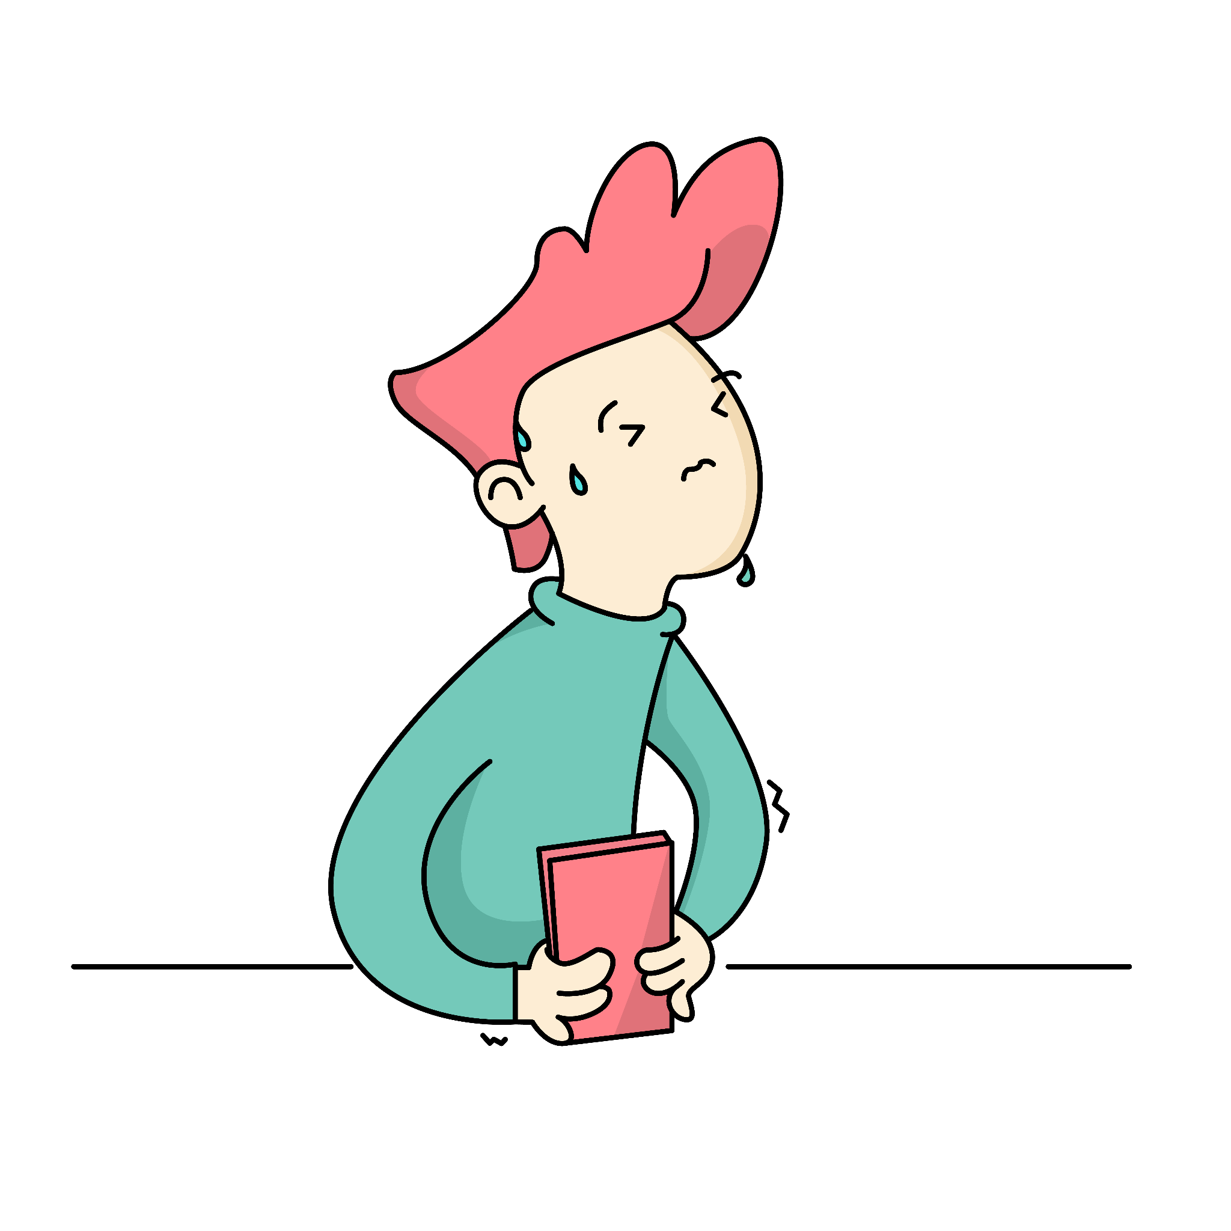

Why am I
scared of exams?

Slide 2

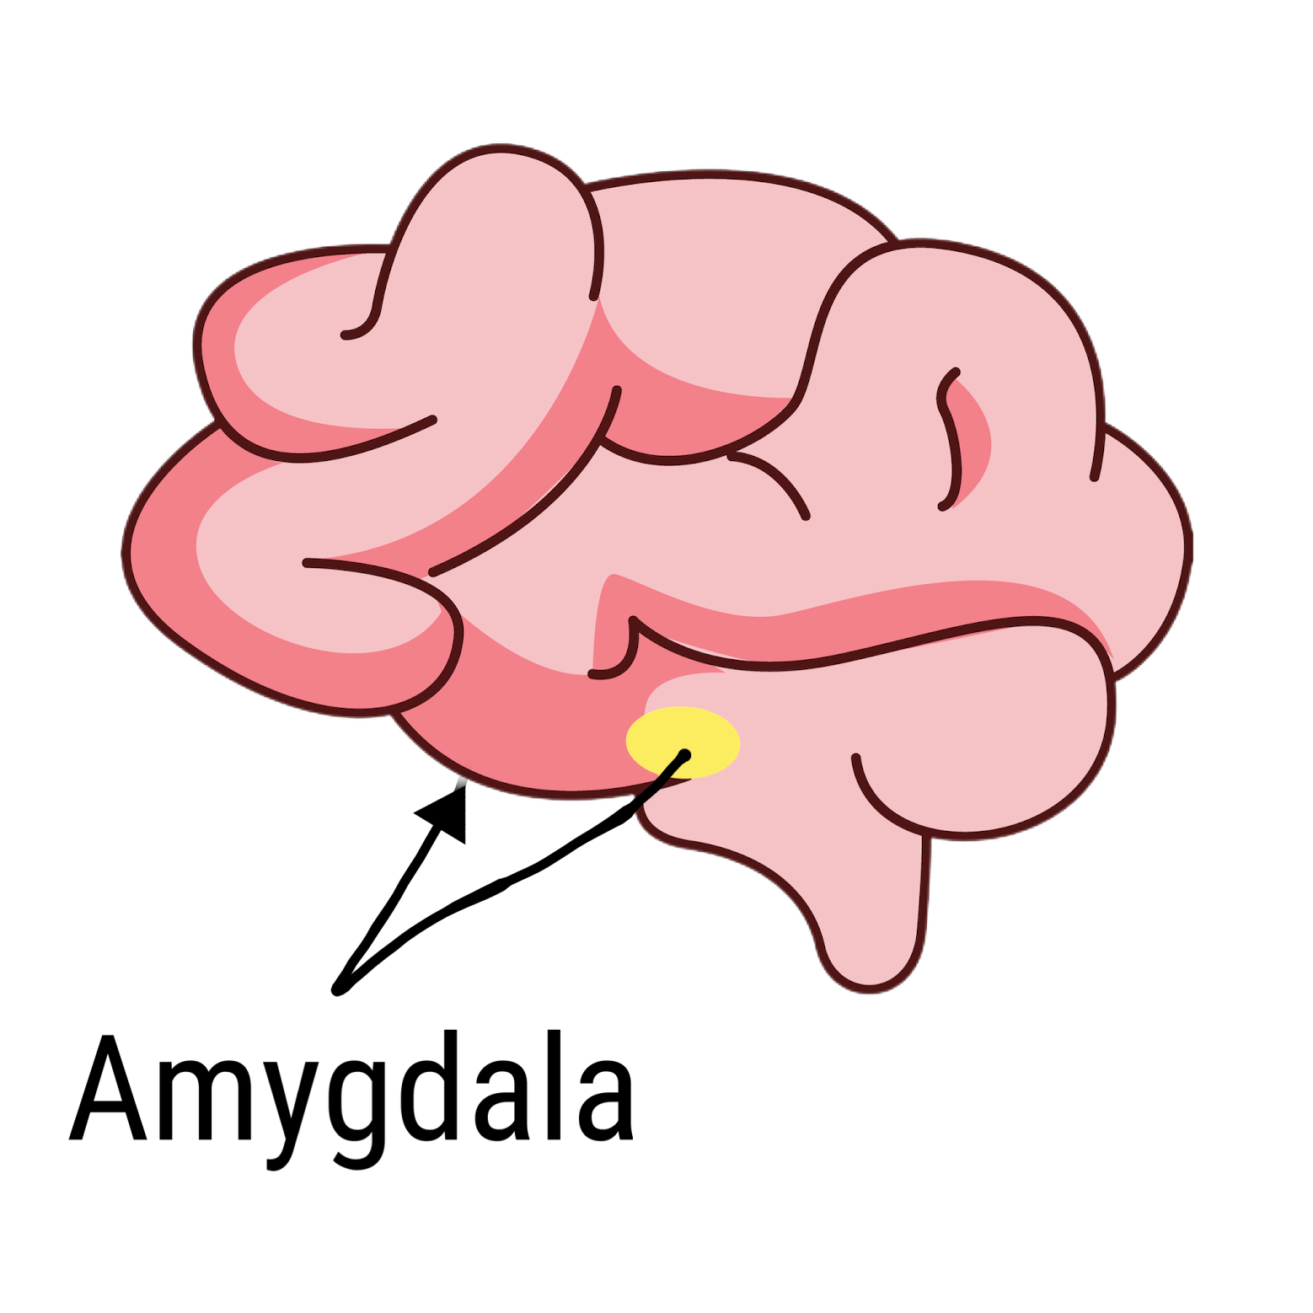
Hand model of the brain
The science behind test anxiety
Your brain has different parts that work together when you feel anxious.
The amygdala gives anxiety its strong emotional feeling, while the prefrontal cortex (PFC) helps you understand the threat and decide how to act.
Other parts of the brain also join in, triggering your body's stress response for fight or flight with hormones like adrenaline.
PFC
Notes:
Brains are very complicated and scientists are still learning more and more about them. In this lesson we will focus on a simplified model of the brain with three key parts. There are more parts sign - post children to resources they can use to learn more.

Slide 3

Where in your body do you feel anxiety?

Slide 4
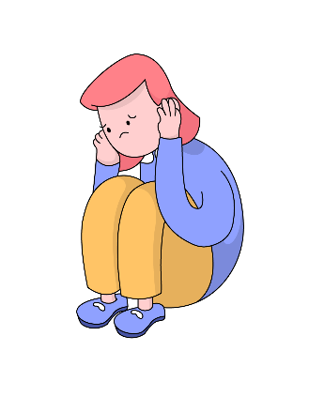
Some students thrive off the adrenaline rush.
However, up to 60% of students are negatively affected by it [1], causing procrastination, impairing sleep, and making it difficult to concentrate.
There are various reasons why students feel anxious…
Exam anxiety is so common!

Slide 5
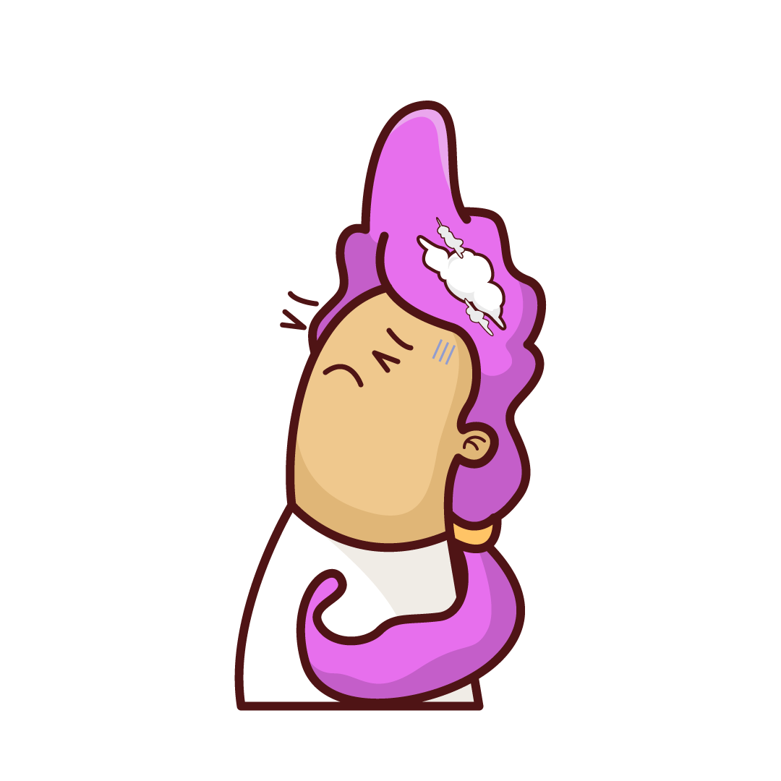
Reason 1: Not prepared
Students who struggle with executive function skills, such as planning, organisation, and attention, may find exams challenging.
They may have difficulty remembering information and managing their stress during exams.

Slide 6
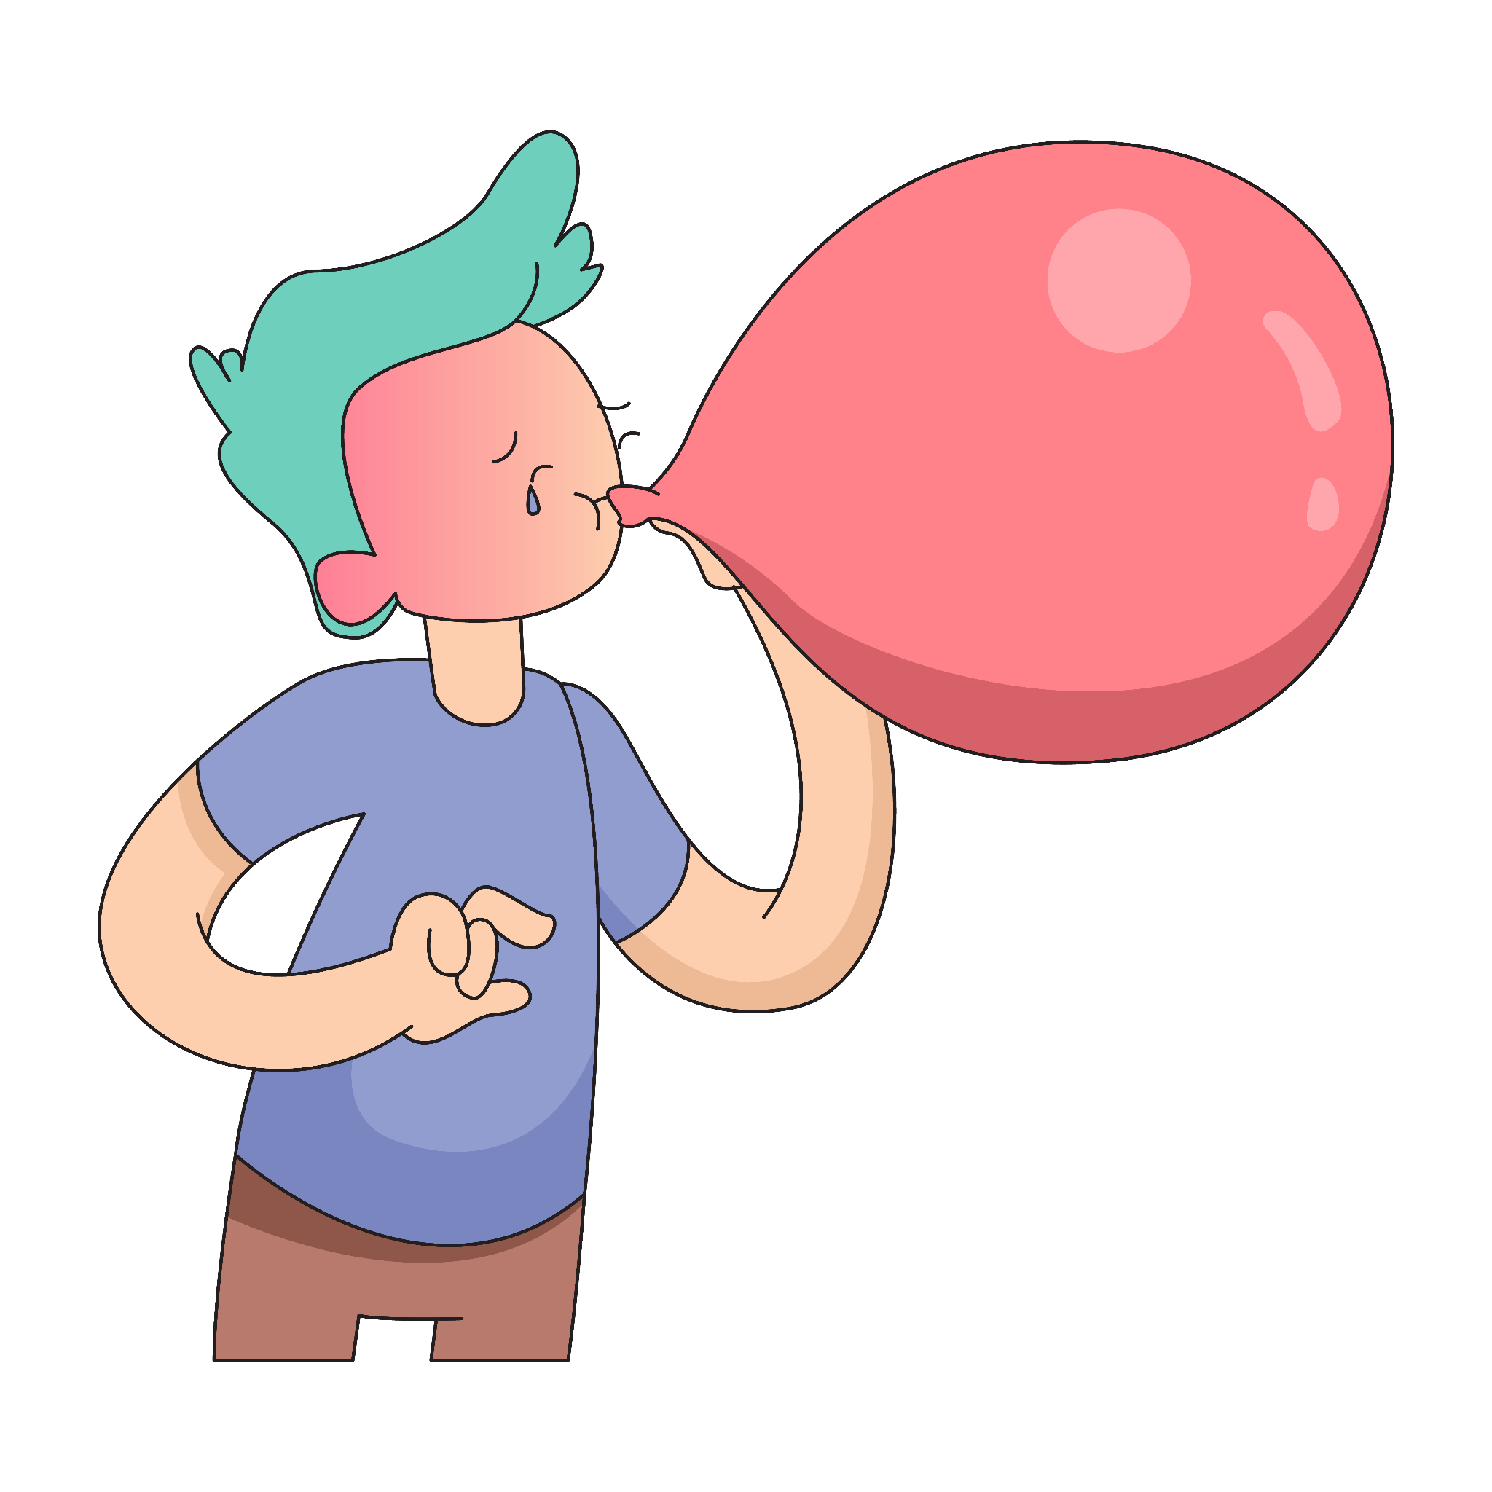
Reason 2: Feeling the pressure
Pressure can come from outside, like parents, teachers, or cultural norms and expectations.
In 2021, a study showed that 86% of parents put pressure on their children [2].
It can also come from inside, feeling as though one needs to get 100% in order to succeed or compete with peers.

Slide 7
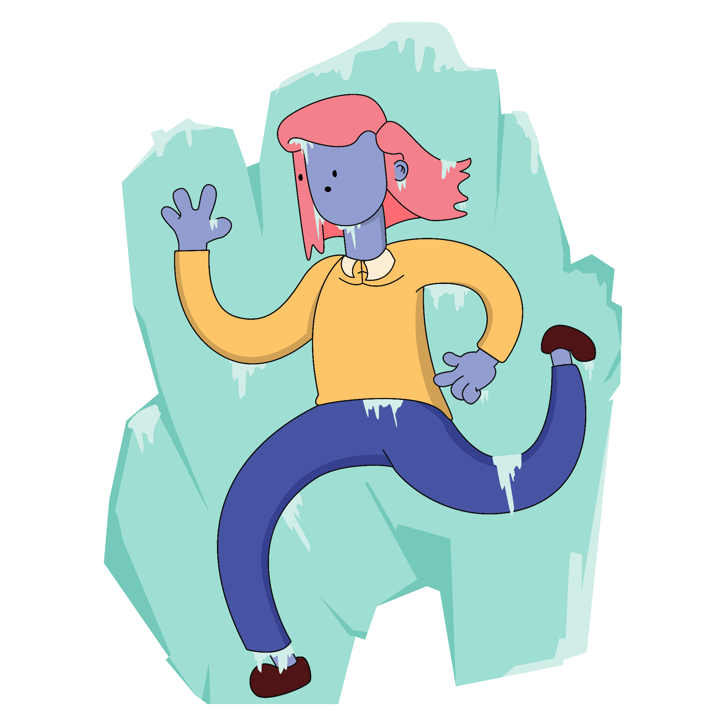
Hand model of the brain
Reason 3: Fear of failing
Students fear exams because they worry about not achieving the minimum passing score, which could lead to failing.
This negative mindset can cause students to feel ‘stuck’, unable to focus, which creates a cycle as students then feel anxious about this, too!
Notes:
Talk them through the hand model of the brain and flipping your lid - when the amygdala is stimulated because of a real or imagined threat it hijacks the brain and puts us into fight flight or freeze mode to keep up safe.

Slide 8

Which reason resonates most
with you?
Not prepared
Feeling pressure
Fear of failing
A combination of…
Notes:
Explain that executive functions are brain functions that help us to control our thoughts, feelings and actions. Some people call this the conductor or the air traffic controller of the brain. Executive functions are essential for rational thought and learning.

Slide 9

Tips to overcome exam anxiety
Don’t compare yourself to your peers.
Plan ahead! Write out a weekly study schedule and stick to it.
Treat yourself to little ‘rewards’ once you’ve completed revising a section.
Take regular breaks and Epsom salt baths.
Nutritious food & plenty of water.
Get an early sleep.
Talk about your feelings with loved ones.

Slide 10

References
[1] https://smhp.psych.ucla.edu/pdfdocs/testanx.pdf
[2] https://psychcentral.com/lib/parental-pressure-and-kids-mental-health#causes

