Slide 1





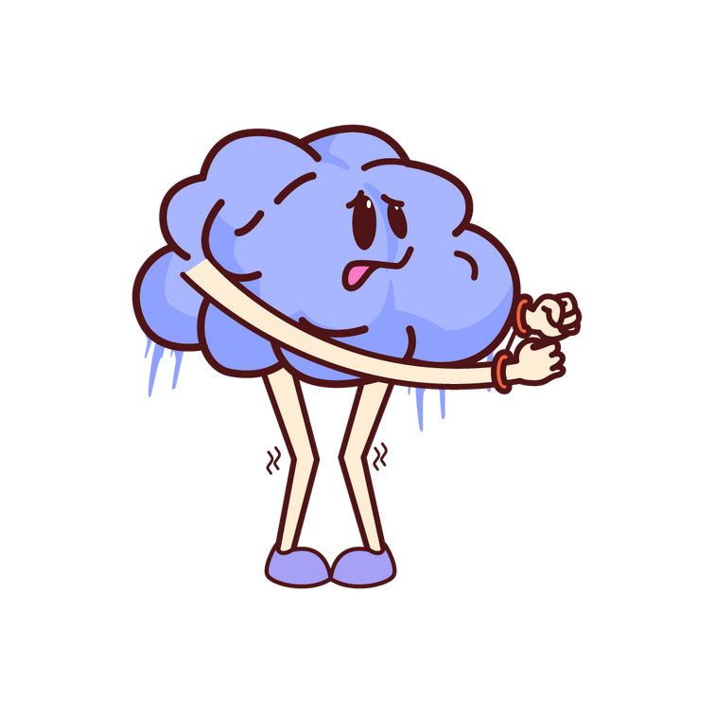
SOCIAL ANXIETY
Let’s break the ice!

Slide 2
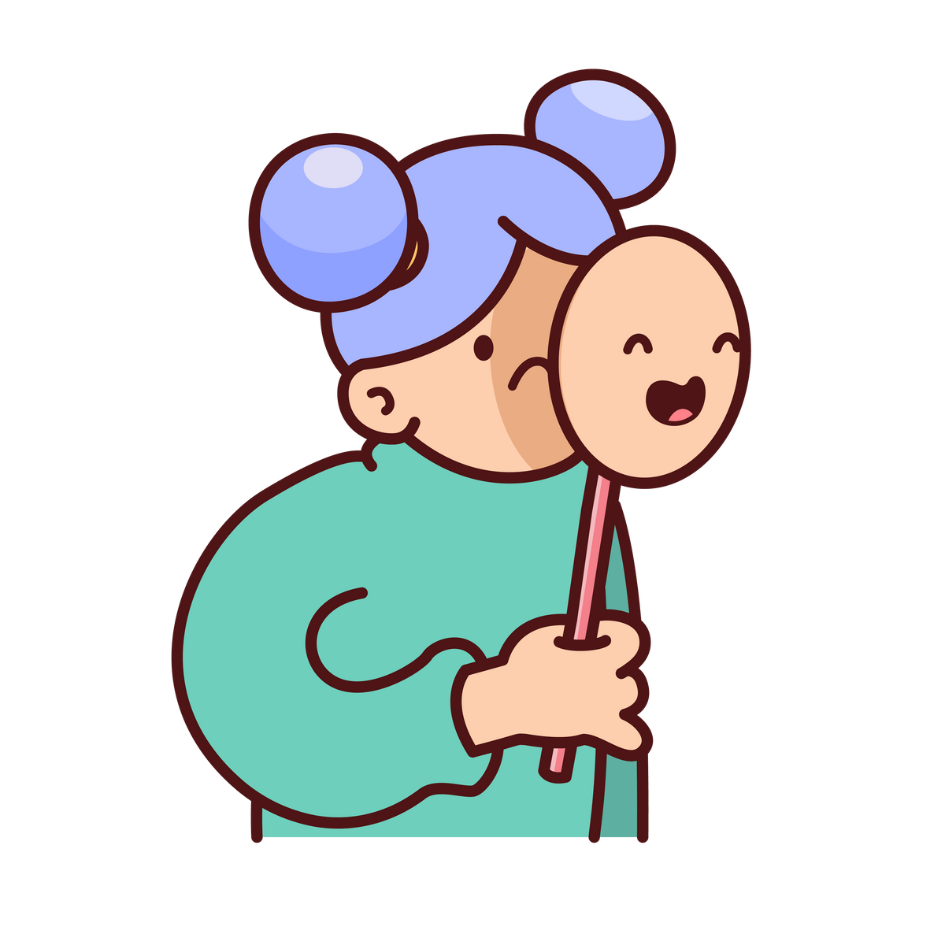


WHAT IS SOCIAL ANXIETY?
Social anxiety is the fear of being judged, embarrassed, or rejected in social situations.
It’s more than just being shy; it’s a strong, persistent fear that can affect daily life.
Did you know... over 8 million people in the UK experience social anxiety at some point in their lives*
*alena.com

Slide 3
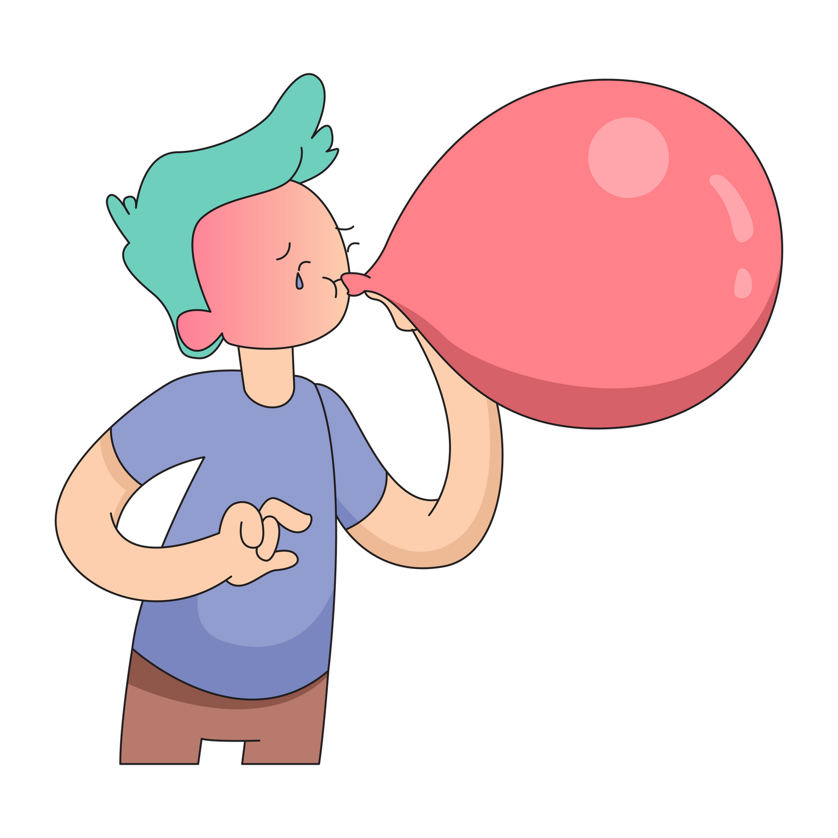


HOW DOES IT FEEL INSIDE?
Physically, we can experience sweating, trembling, and a rapid heartbeat.
Emotionally, we can feel fear, embarrassment and, overwhelming worry.
What does anxiety feel like for you?

Slide 4

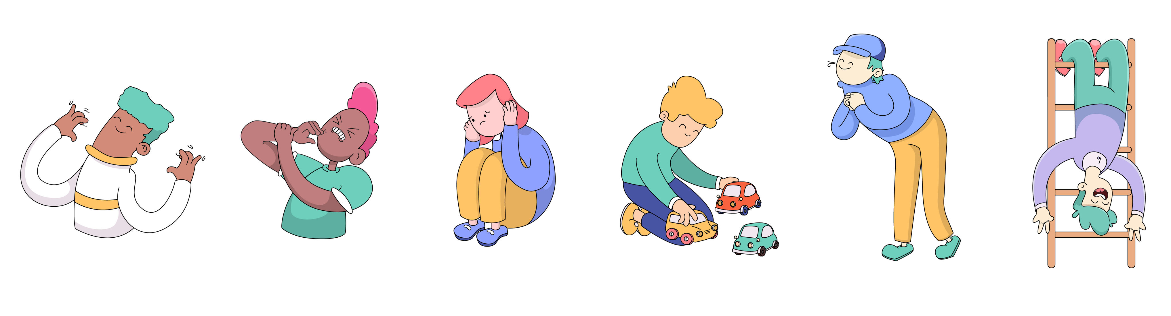
WHAT DOES IT LOOK LIKE?
Avoiding eye contact or conversations.
Frequently absent from social events.
Overly concerned about what others think.
Nervous, quiet, or withdrawn in group
settings.

Slide 5
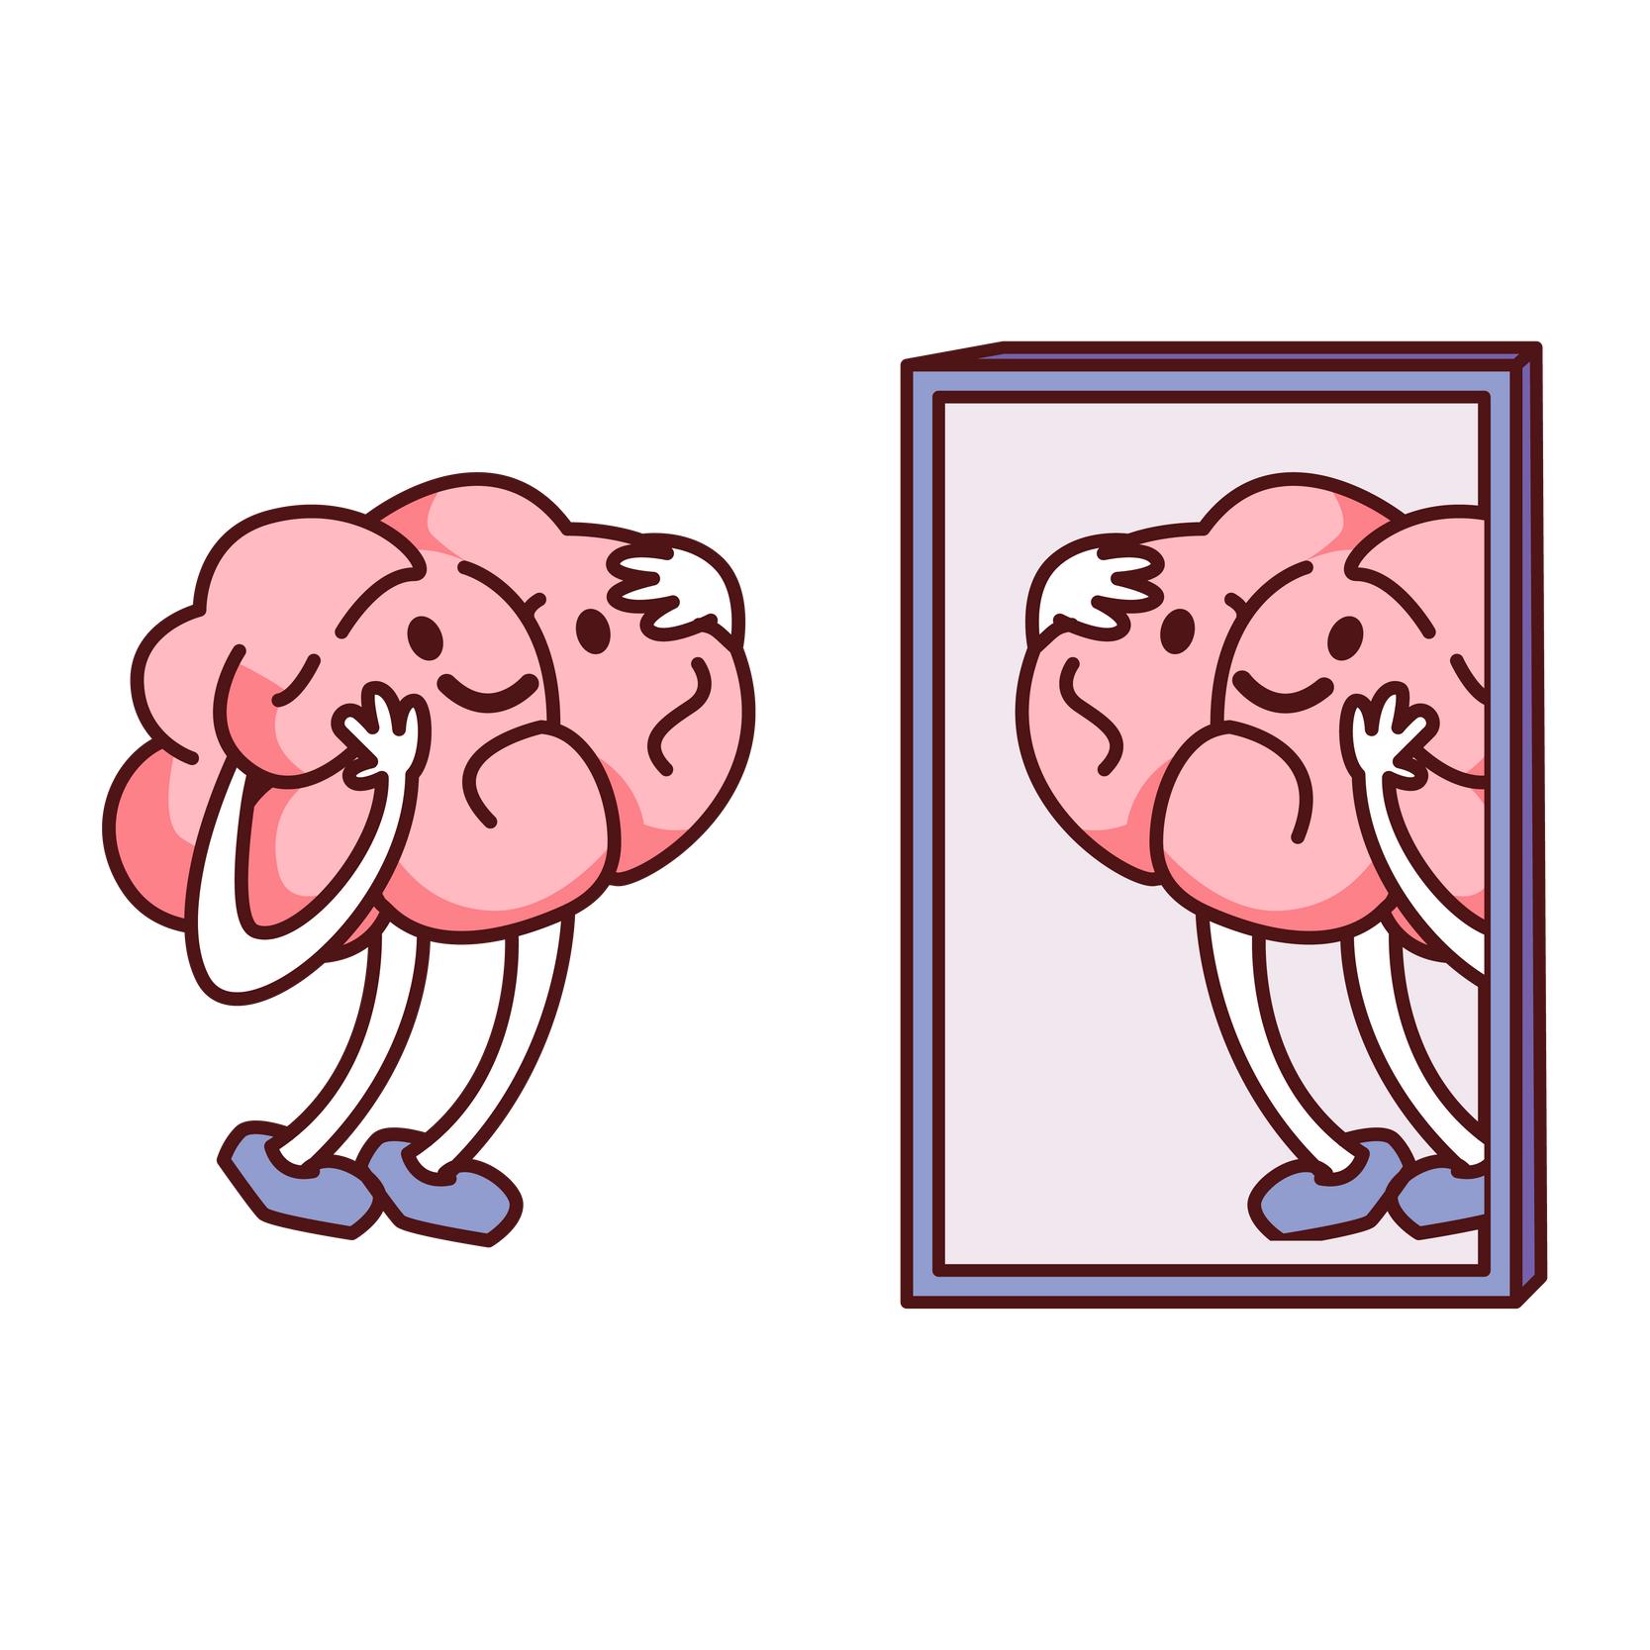
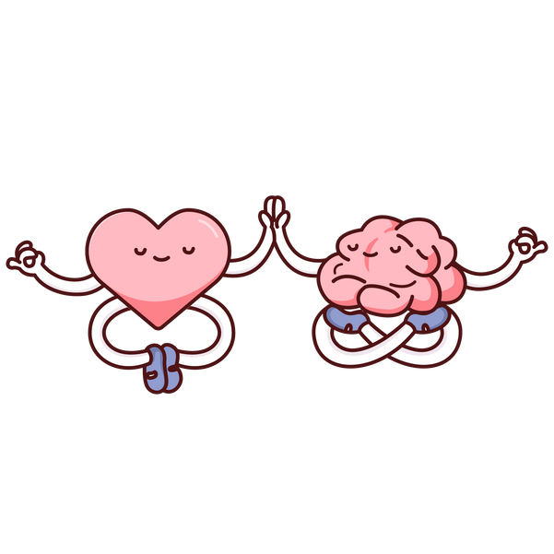
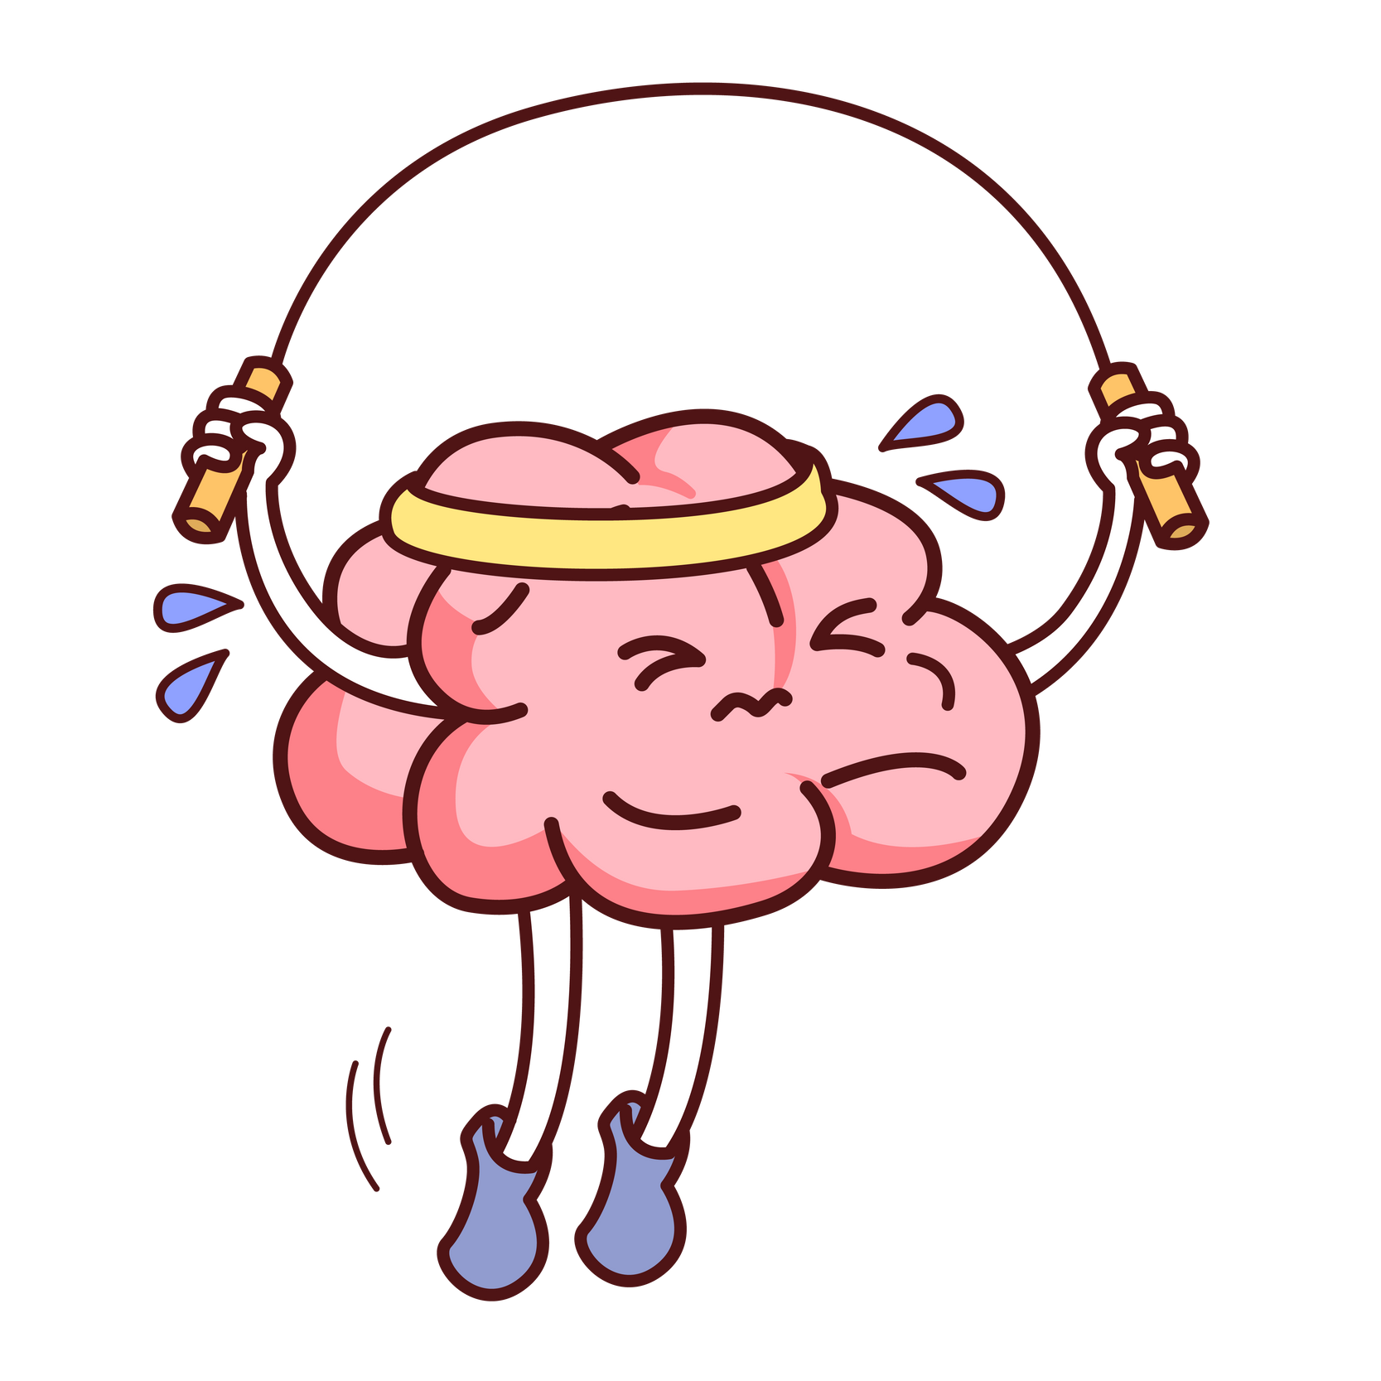
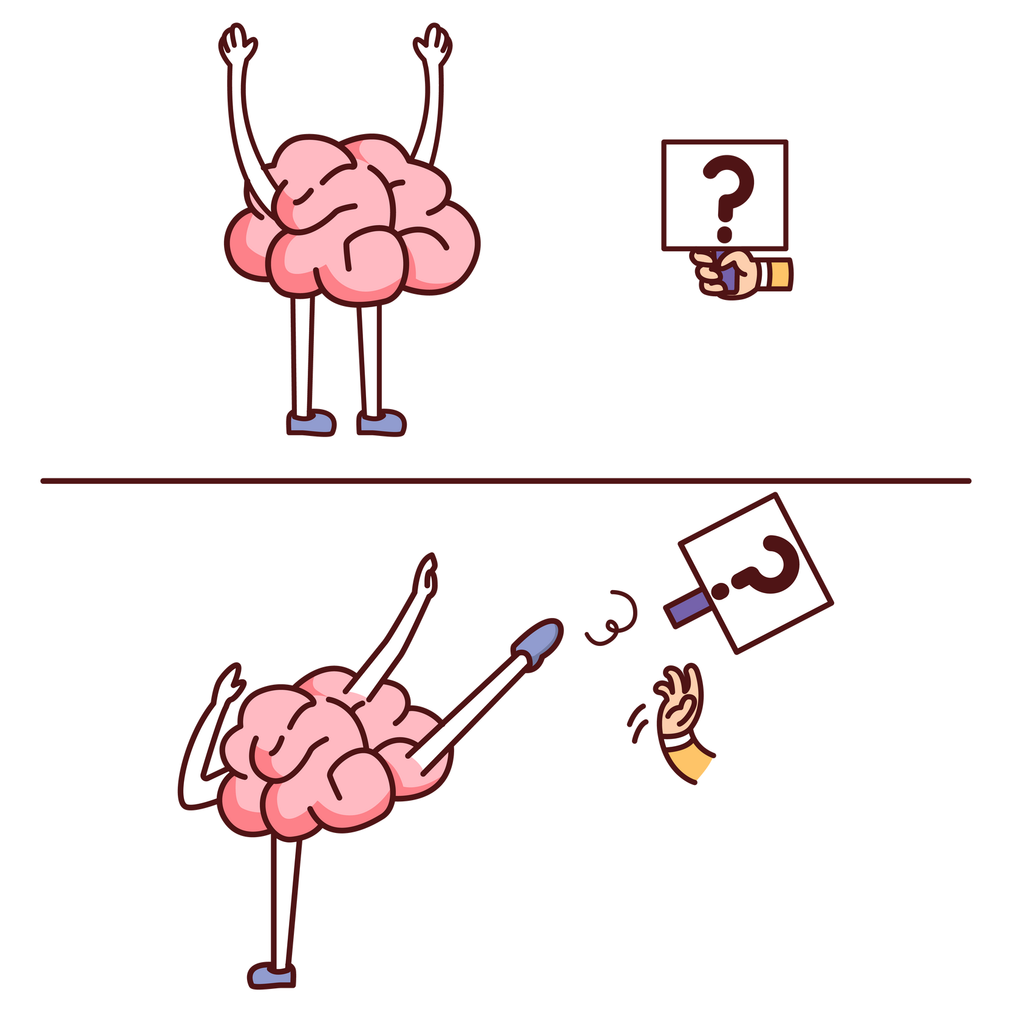

HOW TO OVERCOME SOCIAL ANXIETY
Start small & work your way up.
Practice self-compassion and kind self-talk.
Join clubs of hobbies you enjoy.
Talk to someone you trust for support.

Slide 6
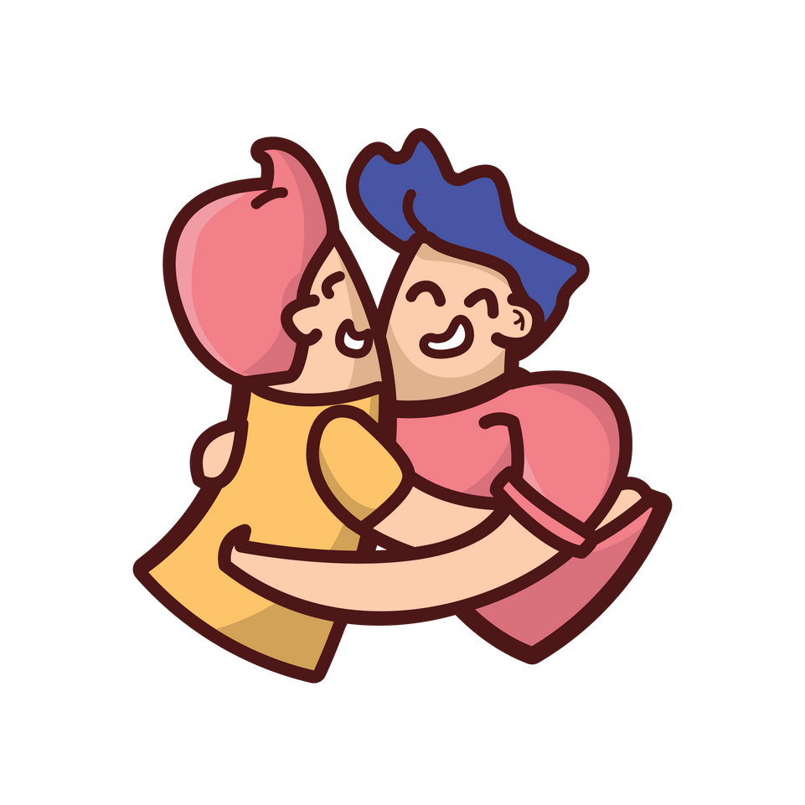
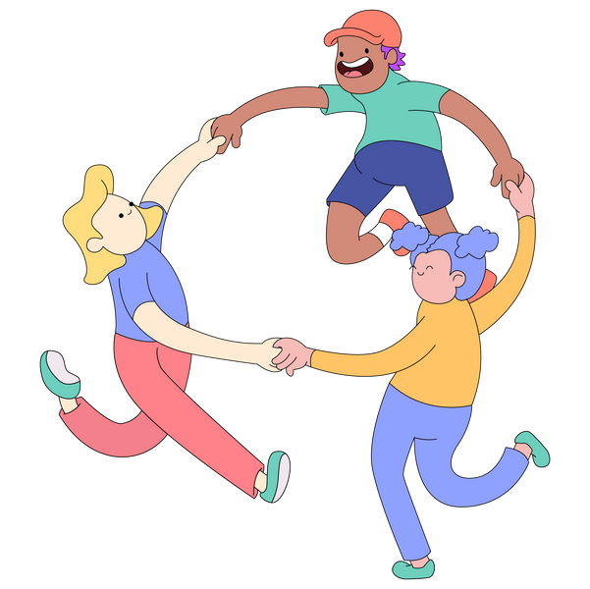

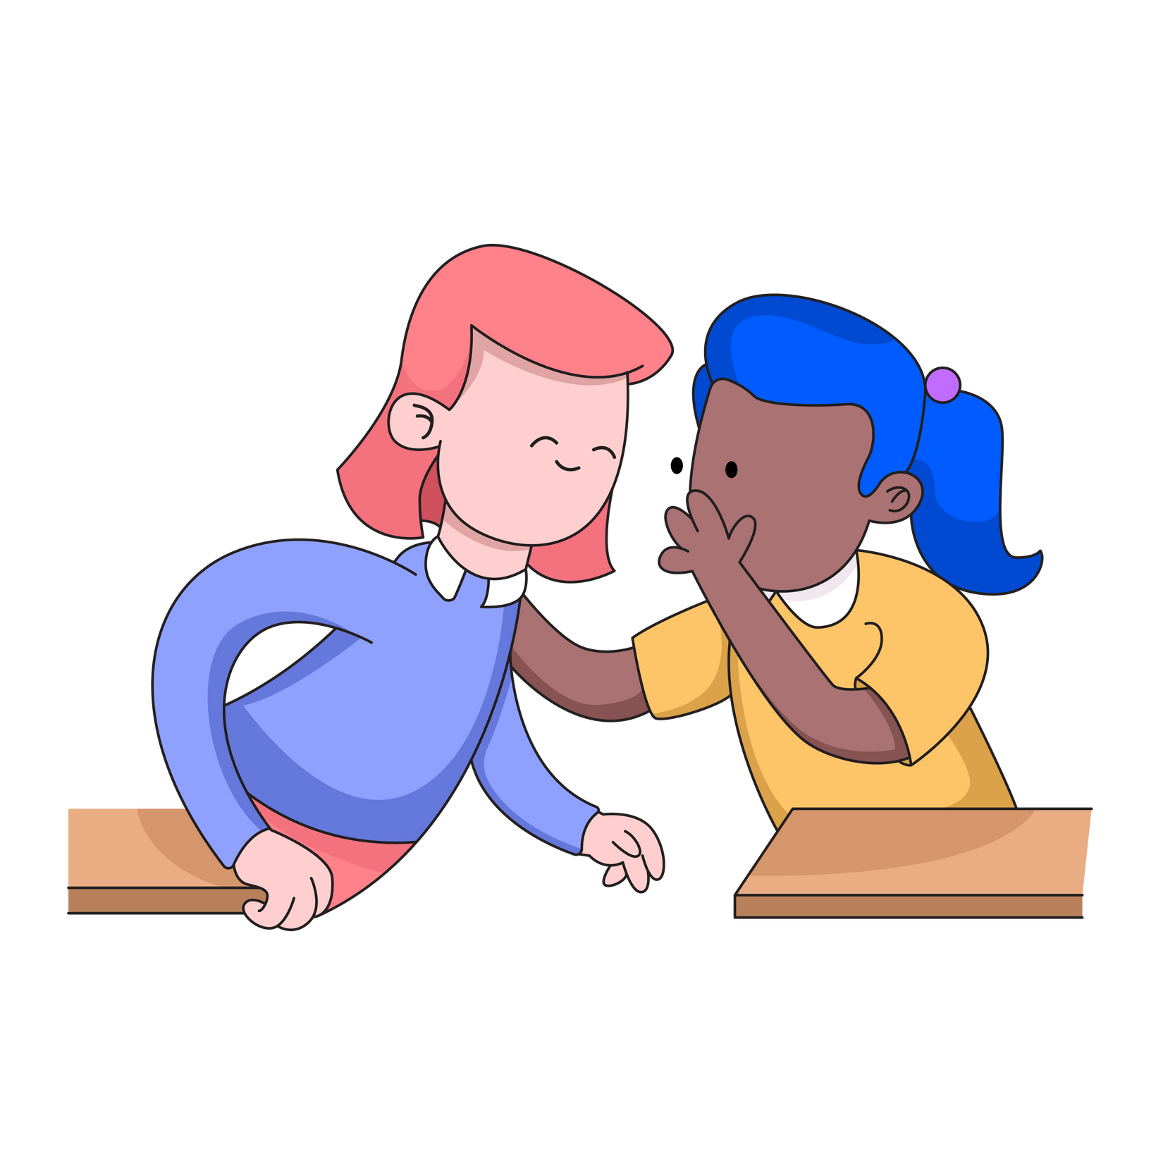
HOW TO SUPPORT OTHERS WITH IT
Have patience and show understanding.
Include them but not pressure them into it.
Lend an ear to listen to how they’re feeling.
Offer encouragement.

Slide 7

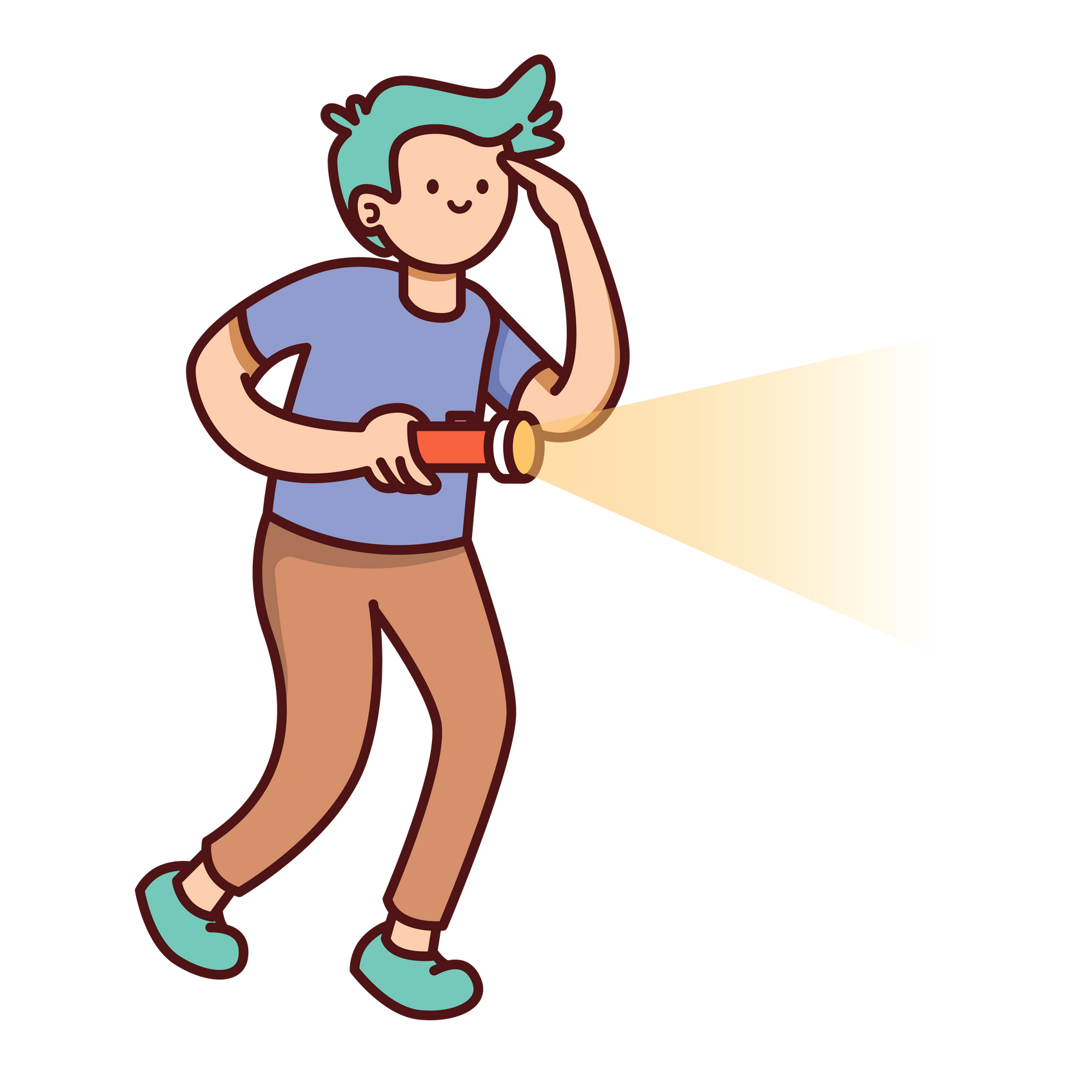
MYTHS VS TRUTHS
MYTH:
They’re just shy
TRUTH:
Social anxiety is more intense and persistent
MYTH:
They just need to try harder
TRUTH:
Overcoming social anxiety takes time and support

Slide 8




WHERE TO FIND HELP
School counsellor or trusted teacher
Ring HOPELINEUK on 0800 068 4141
Talk to your parents or caretaker
Text SHOUT to Shout's textline on 85258

Slide 9
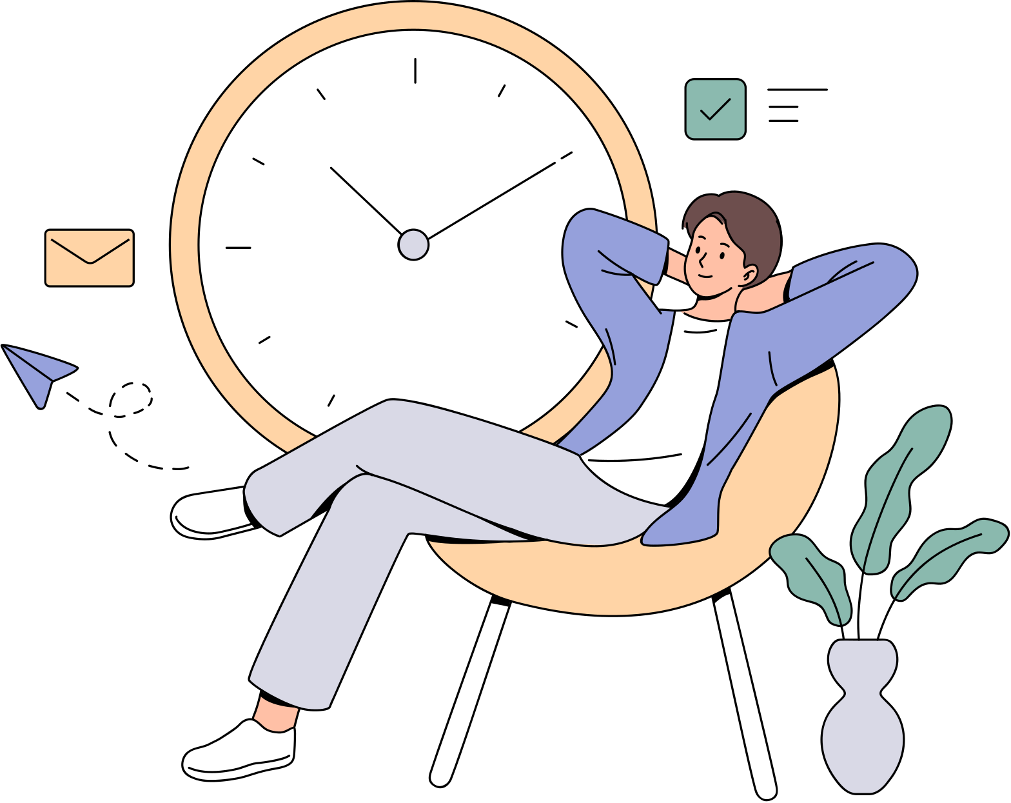
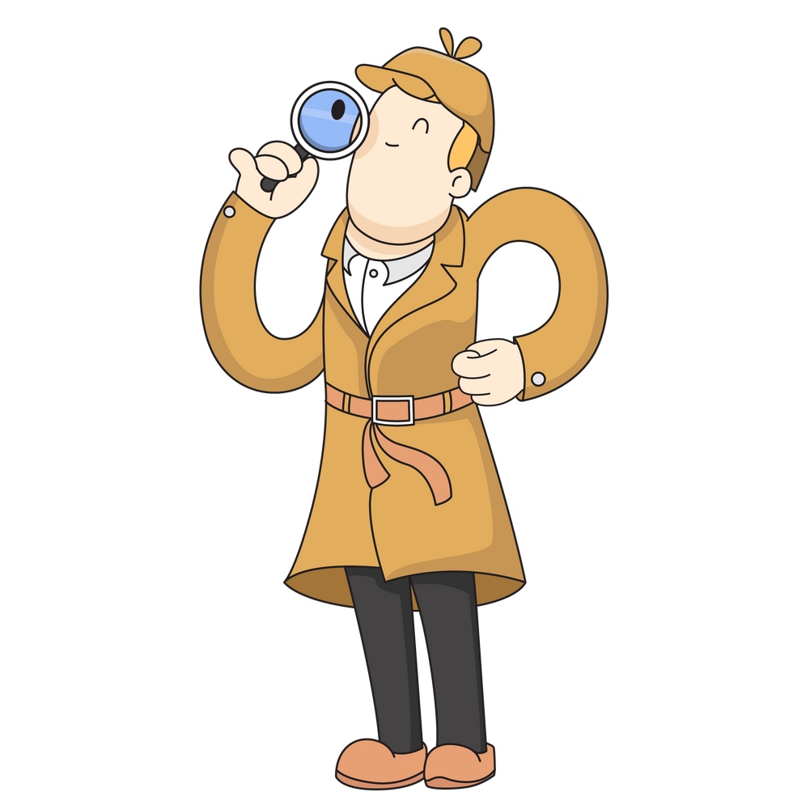
LET’S TALK ABOUT IT
Have you ever felt nervous or worried in a social situation?

