Slide 1

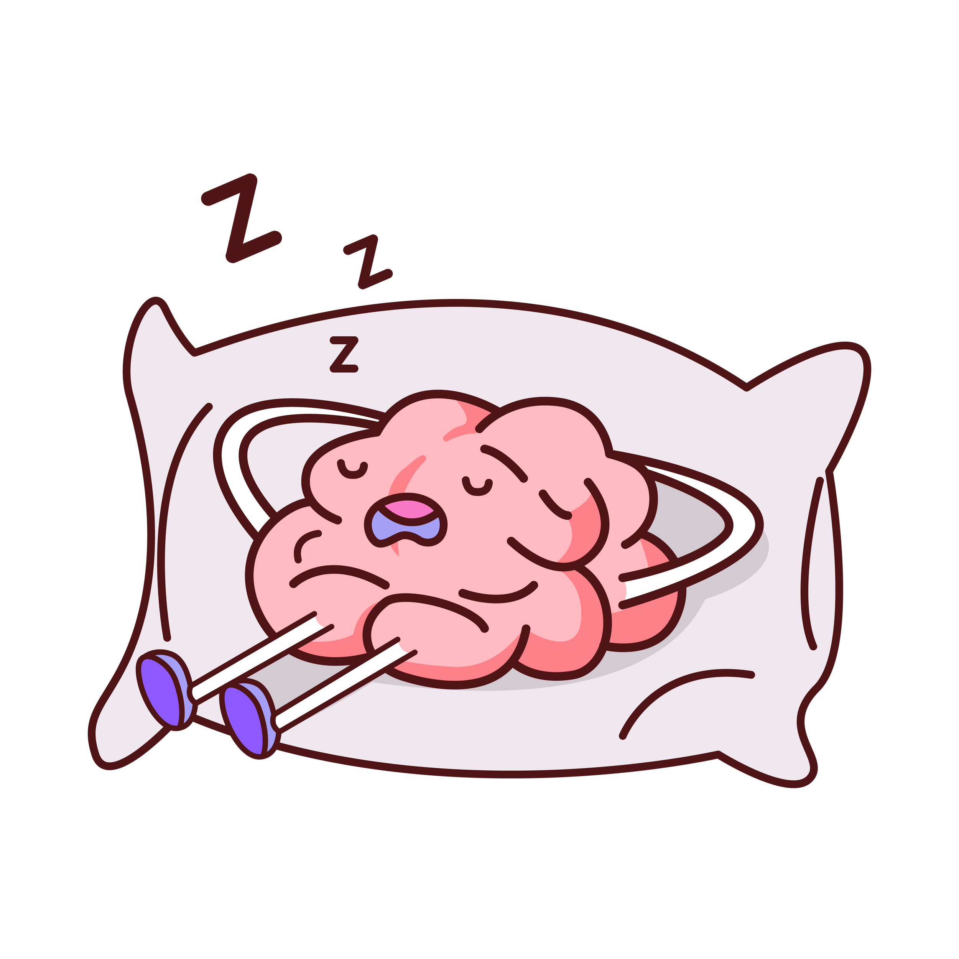
The science of
sleep

Slide 2


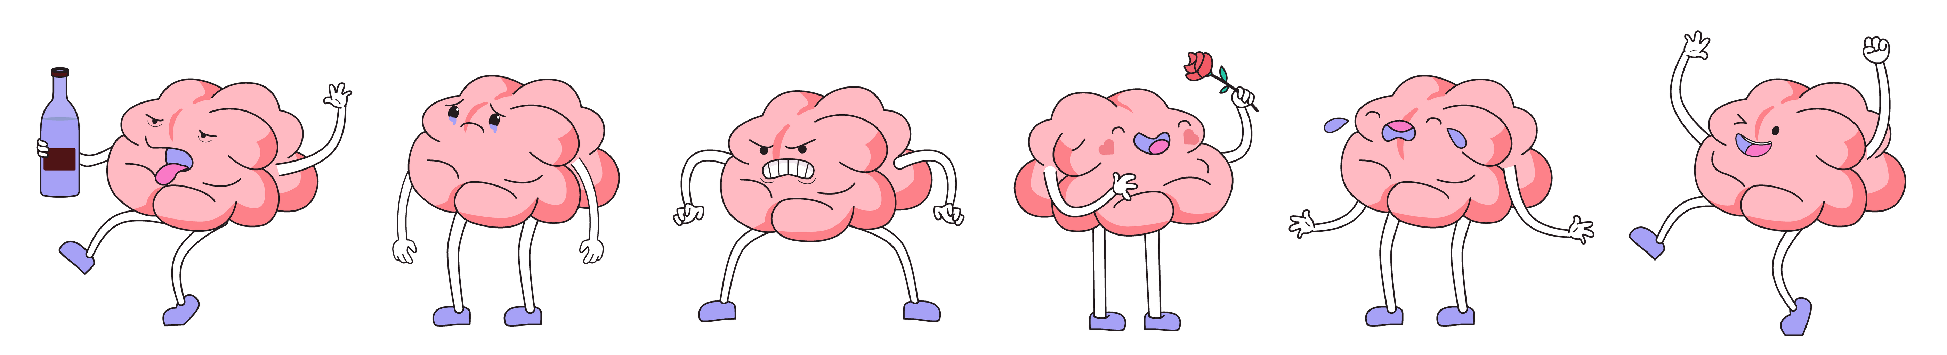
What is your brain doing while
you sleep?
While you’re fast asleep, your brain is super busy doing a deep clean. The body isn’t just repairing tissue and consolidating memories from the day, it’s also clearing out waste products and toxins in neurons.
This is a process called autophagy.
Notes:
During sleep, the body repairs tissues, consolidates and processes memories, and replenishes energy levels. The brain processes and consolidates memories, improves learning, and clears out waste products. Adequate sleep is essential for emotional regulation, stabilizing mood, and reducing stress. It also plays a critical role in maintaining overall physical health, including immune function, metabolism, and cardiovascular health, and is particularly important for growth and development in children and adolescents.

Slide 3
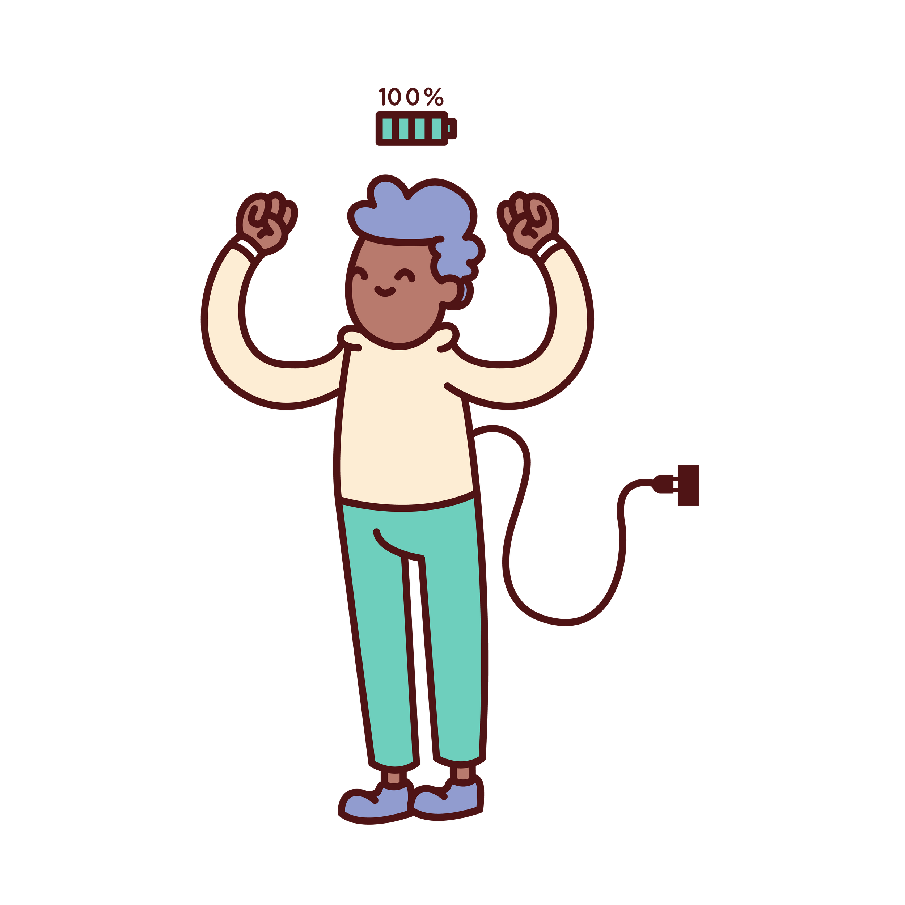

Why is sleep important?
Sleep is crucial for executive functioning, as well as physical health, including your...
  immune system,
  metabolism,
  heart health,
  and development in children and teenagers.
Notes:
During sleep, the body repairs tissues, consolidates and processes memories, and replenishes energy levels. The brain processes and consolidates memories, improves learning, and clears out waste products. Adequate sleep is essential for emotional regulation, stabilizing mood, and reducing stress. It also plays a critical role in maintaining overall physical health, including immune function, metabolism, and cardiovascular health, and is particularly important for growth and development in children and adolescents.

Slide 4



Sleep & puberty
As you grow, so do your sleep needs. Puberty brings changes in your body's internal clock, making it harder to fall asleep early and wake up early.
As a result, 70% of teens feel they don’t get enough sleep [1].
Do you get enough sleep?

Slide 5

How many hours of sleep do you need?
Age range
Hours of sleep daily
6-12
9-12
13-18
8-10
18+
7+

Slide 6



Screens & Stimulants on Sleep
  Smart device screens emit blue light that can trick your brain into thinking it's daytime, making it harder to fall asleep.
  Caffeine and nicotine are stimulants that can interfere with your sleep cycle, making it harder to get the rest you need.

Slide 7



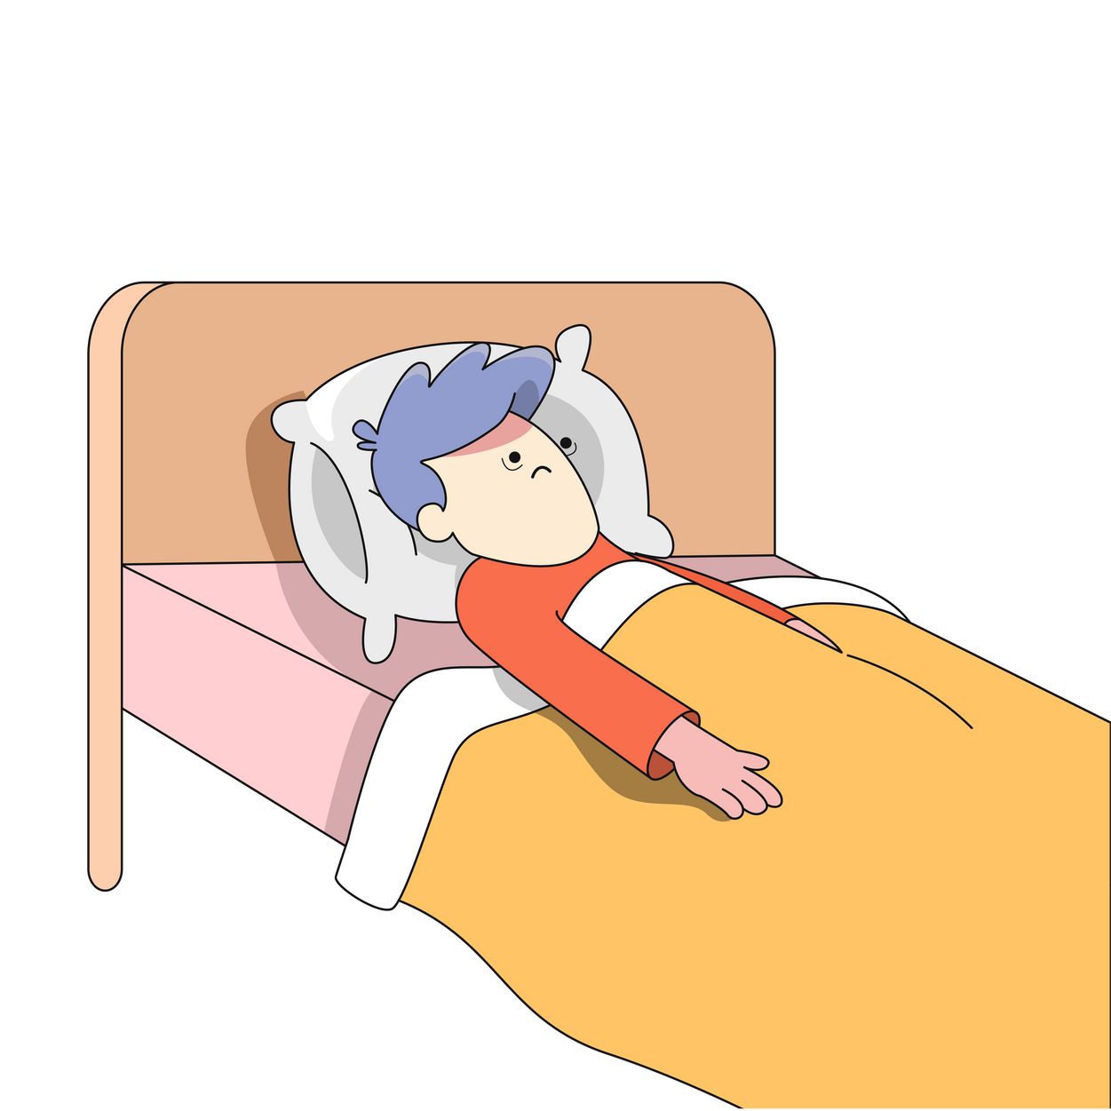
Did you know...
... any minute now...
Research shows that people who use nicotine products like cigarettes and ‘vapes’ can take up to 25 minutes longer to fall asleep than those who don't use nicotine [2].

Slide 8


Realistic sleep strategies
  limit caffeine to mornings
  wake up and go to bed at the same times in the school week
  keep your room cool, quiet, and dark
  instead of scrolling TikTok or watching series in that hour before sleep, rather listen to a podcast, audiobook, or read

Slide 9
References
[1] sleepfoundation.org/teens-and-sleep
[2] How long does nicotine keep you awake?

