Slide 1


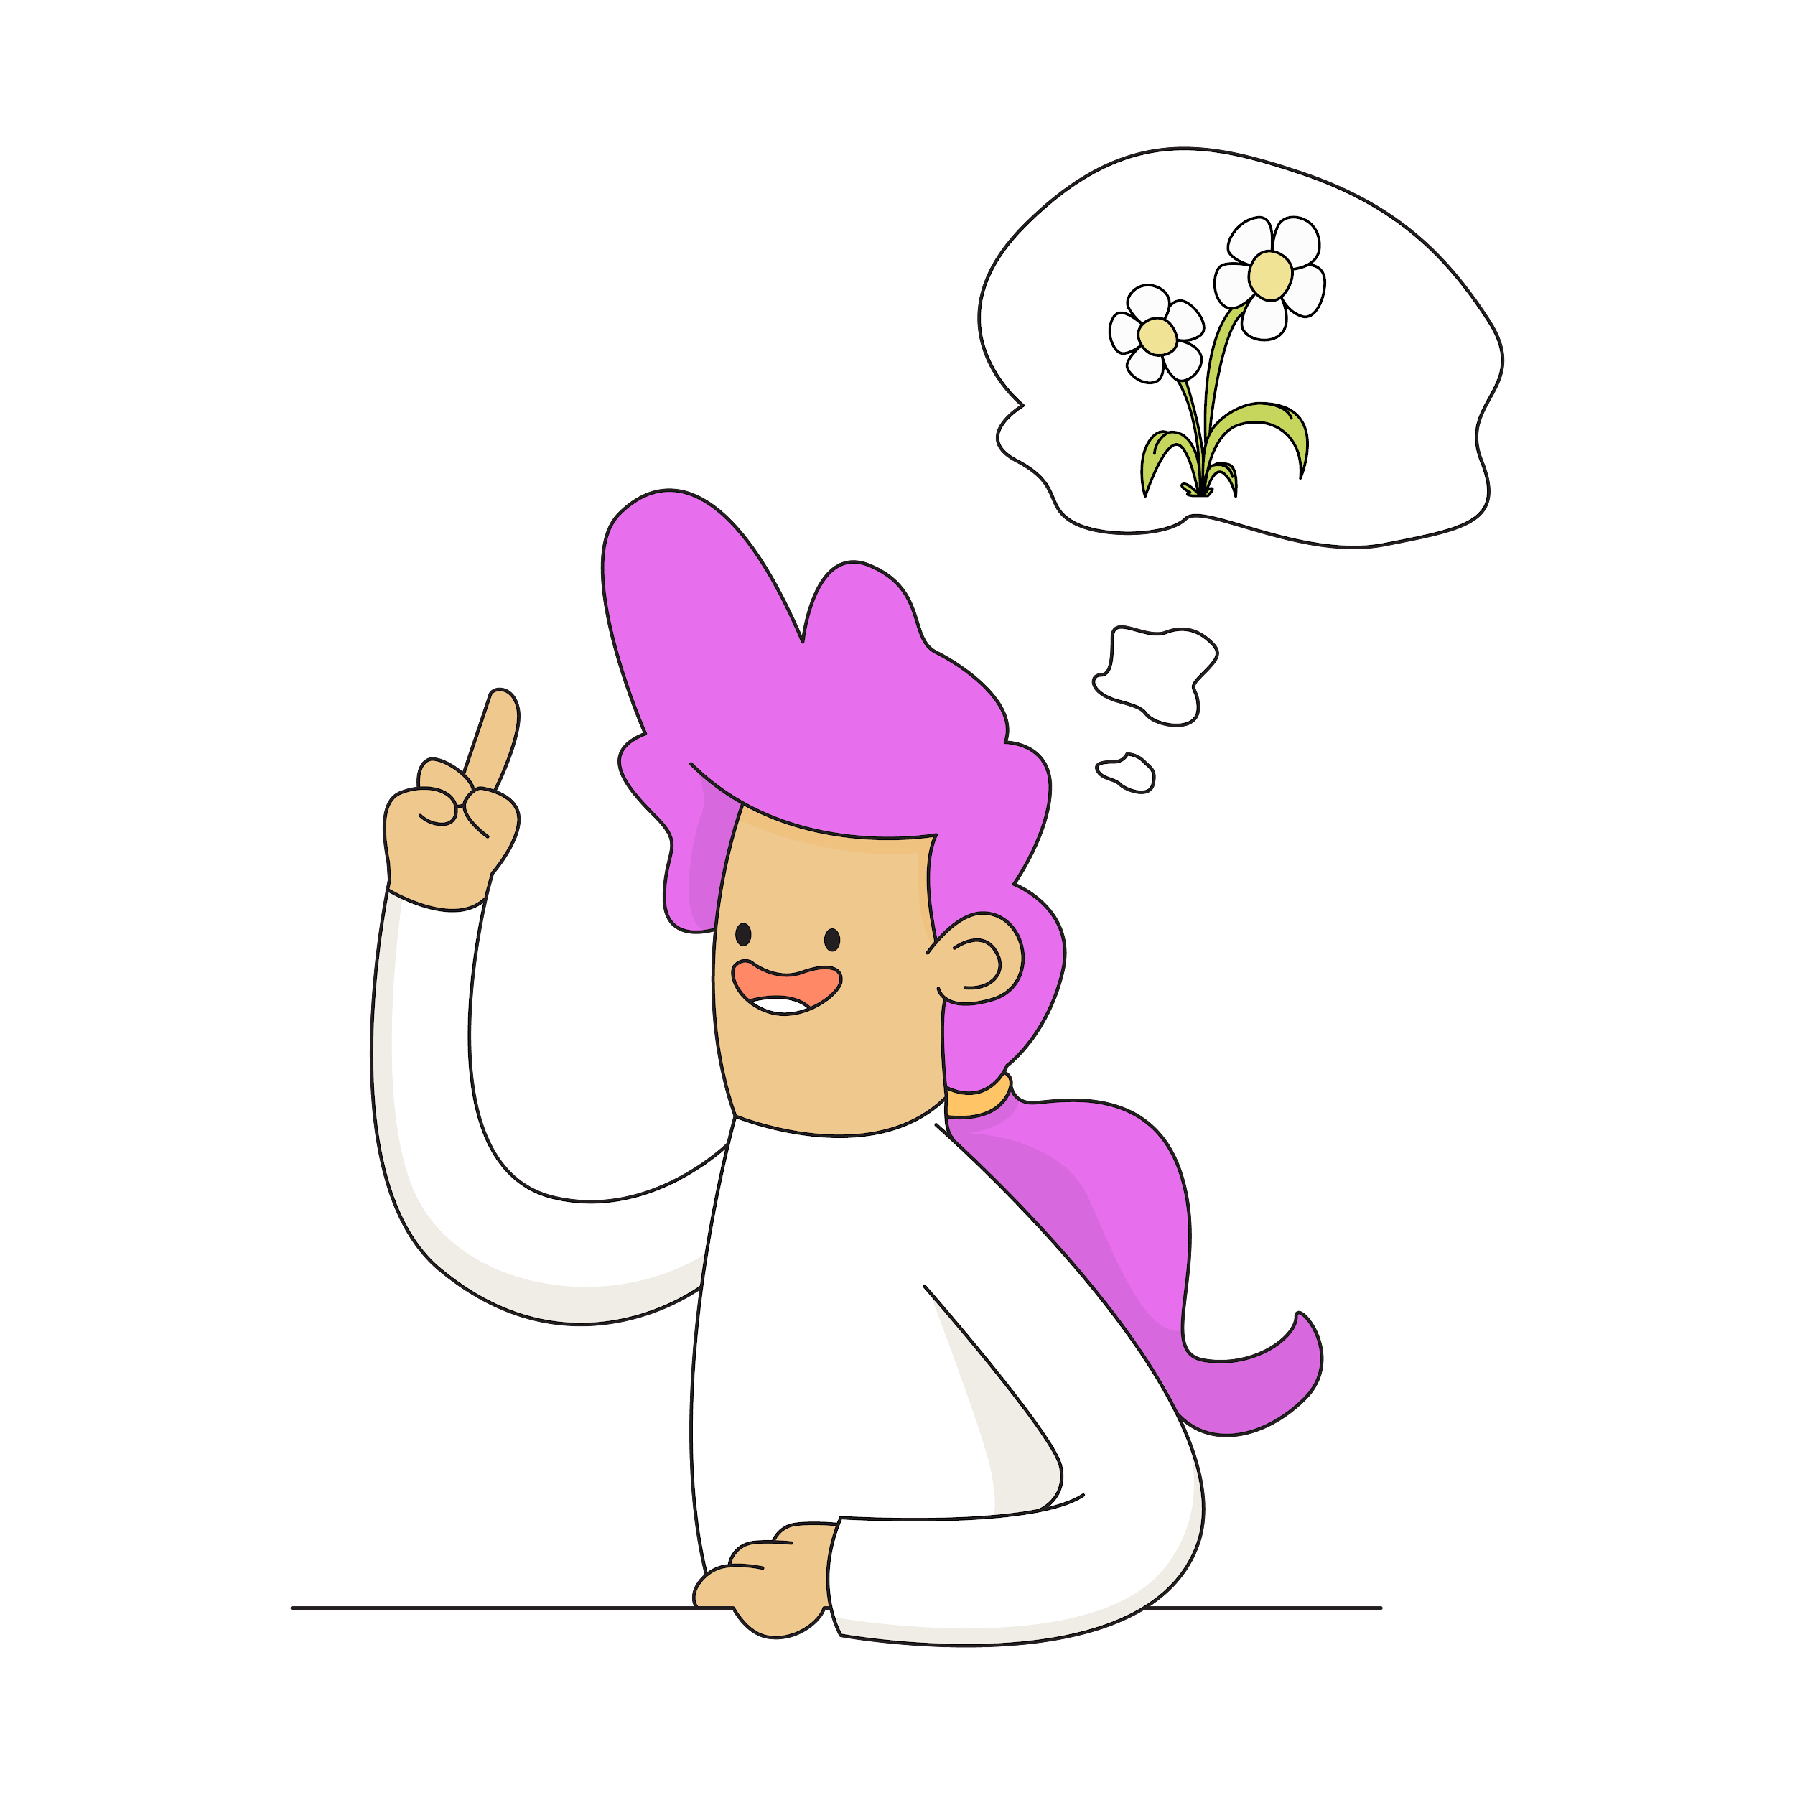
Revision myths
& Truths

Slide 2
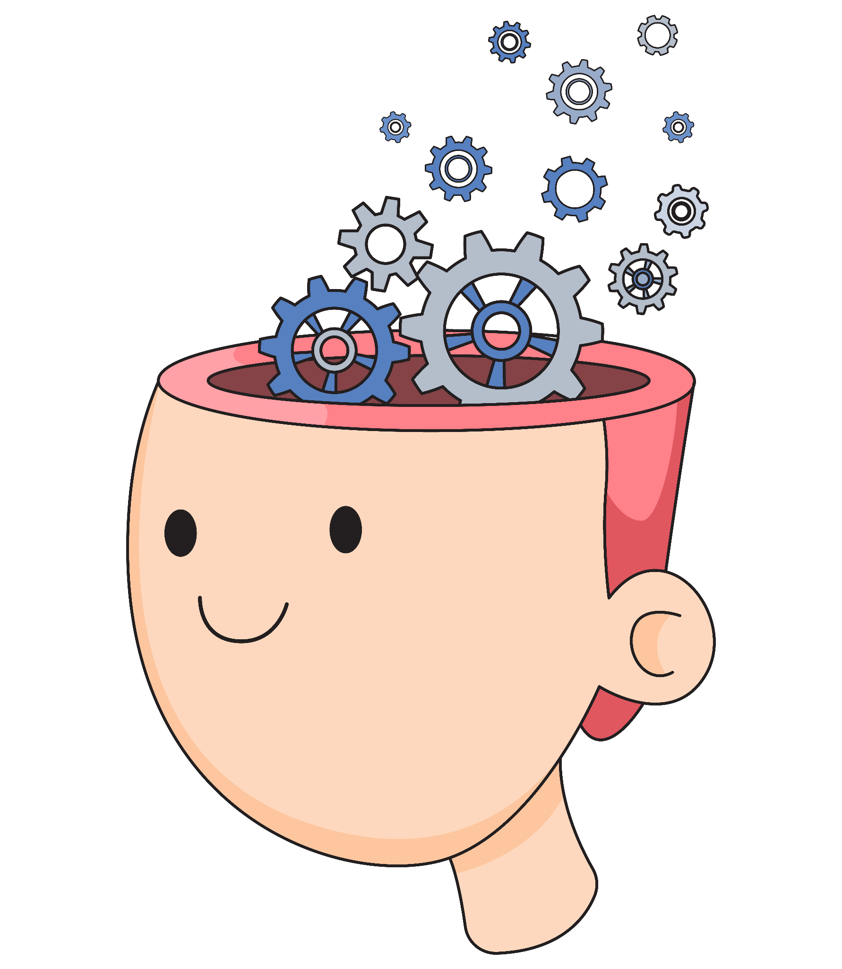
Regular review of material is essential for retention. Without review, people often forget up to 70% of newly learned information within 24 hours and up to 90% within a week! [1]
Importance of revising

Slide 3
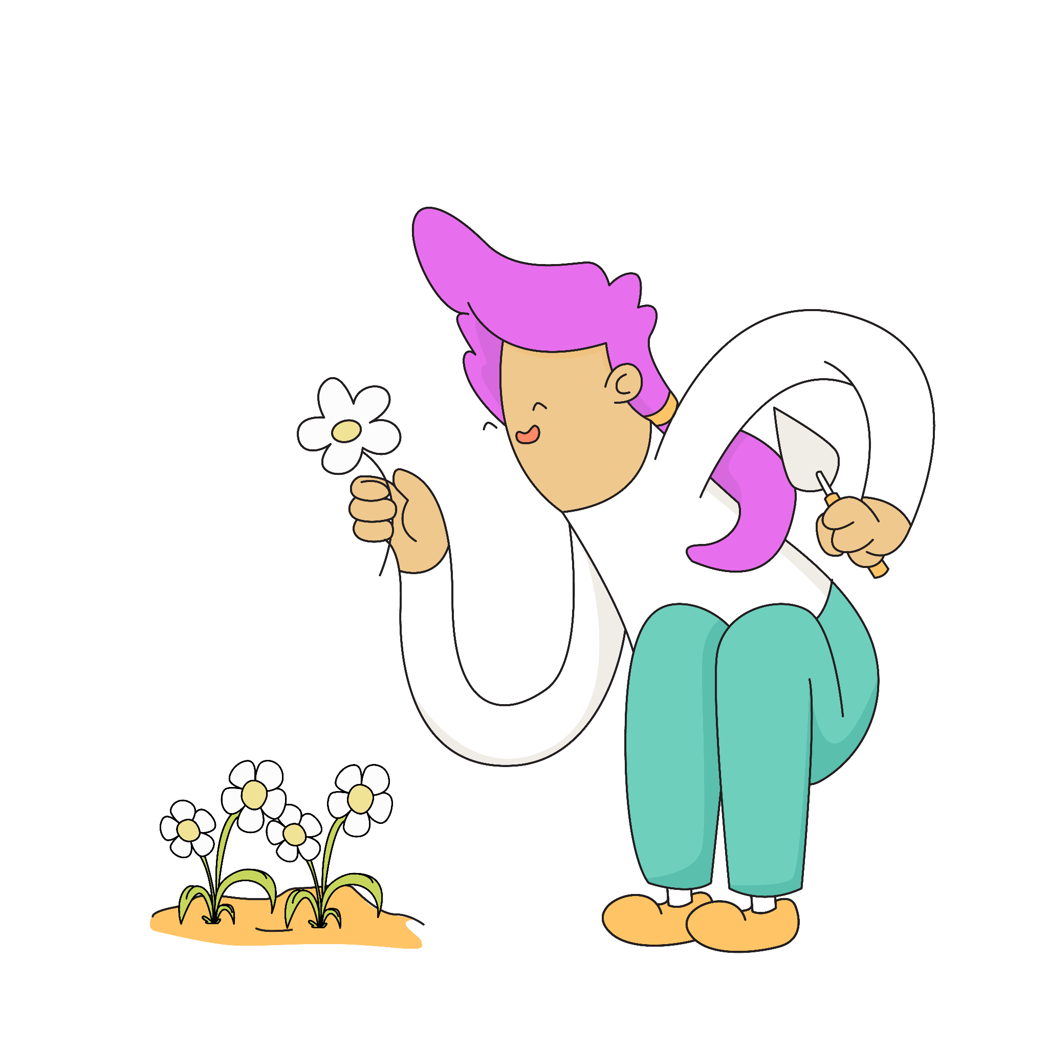
Your brain is a Super Learner!
During adolescence, the brain undergoes a process called synaptic pruning [2].
This is where weak neural connections are eliminated while strong ones are strengthened.
It increases your brain's ability to learning new things!

Slide 4

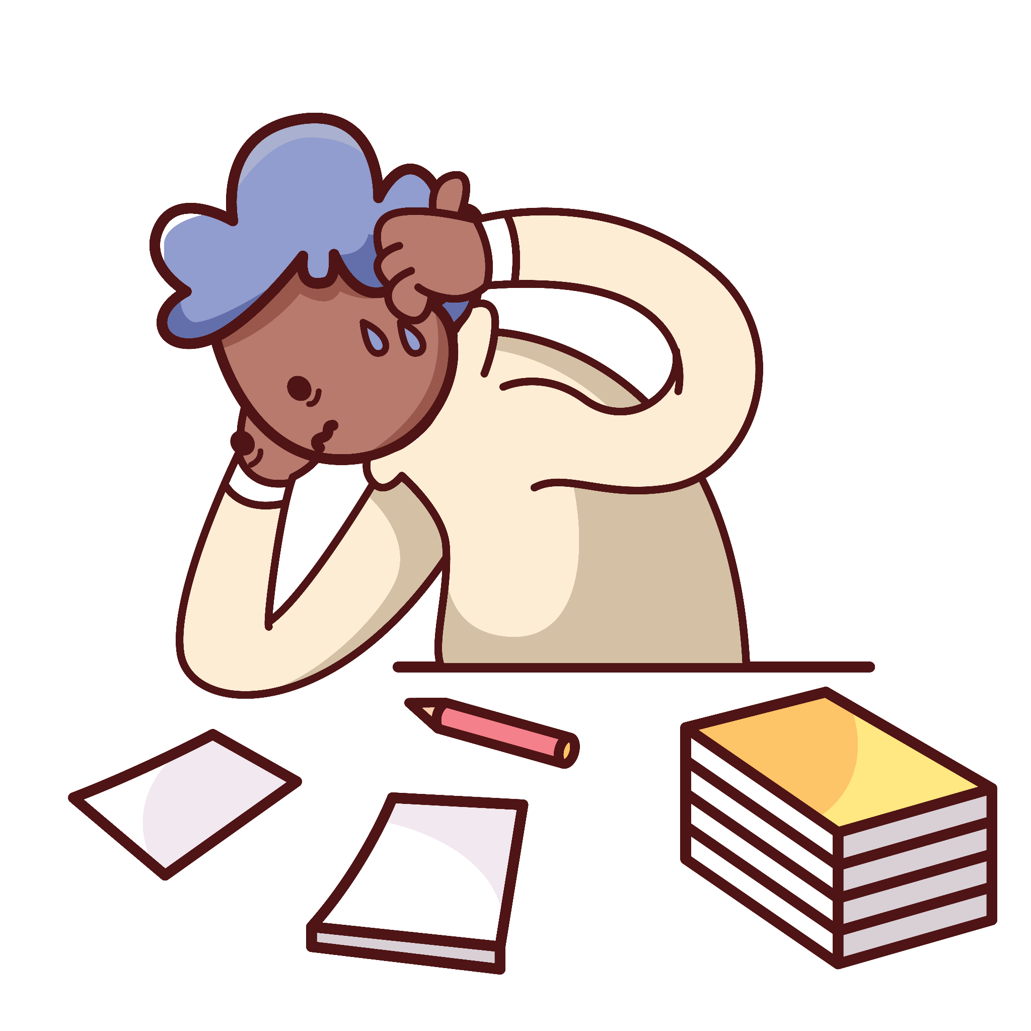
Hand model of the brain
Revision Myth 1: Cramming Works
Truth: Regular, spaced out study sessions lead to better retention and understanding.
Notes:
Brains are very complicated and scientists are still learning more and more about them. In this lesson we will focus on a simplified model of the brain with three key parts. There are more parts sign - post children to resources they can use to learn more.

Slide 5
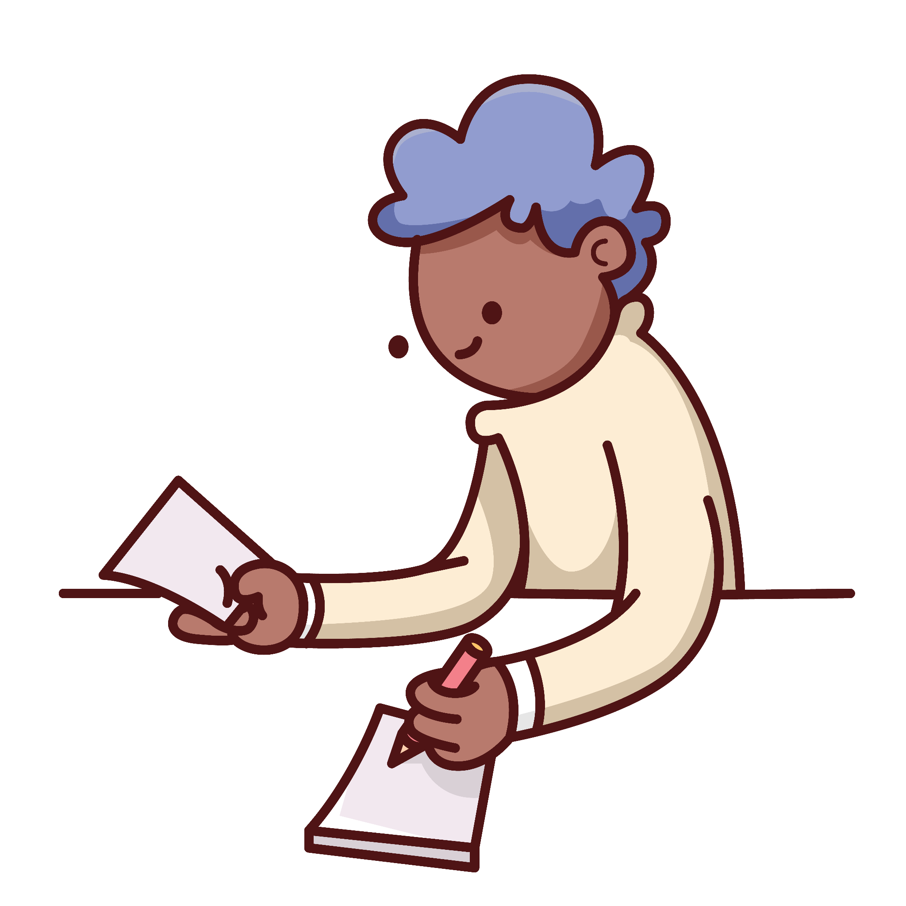
Revision Myth 2: Rereading is
enough
Truth: Actively engaging with the material through practice tests and quizzes enhances learning.
Notes:
Explain that executive functions are brain functions that help us to control our thoughts, feelings and actions. Some people call this the conductor or the air traffic controller of the brain. Executive functions are essential for rational thought and learning.

Slide 6

Hand model of the brain
Revision Myth 3: More Hours = Better Results
Truth: Quality of study time matters more than quantity. Short, focussed study sessions are more effective, so be sure to take regular breaks between sessions!
(top tip: go for a walk with your four-legged pal in your break for an endorphin boost!)
Notes:
Talk them through the hand model of the brain and flipping your lid - when the amygdala is stimulated because of a real or imagined threat it hijacks the brain and puts us into fight flight or freeze mode to keep up safe.

Slide 7

Myth 4: Highlighting Is Effective
Truth: While highlighting can be helpful, it’s not very effective alone. It's more effective to write summaries or create flashcards.

Slide 8

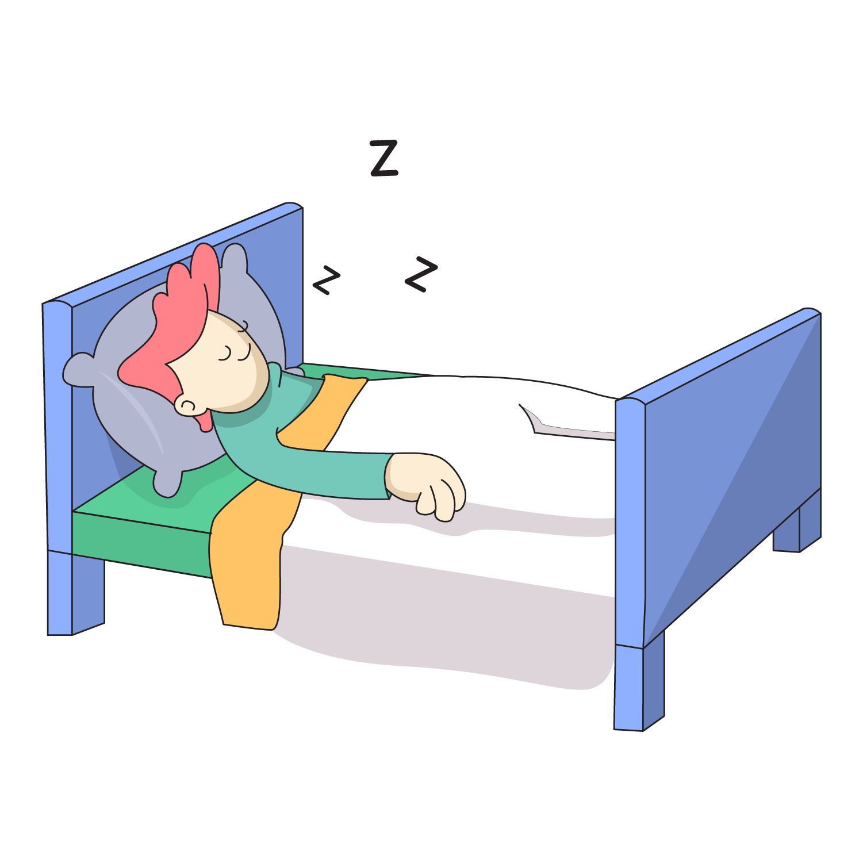
Revision truths:
Sleep is essential: Getting enough sleep is crucial to processing what you learned in the day. It also ensures you’re able to concentrate when you wake up.
Listen to the astronauts: Taking a nap of 10-20 minutes can improve alertness and performance. NASA found
that naps improved performance by 34% and
alertness by 100% [3, 4].

Slide 9
References
[1]https://medium.com/@CWContent/6-ways-to-overcome-the-forgetting-curve-354151c355c
[2] https://www.ncbi.nlm.nih.gov/pmc/articles/PMC3982854/
[3] https://ntrs.nasa.gov/api/citations/20190033981/downloads/20190033981.pdf
[4] nasanaps

