Slide 1





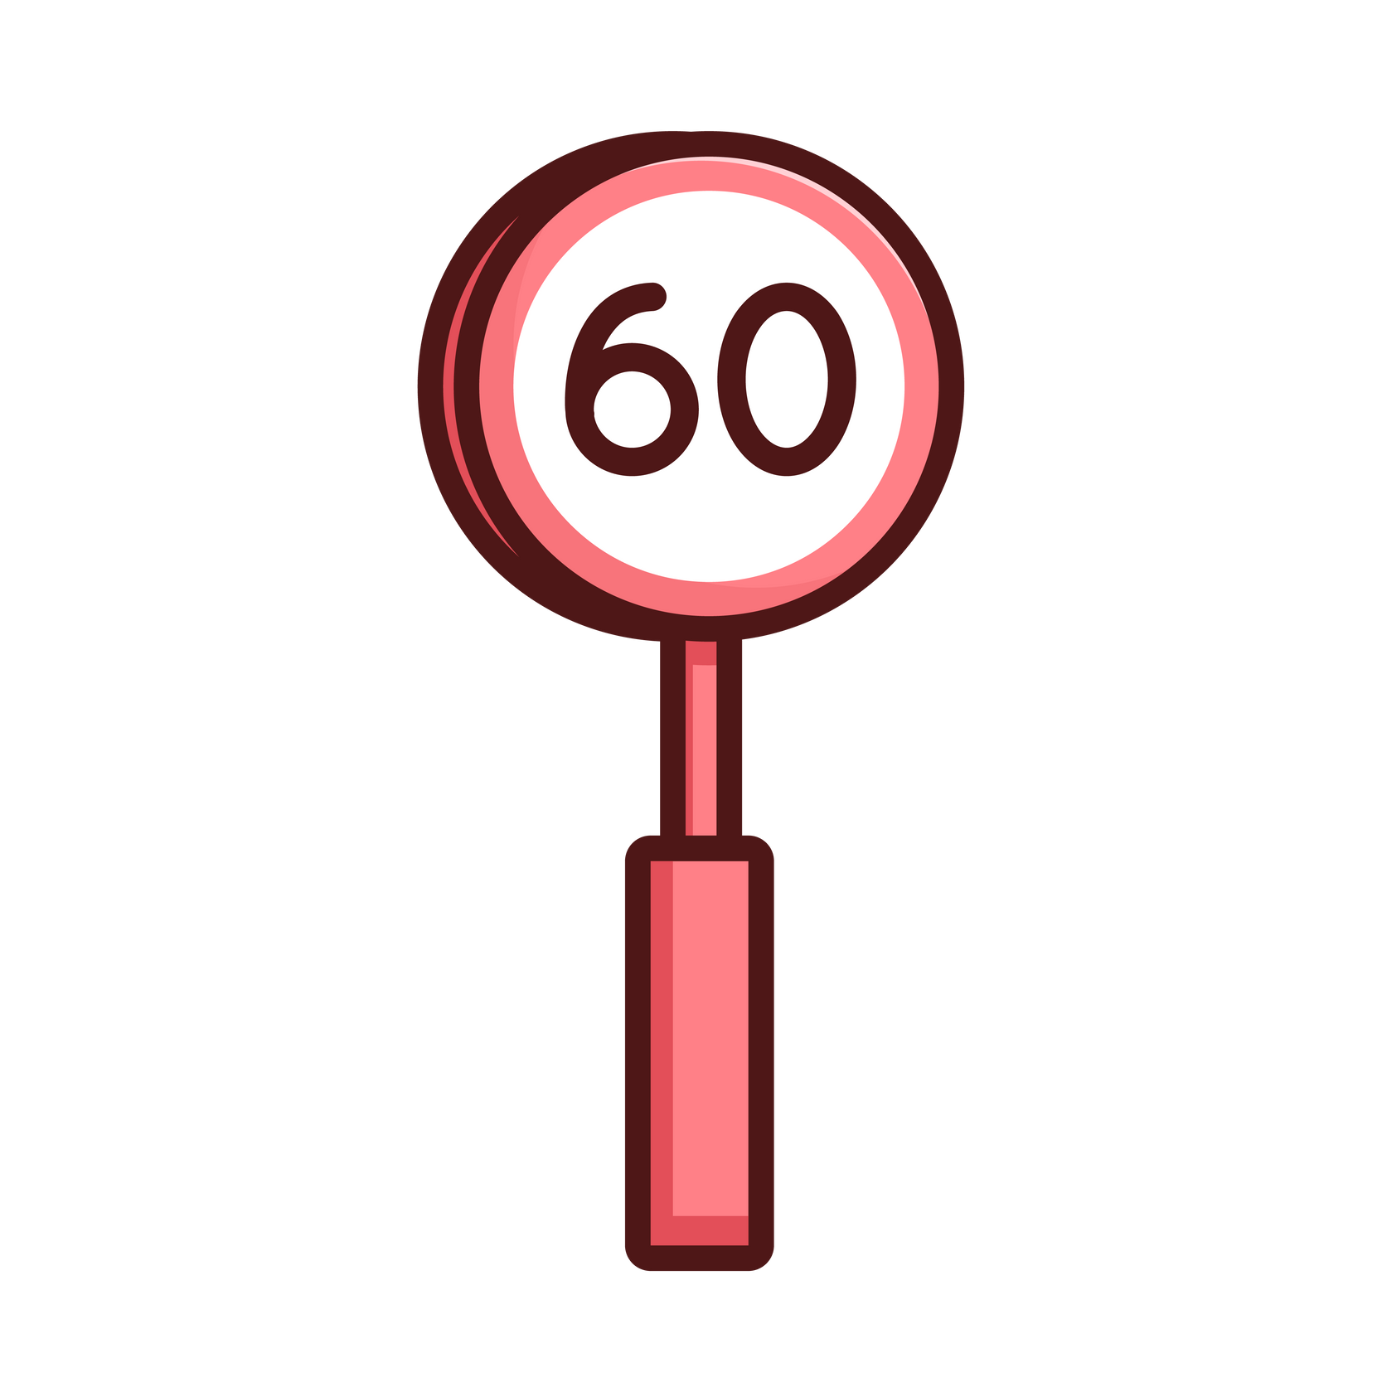
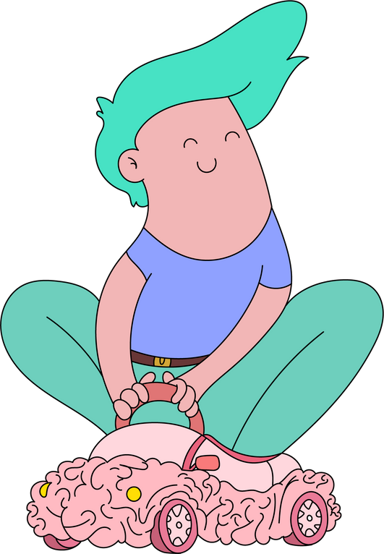
MYELINATION
120
Getting your brain in the fast lane

Slide 2


WHAT IS MYELINATION?
Myelination is the protective cover that grows thicker and thicker around a section of your neurons in your brain.
These sections are wire-like parts called ‘axons’, and the cover is called the ‘myelin’ sheath.
Myelin insulates your neurons allowing messages in your brain travel faster, like insulations around electrical wires.

Slide 3
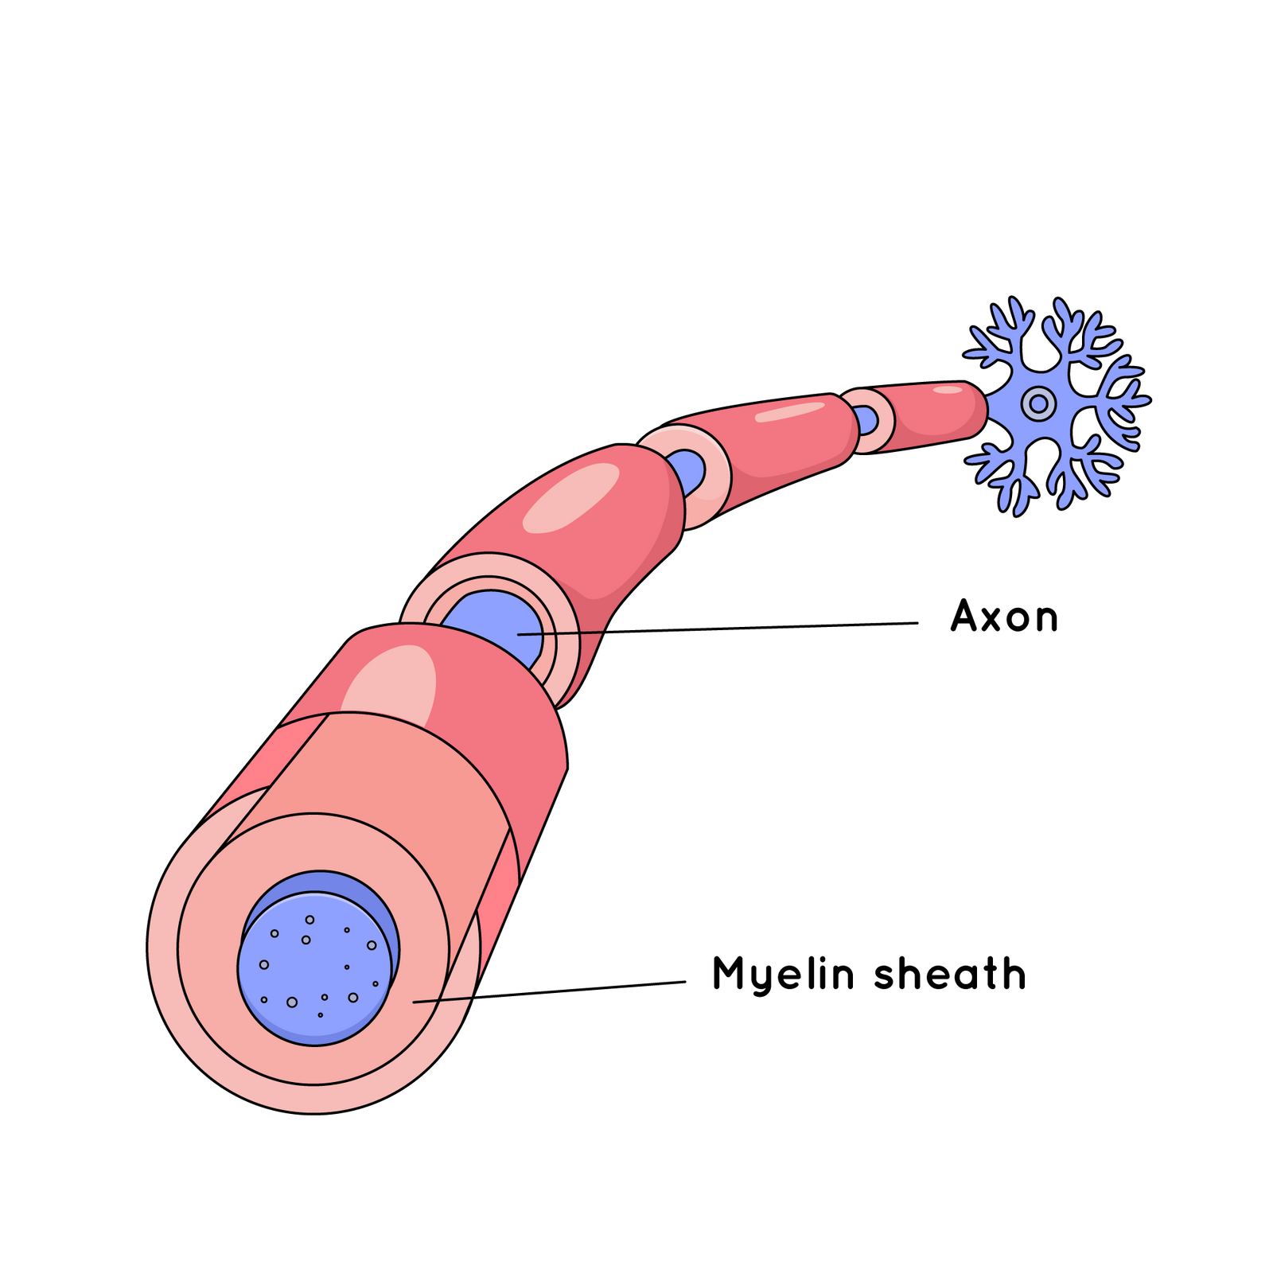
WHAT DOES THIS LOOK LIKE?

Slide 4
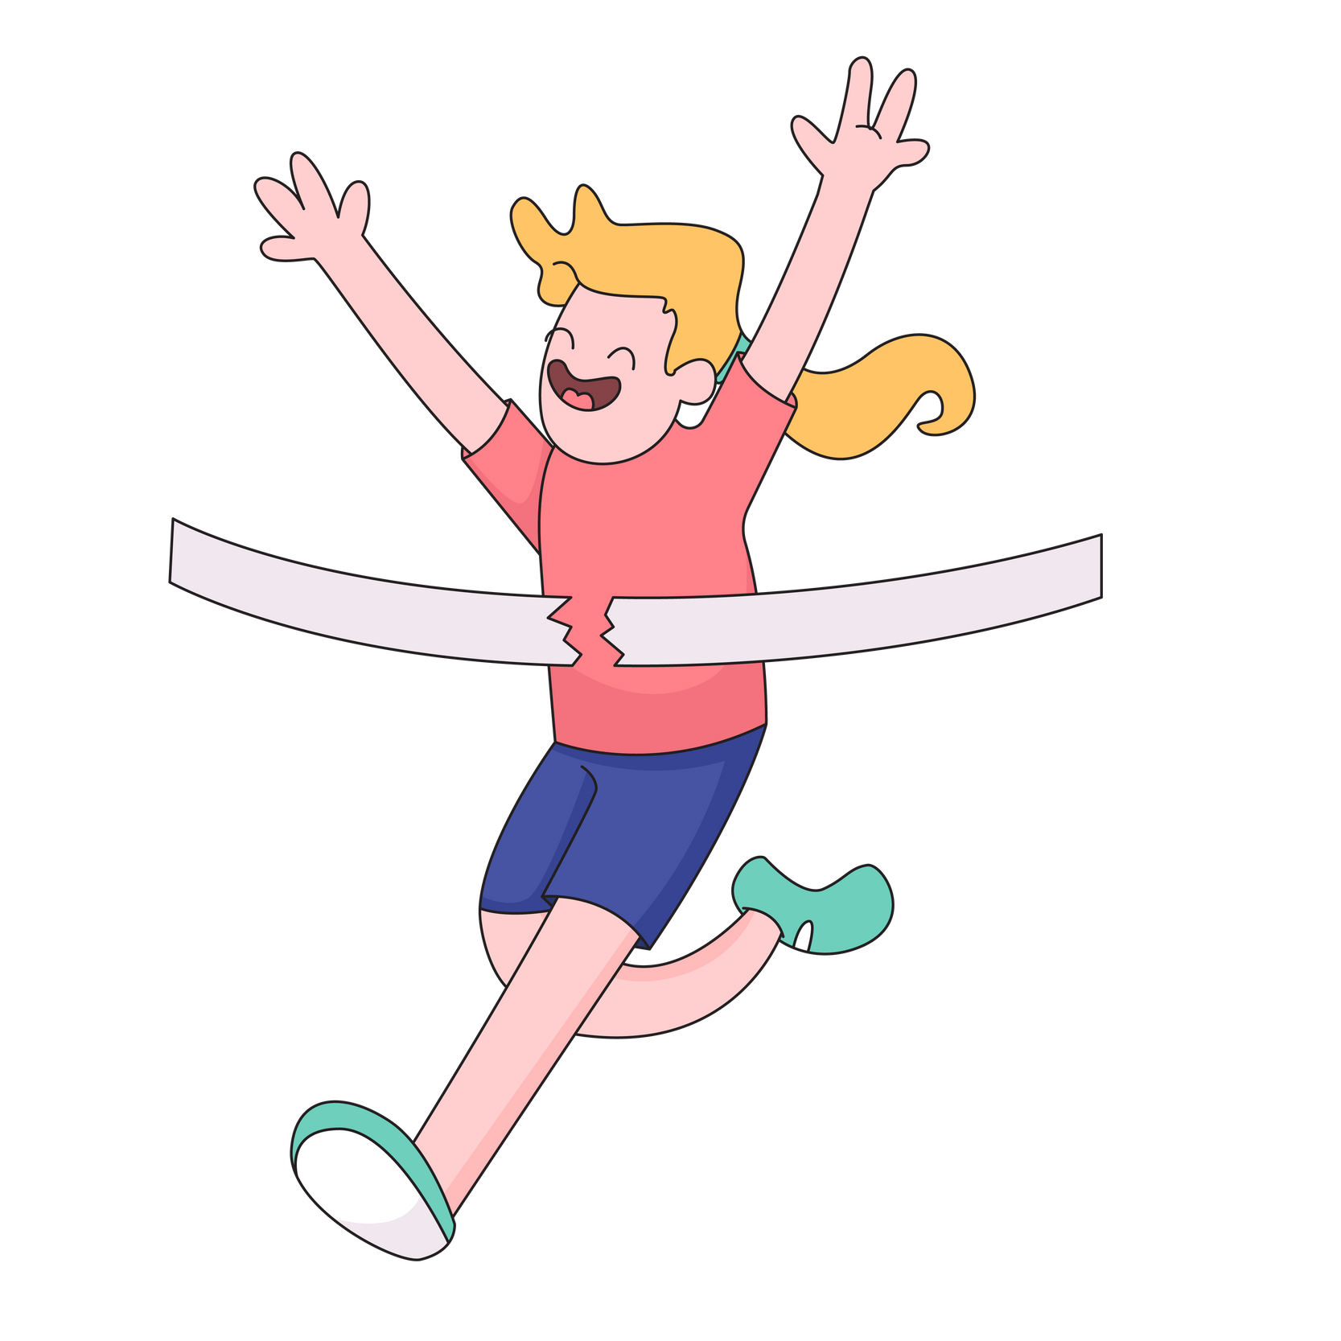


WHY’S IT IMPORTANT?
Myelination helps you think, move, and learn more quickly.
It improves your memory, focus, and problem-solving.
The thicker your myelin sheaths, the better you gets at doing things like sports, socialising, and maths!

Slide 5
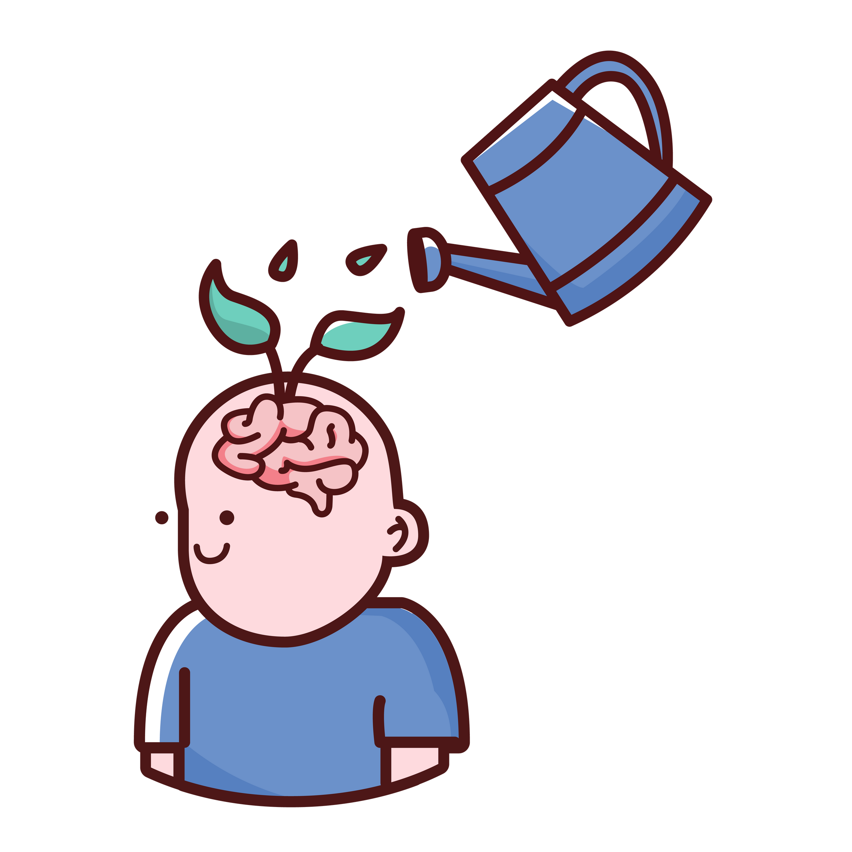
WHAT AFFECTS MYELINATION?
Factors like stress, lack of sleep, and unbalanced diet can slow it down.
Repetition: your brain keeps growing myelin as you learn and practice.

Slide 6
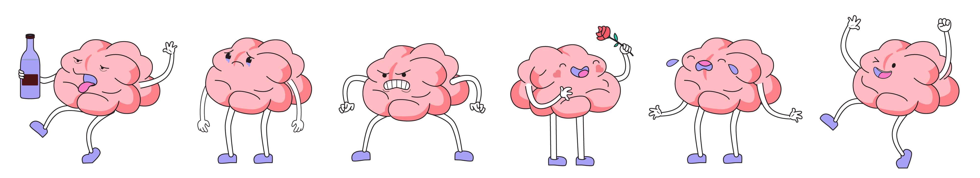
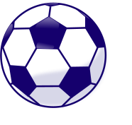
THE ROLE OF REPETITION
Every time we repeat an action, our neurons are wrapped in more myelin, making the connection faster and stronger.
Thicker myelin means easier and quicker learning over time - like upgrading from a dirt path to a smooth highway!
It’s why playing an instrument, solving math problems, or learning new skills becomes more natural with time.

Slide 7
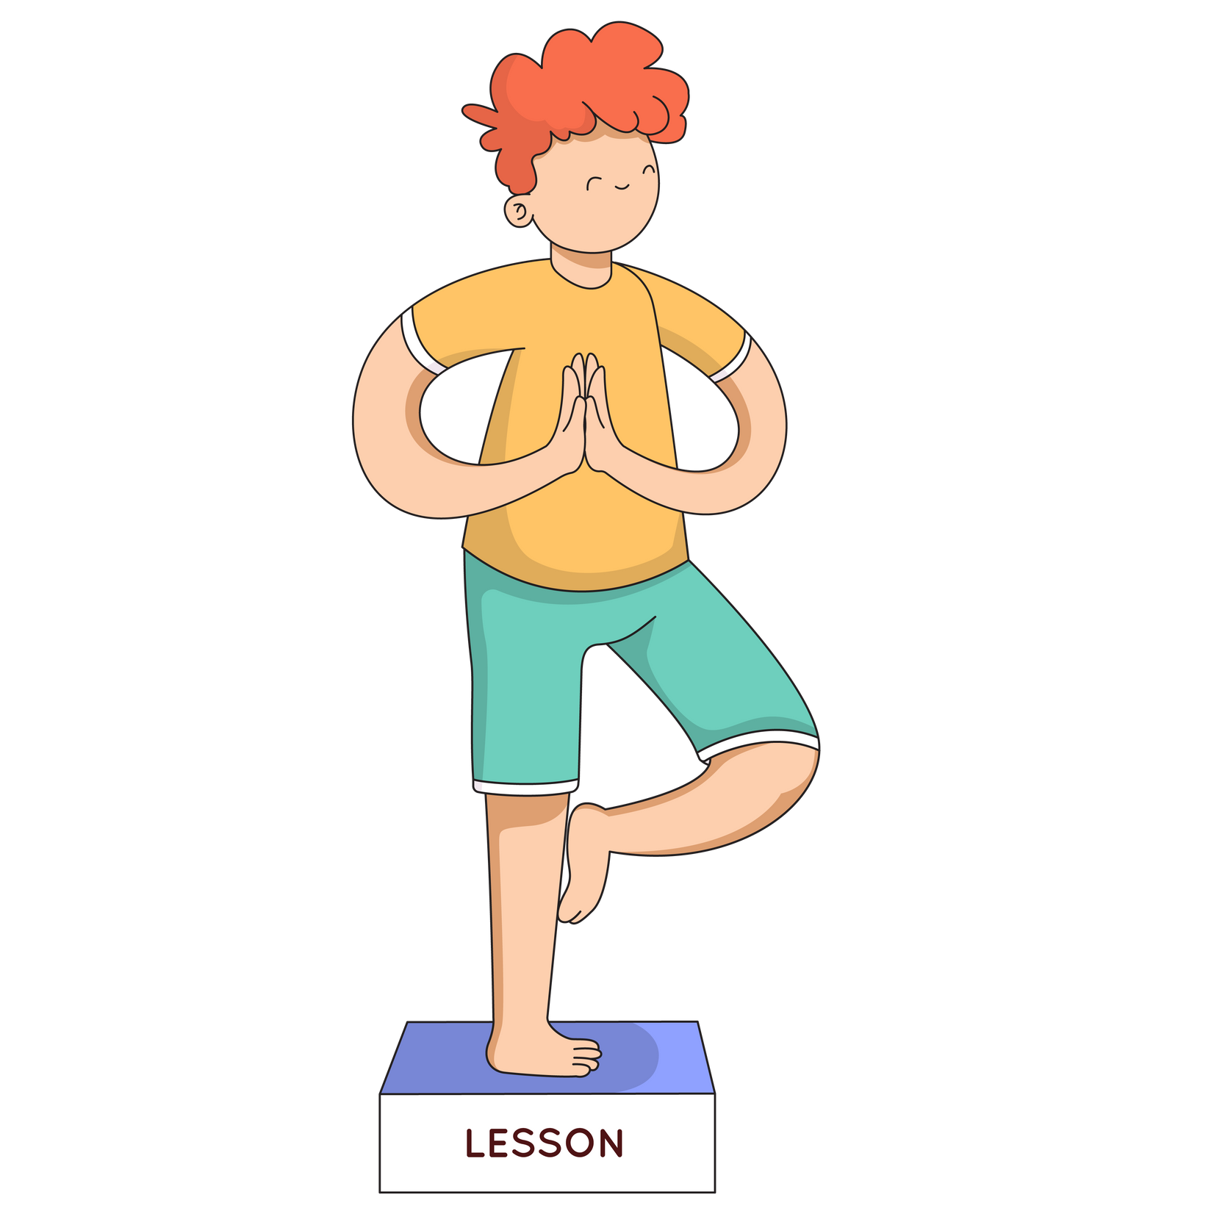
THE RULE OF 66
Did you know? Research shows that it takes an average of 66 days of practicing a behaviour for it to become automatic (Lally et al. 2009). Each repetition boosts myelination, making it easier to recall and perform that task.

Slide 8
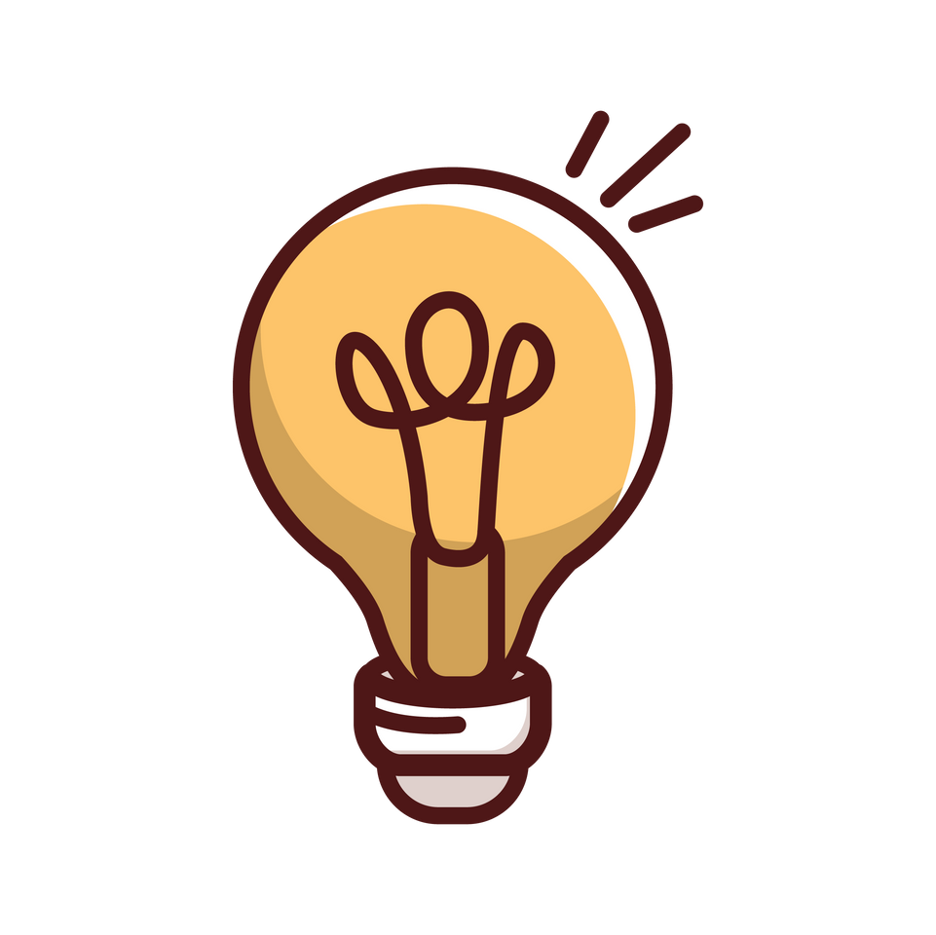
BOOST MYELINATION BY...
Staying active with exercise you enjoy
Getting enough quality sleep & staying hyrdated
Eating foods rich in omega 3,
antioxidants, & minerals*
Sticking at new habits over the longer term.
*These can be found in foods like fish, leafy greens, avocado, nuts, and berries.

Slide 9
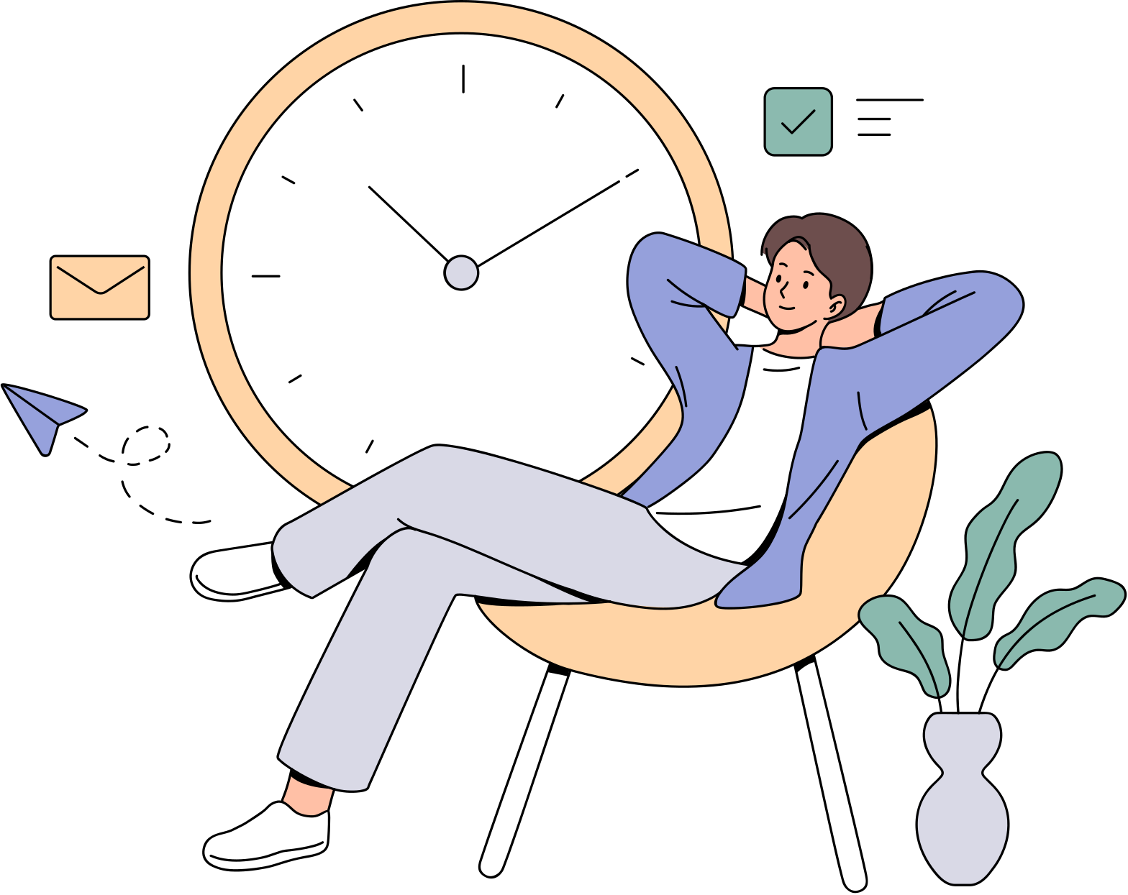
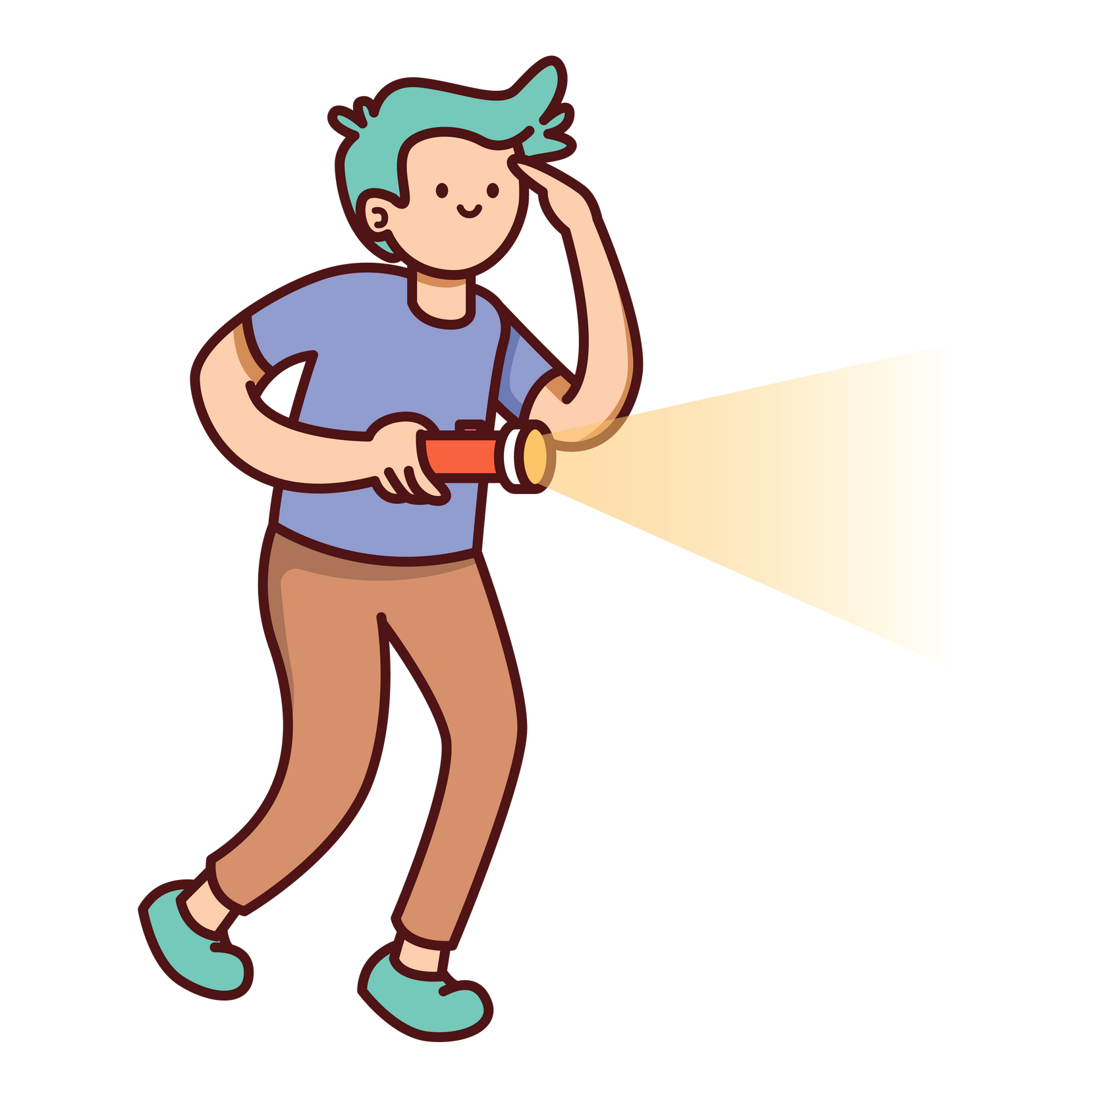
LET’S CHAT!
What new hobby or skill do you want to try?

