Slide 1


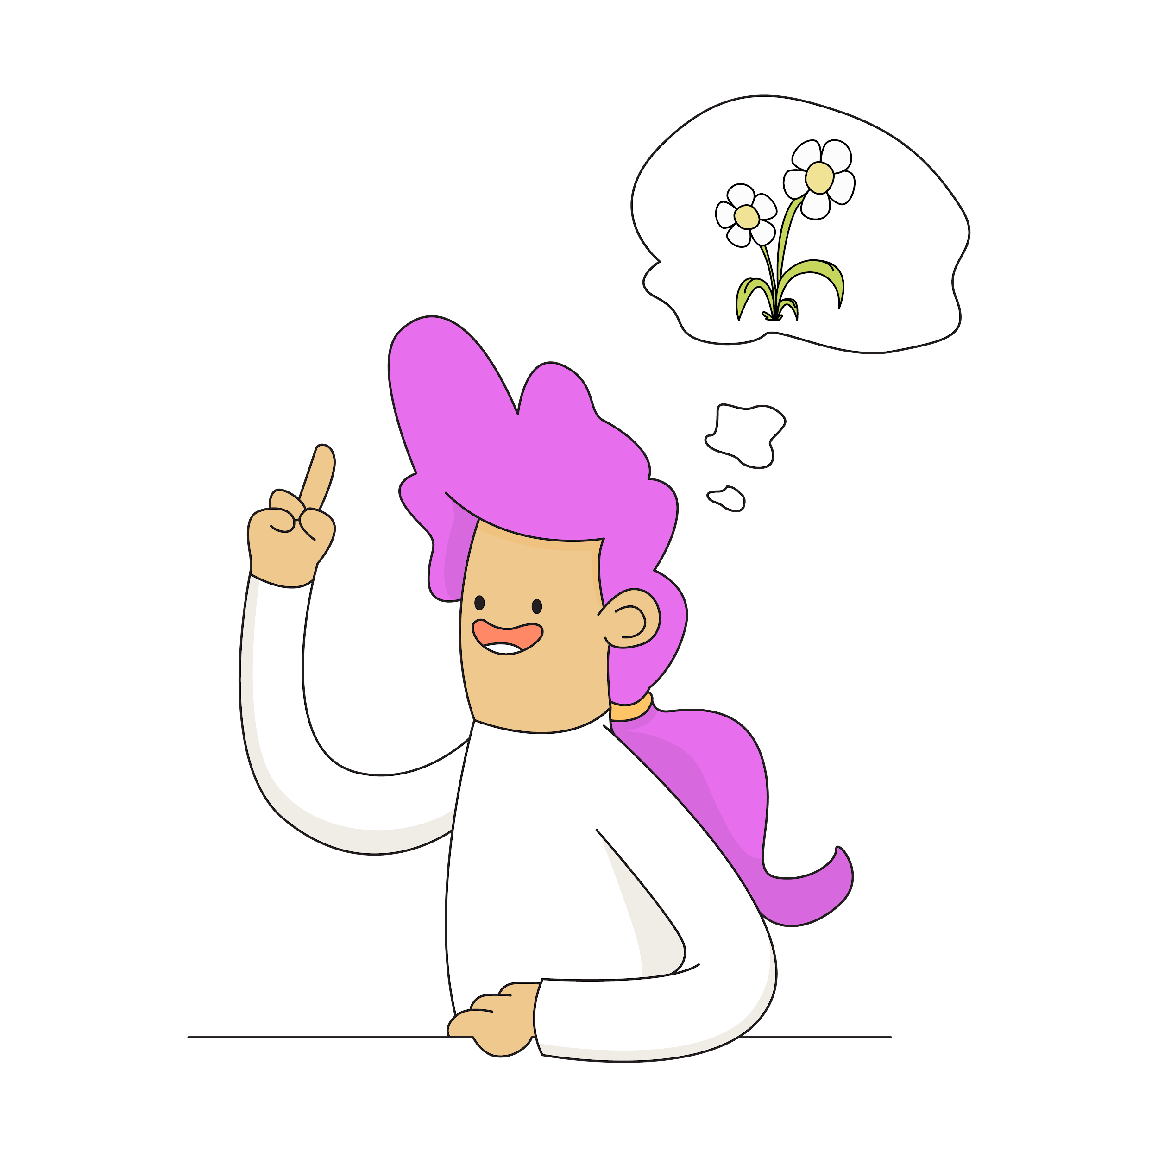
Our Magical Brains

Slide 2
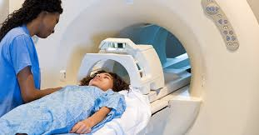
Neuroscience
Neuroscience started in the 1960s
In the 1990s FMRI scanners were invented
Notes:
Explain that neuroscience is the study of our brains and our nervous system.
Explain how the invention of FMRI scanners has helped scientists to learn more about our brains.

Slide 3
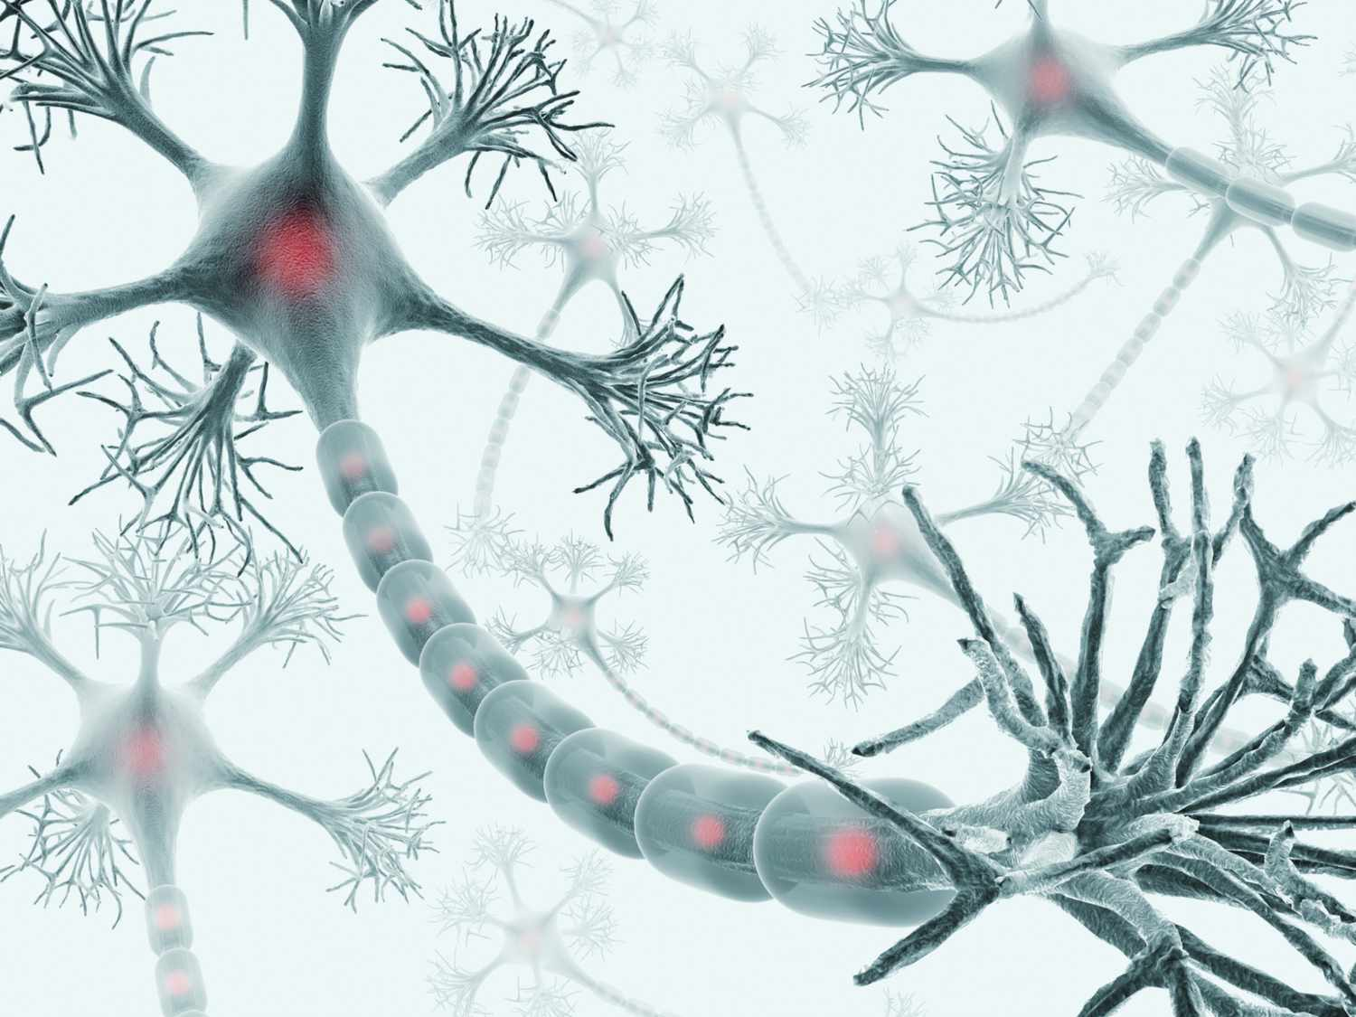
86 billion neurons
Experiences shape our brains
Notes:
Talk about the average 86 billion neurons in the brain and how the experiences we have shape the connections in our brain to form neural pathways. These neurons help us to grow from a baby who needs everything done for them to an adult who can be independent and solve complex problems.

Slide 4

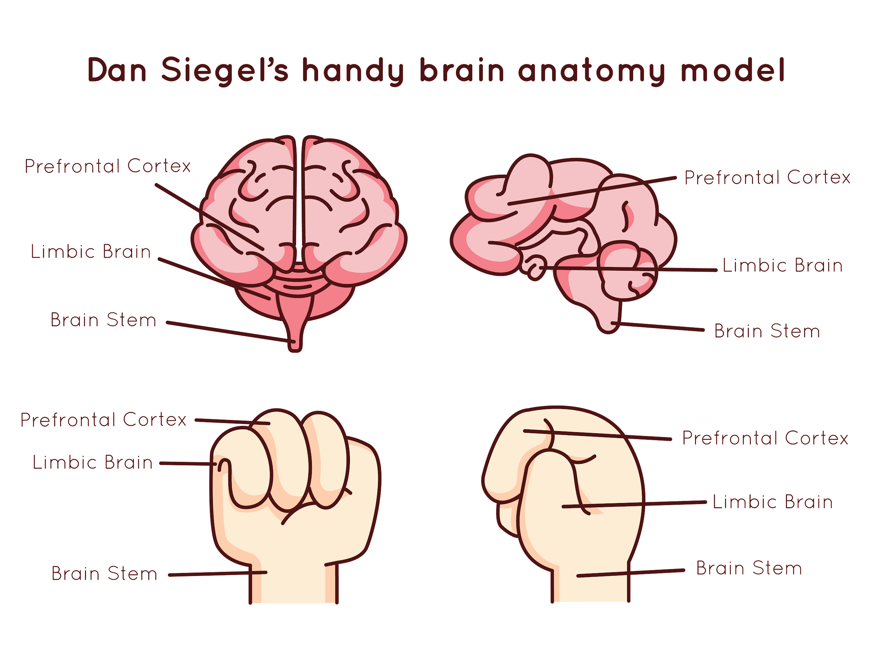
Hand model of the brain
The Simplified Brain
Amygdala
Amygdala
Notes:
Brains are very complicated and scientists are still learning more and more about them. In this lesson we will focus on a simplified model of the brain with three key parts. There are more parts sign - post children to resources they can use to learn more.

Slide 5
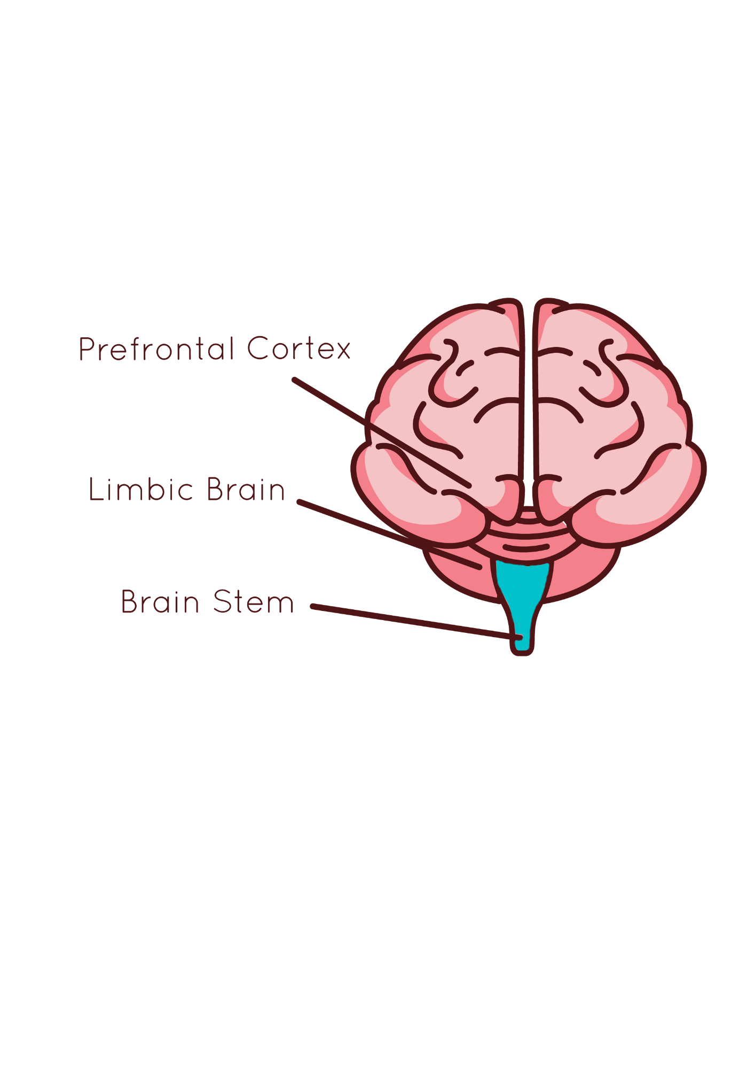
Hand model of the brain
The Brain Stem
Breathing
Heart Beat
Sleep
Amygdala
Notes:
The brain stem is responsible for automatic control of our bodies, including our breathing our heart beat and our sleep.

Slide 6
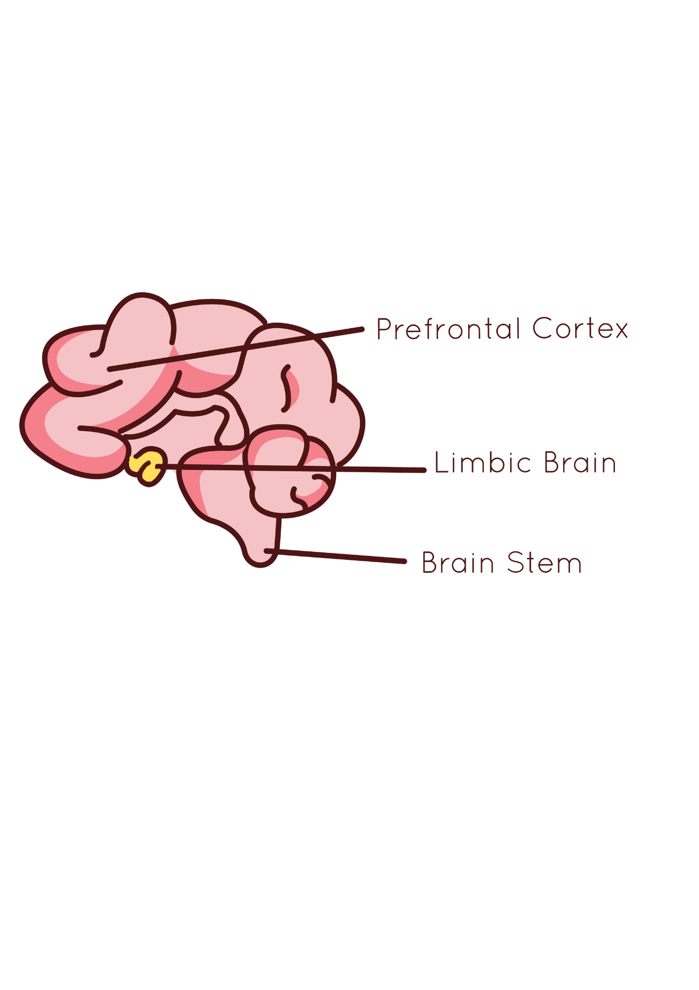
Hand model of the brain
The Amygdala
Fight
Flight
Freeze
Amygdala
Notes:
The amygdala controls our emotional responses by labelling sensory input as either pleasurable or threatening. Input seen as threatening is blocked by the amygdala, prompting an immediate reflexive reaction: Fight, flight, or freeze.
The amygdala does not see a difference between perceived threats and actual dangers. It often triggers “false alarms” and reactive behavior. We sometimes freeze in stressful situations, like public speaking or when taking a test. Though neither of these activities are life-threatening, we disconnect from rational thinking and become impulsive and reactive.

Slide 7
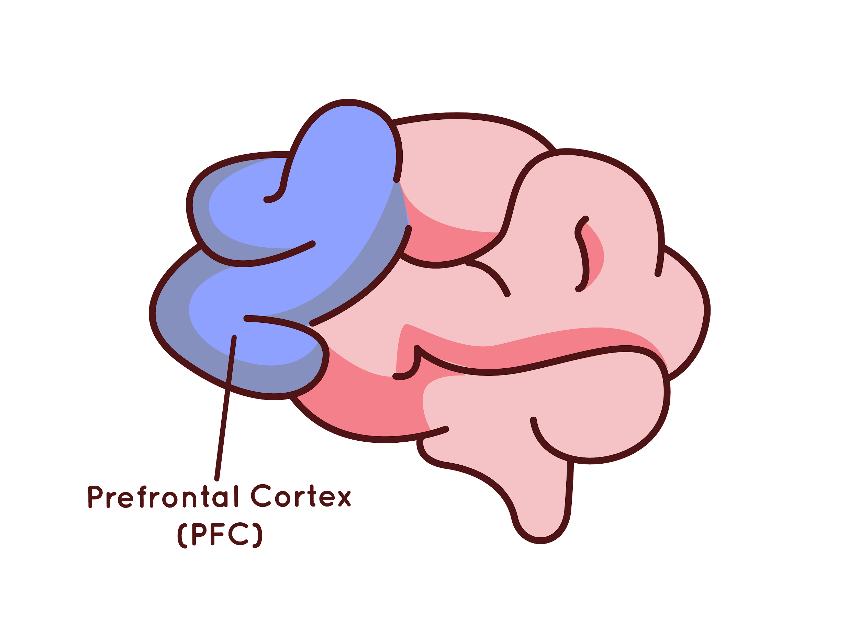
The Prefrontal Cortex
Houses Executive Functions
The conductor of the brain
Notes:
Explain that executive functions are brain functions that help us to control our thoughts, feelings and actions. Some people call this the conductor or the air traffic controller of the brain. Executive functions are essential for rational thought and learning.

Slide 8
Hand model of the brain
Hand Model of the Brain
Notes:
Talk them through the hand model of the brain and flipping your lid - when the amygdala is stimulated because of a real or imagined threat it hijacks the brain and puts us into fight flight or freeze mode to keep up safe.

Slide 9
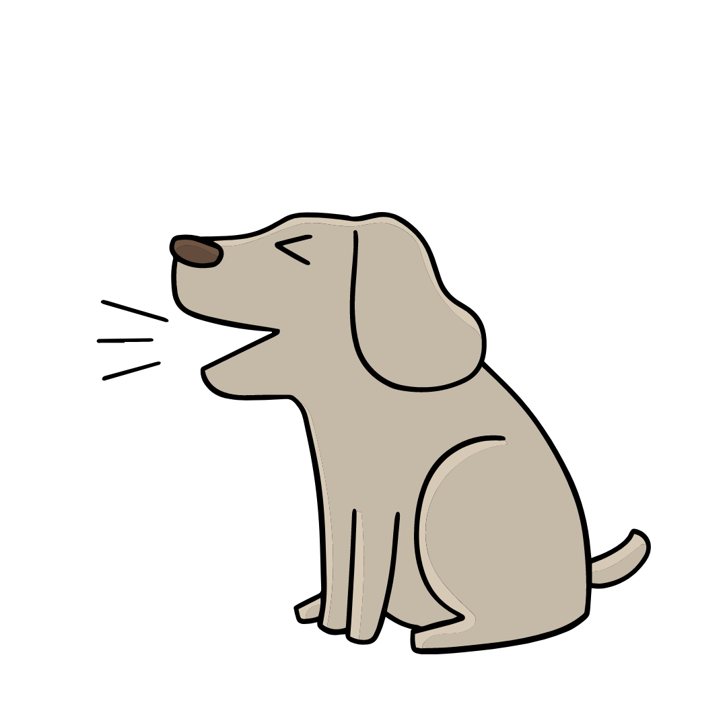

Hand model of the brain
Amygdala Hijack
Amygdala
Notes:
It helps some people to think of our amygdala as a very sensitive guard dog or fire alarm - sometimes it goes off for no reason. When we evolved there was much more life and death danger so it made sense for the alarm/guard dog to be super sensitive, now there is less danger it doesn’t need to be so sensitive but it still is and for some people it is more sensitive than others. When our amygdala is triggered, then it hijacks the brain so that our prefrontal cortex can’t work as well.

Slide 10
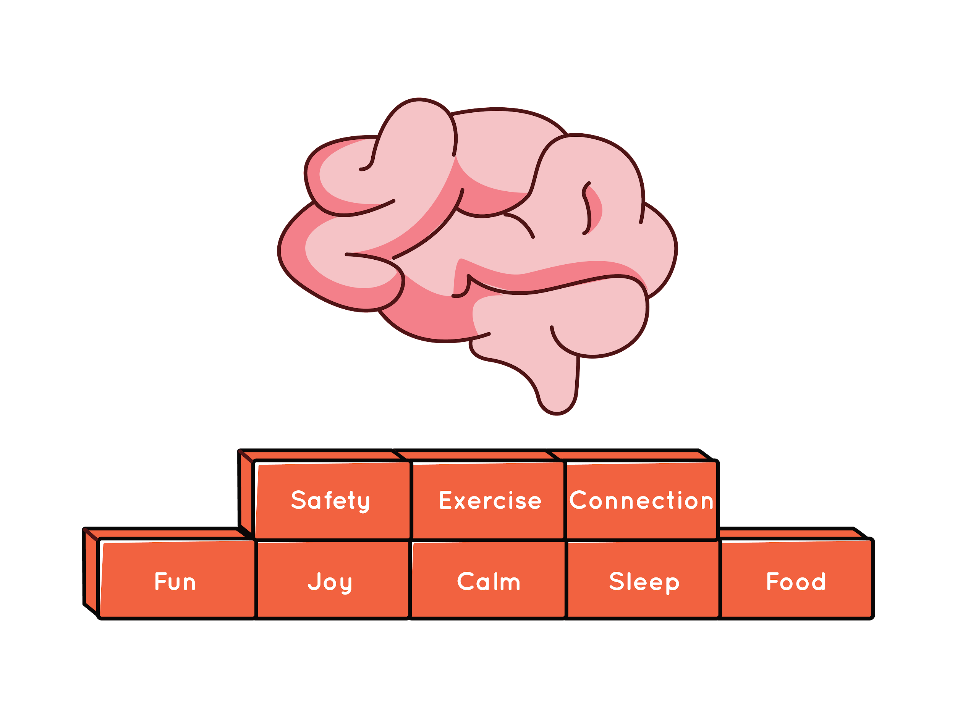

Hand model of the brain
Strengthening our frontal-amygdala connection
Building Blocks of Strong Executive Functions
Notes:
We can help our guard dog/alarm to not be triggered by false alarms by strengthening the link between our prefrontal cortex and the amygdala our fronto-amygdala connection. Working on our building blocks helps us to do this.

