Slide 1
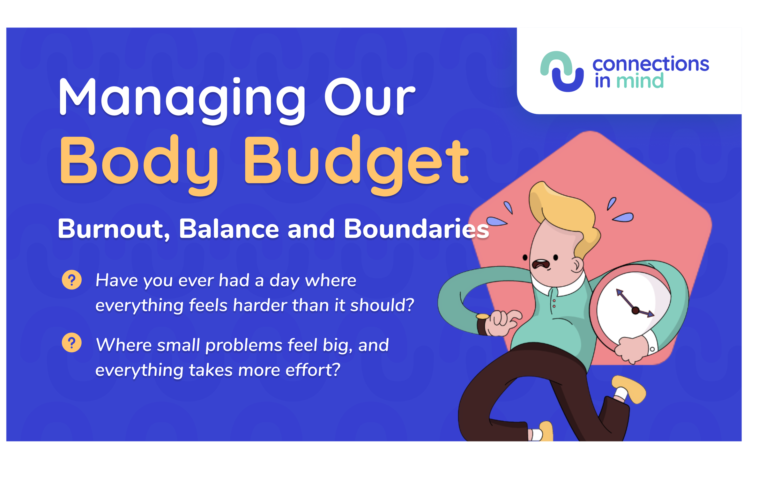
Managing Our
Body Budget
Burnout, Balance and Boundaries
Have you ever had a day where everything feels harder than it should?
Where small problems feel big, and everything takes more effort?

Slide 2
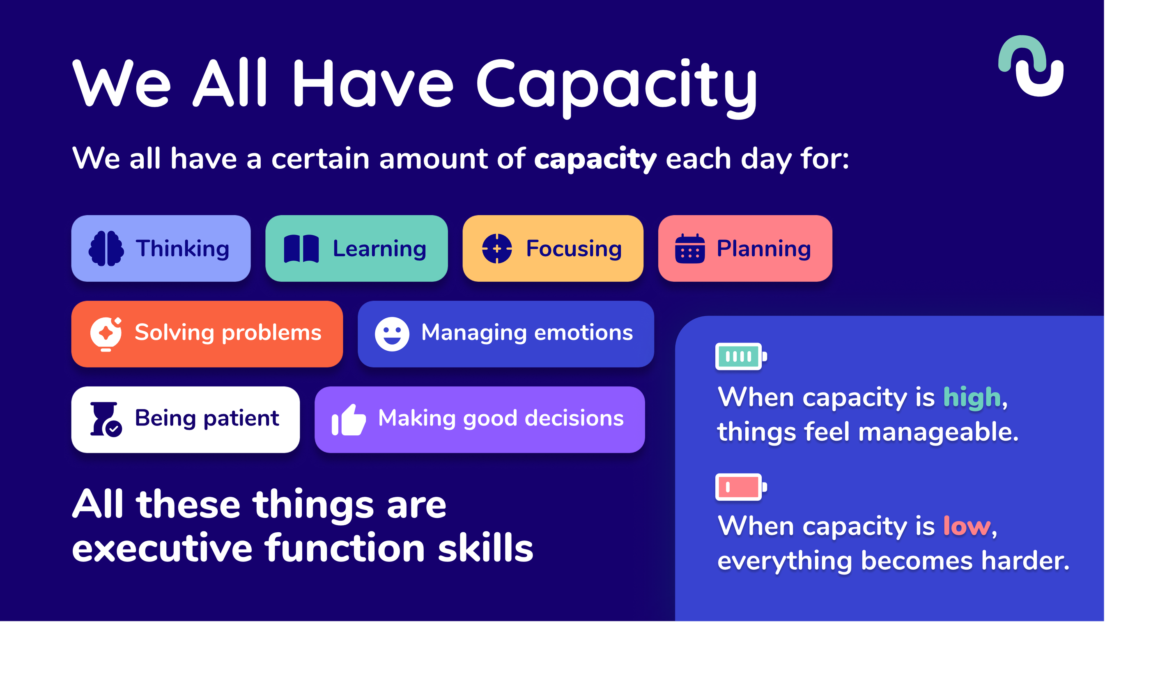
We All Have Capacity
We all have a certain amount of capacity each day for:
Thinking Learning Focusing
Planning
Solving problemsManaging emotions
When capacity is high, things feel manageable.
When capacity is low, everything becomes harder.
Being patientMaking good decisions
All these things are executive function skills

Slide 3
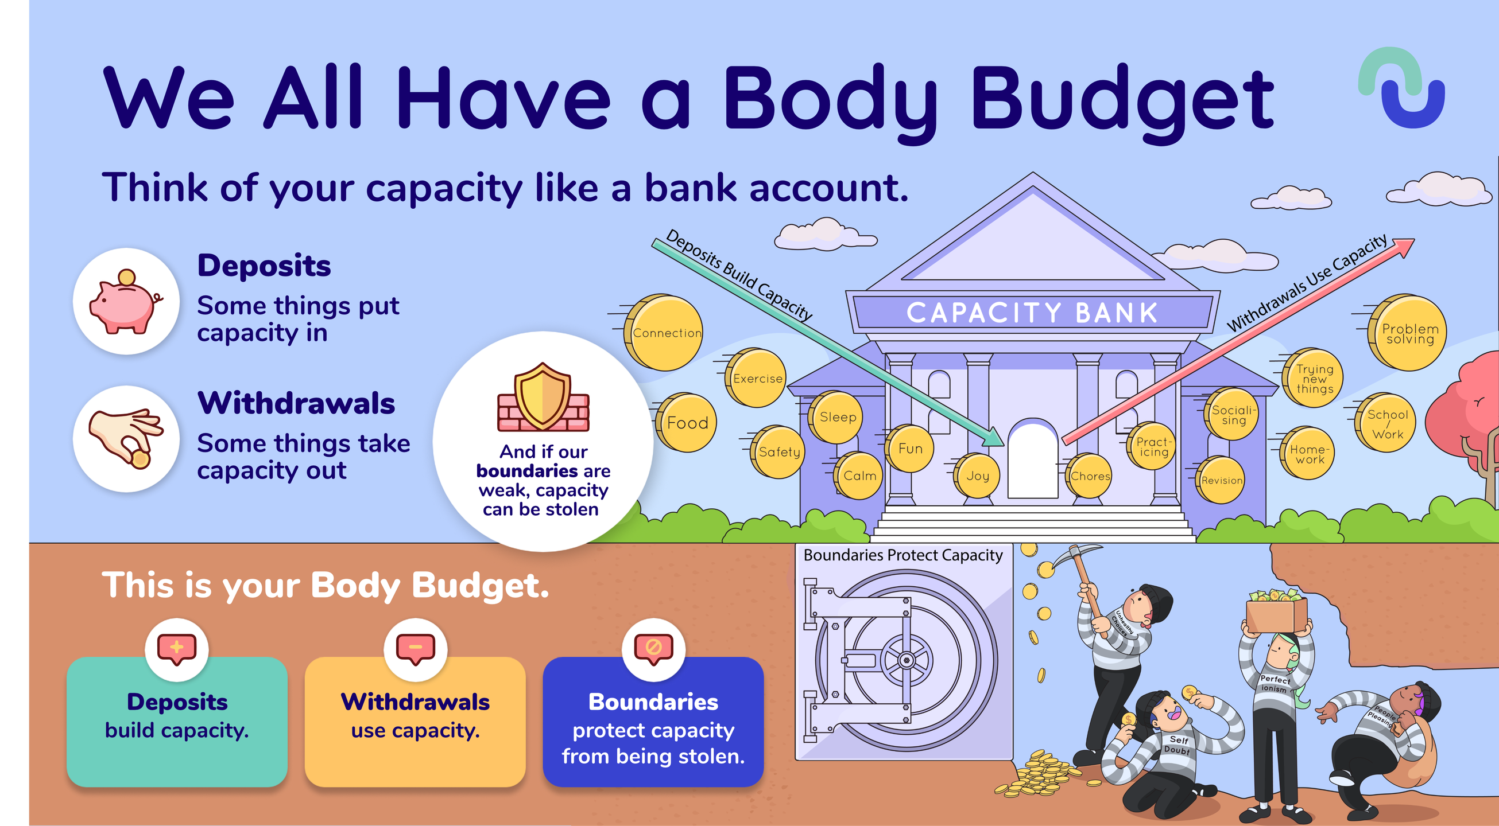
We All Have a Body Budget
Deposits
Some things put capacity in
Withdrawals
Some things take capacity out
And if our boundaries are weak, capacity
can be stolen
This is your Body Budget.
Deposits
build capacity.
Withdrawals
use capacity.
Boundaries
protect capacity from being stolen.

Slide 4
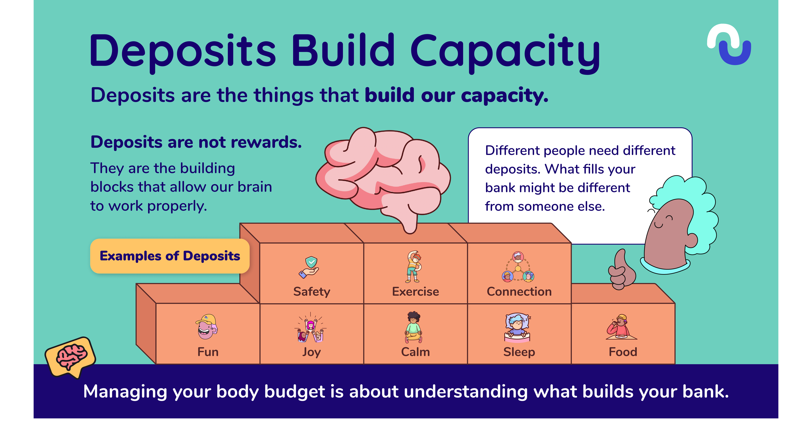
Deposits Build Capacity
Deposits are not rewards.
They are the building
blocks that allow our brain
to work properly.
Different people need different deposits. What fills your
bank might be different
from someone else.
Examples of Deposits
Safety
Exercise
Connection
Fun
Joy
Calm
Sleep
Food
Managing your body budget is about understanding what builds your bank.

Slide 5
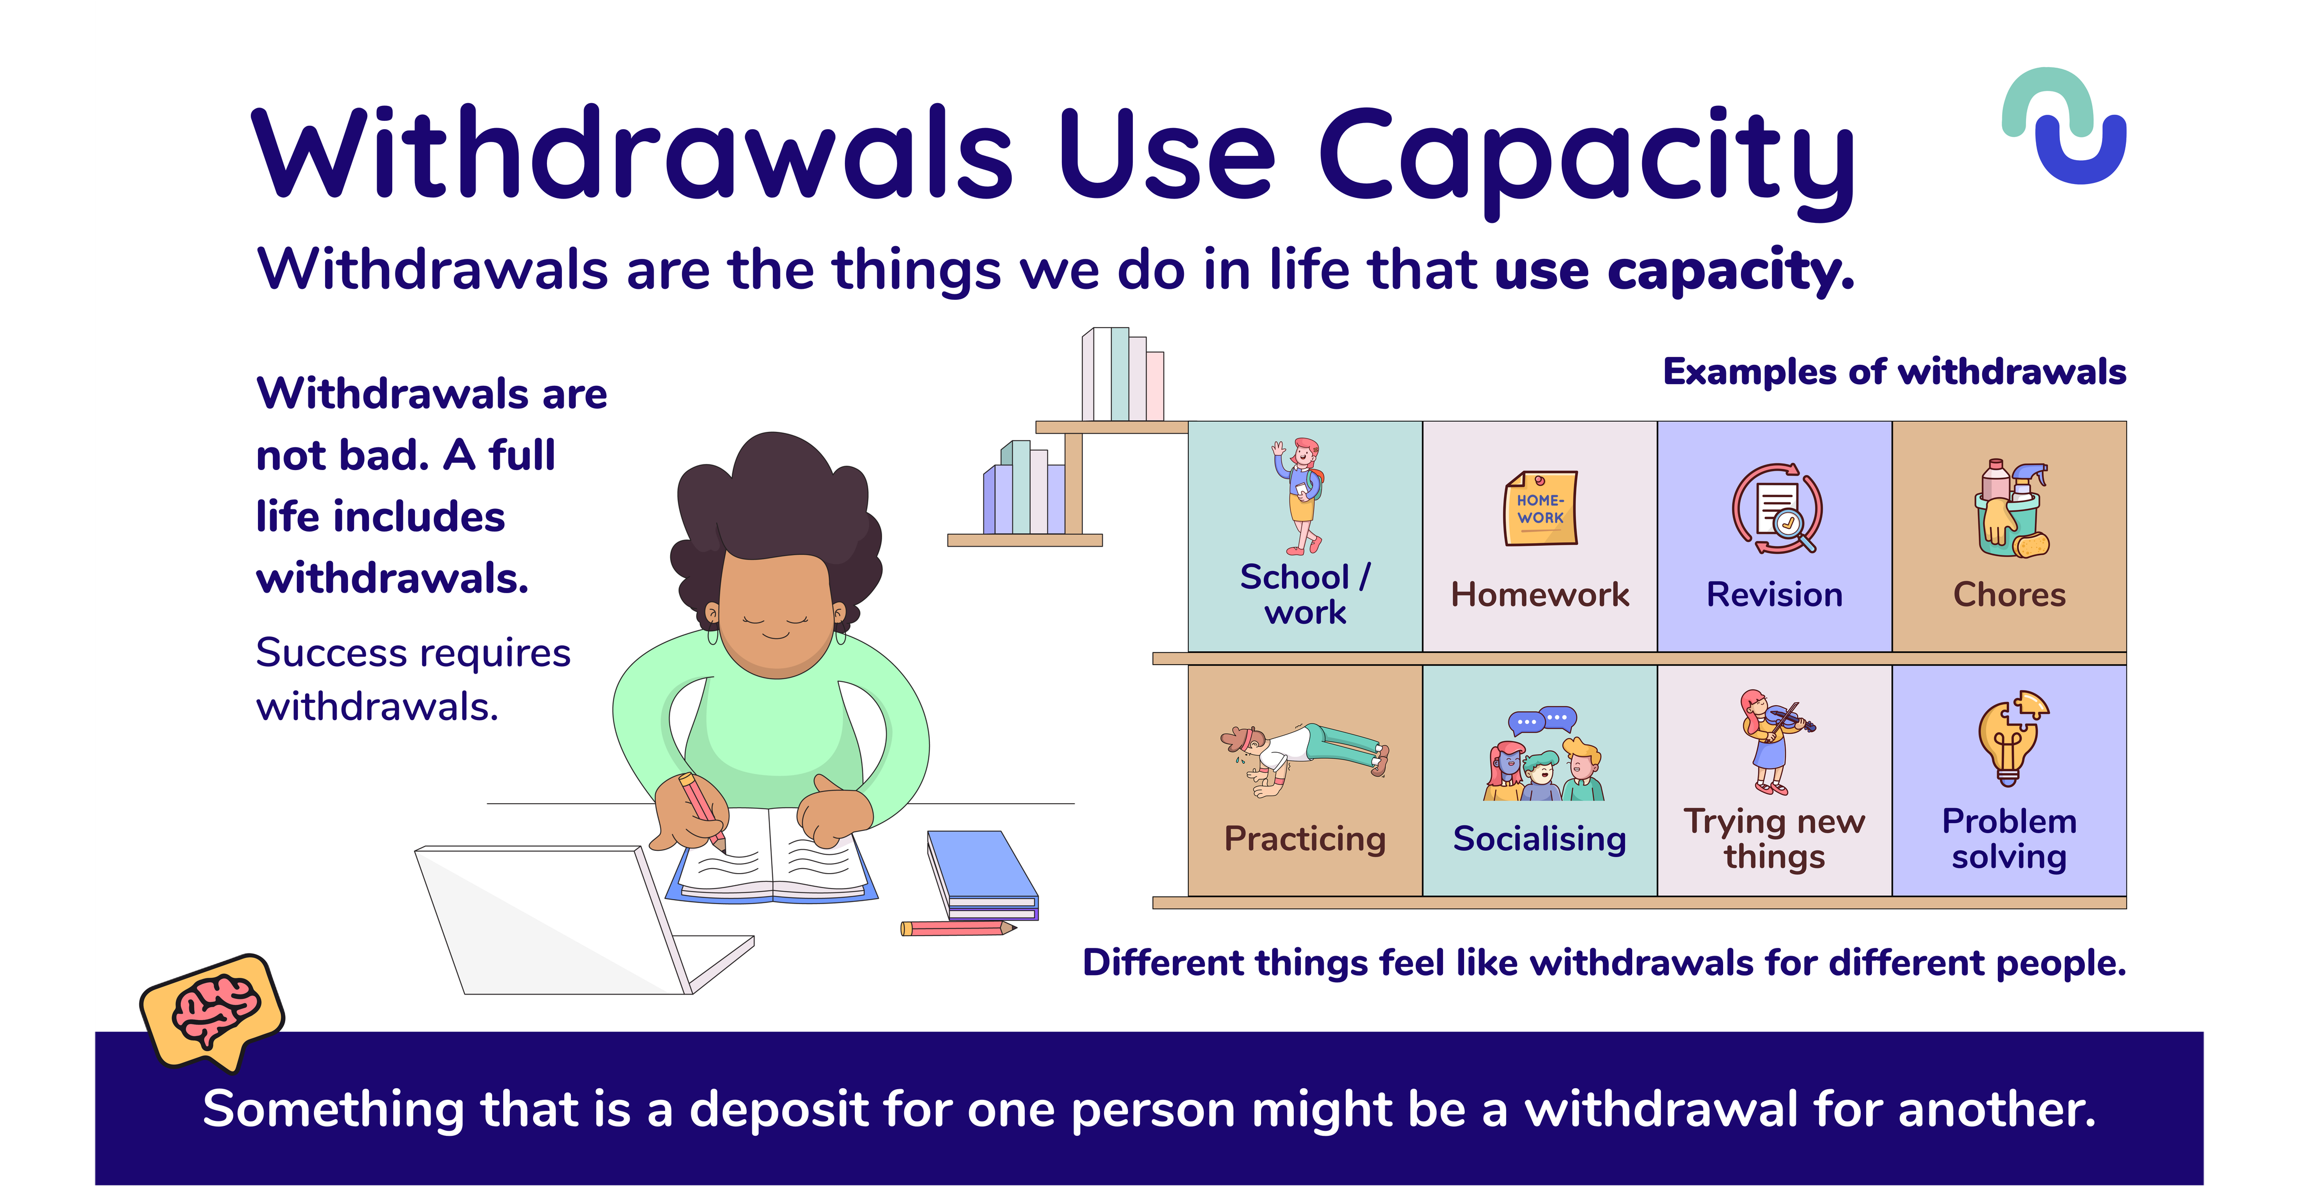
Withdrawals Use Capacity
Withdrawals are not bad. A full life includes withdrawals.
Success requires withdrawals.
Examples of withdrawals
School / work
Homework
Revision
Chores
Practicing
Socialising
Trying new
Problem
things
solving
Different things feel like withdrawals for different people.
Something that is a deposit for one person might be a withdrawal for another.

Slide 6
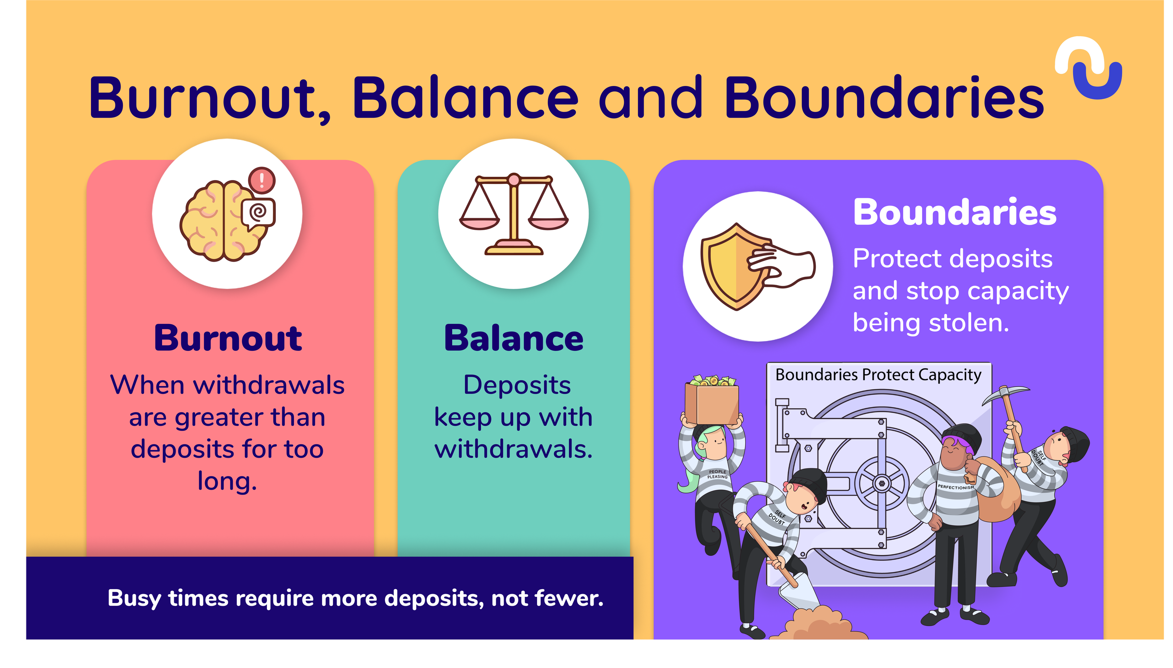
Burnout, Balance and Boundaries
Boundaries
Protect deposits and stop capacity being stolen.
Burnout
Balance
When withdrawals are greater than deposits for too
Deposits keep up with withdrawals.
long.
Busy times require more deposits, not fewer.

Slide 7
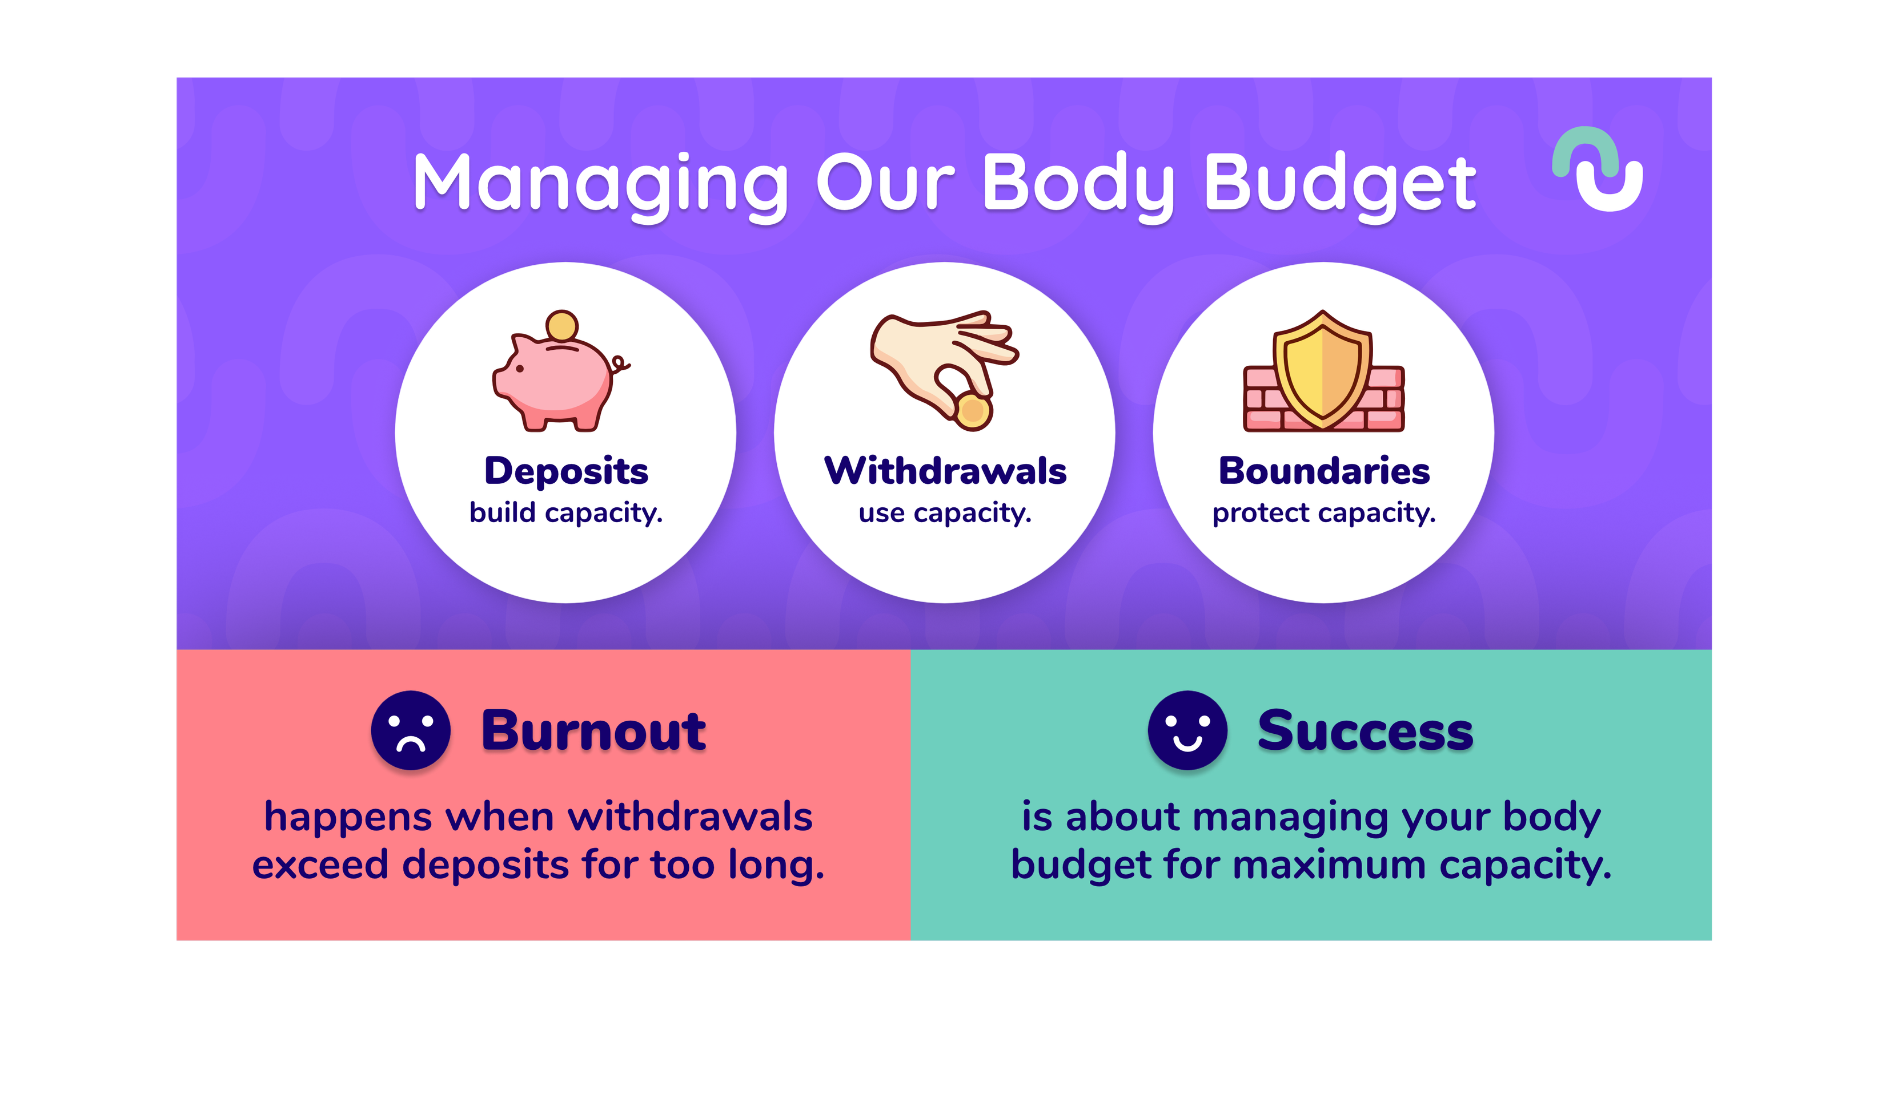
Managing Our Body Budget
Deposits
Withdrawals
Boundaries
Burnout
Success
happens when withdrawals exceed deposits for too long.
is about managing your body budget for maximum capacity.

