Slide 1

Executive Function
skills and strategies

Slide 2
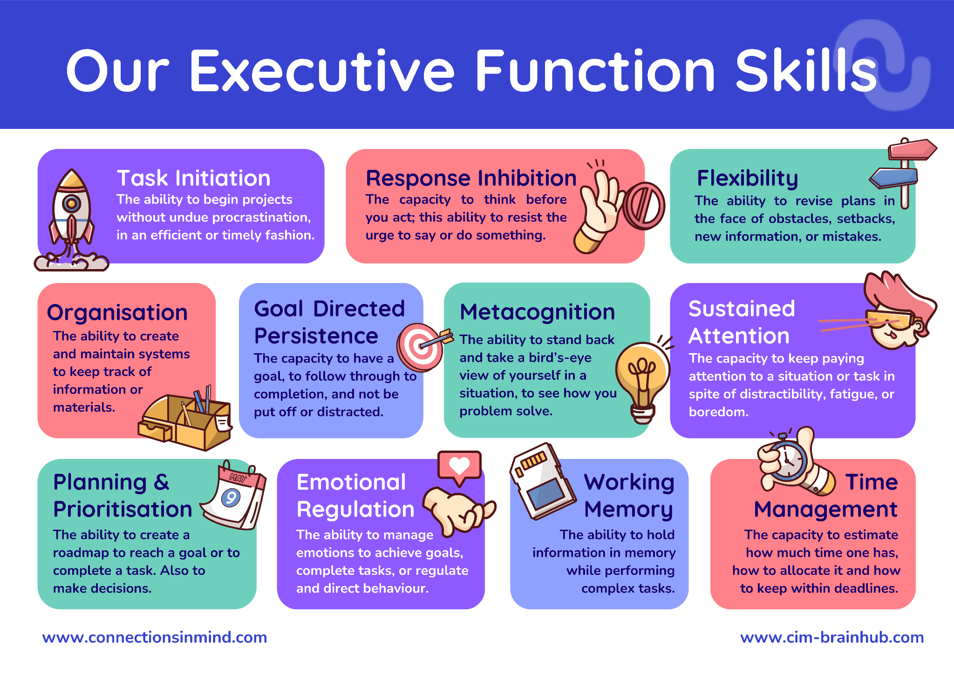

Slide 4
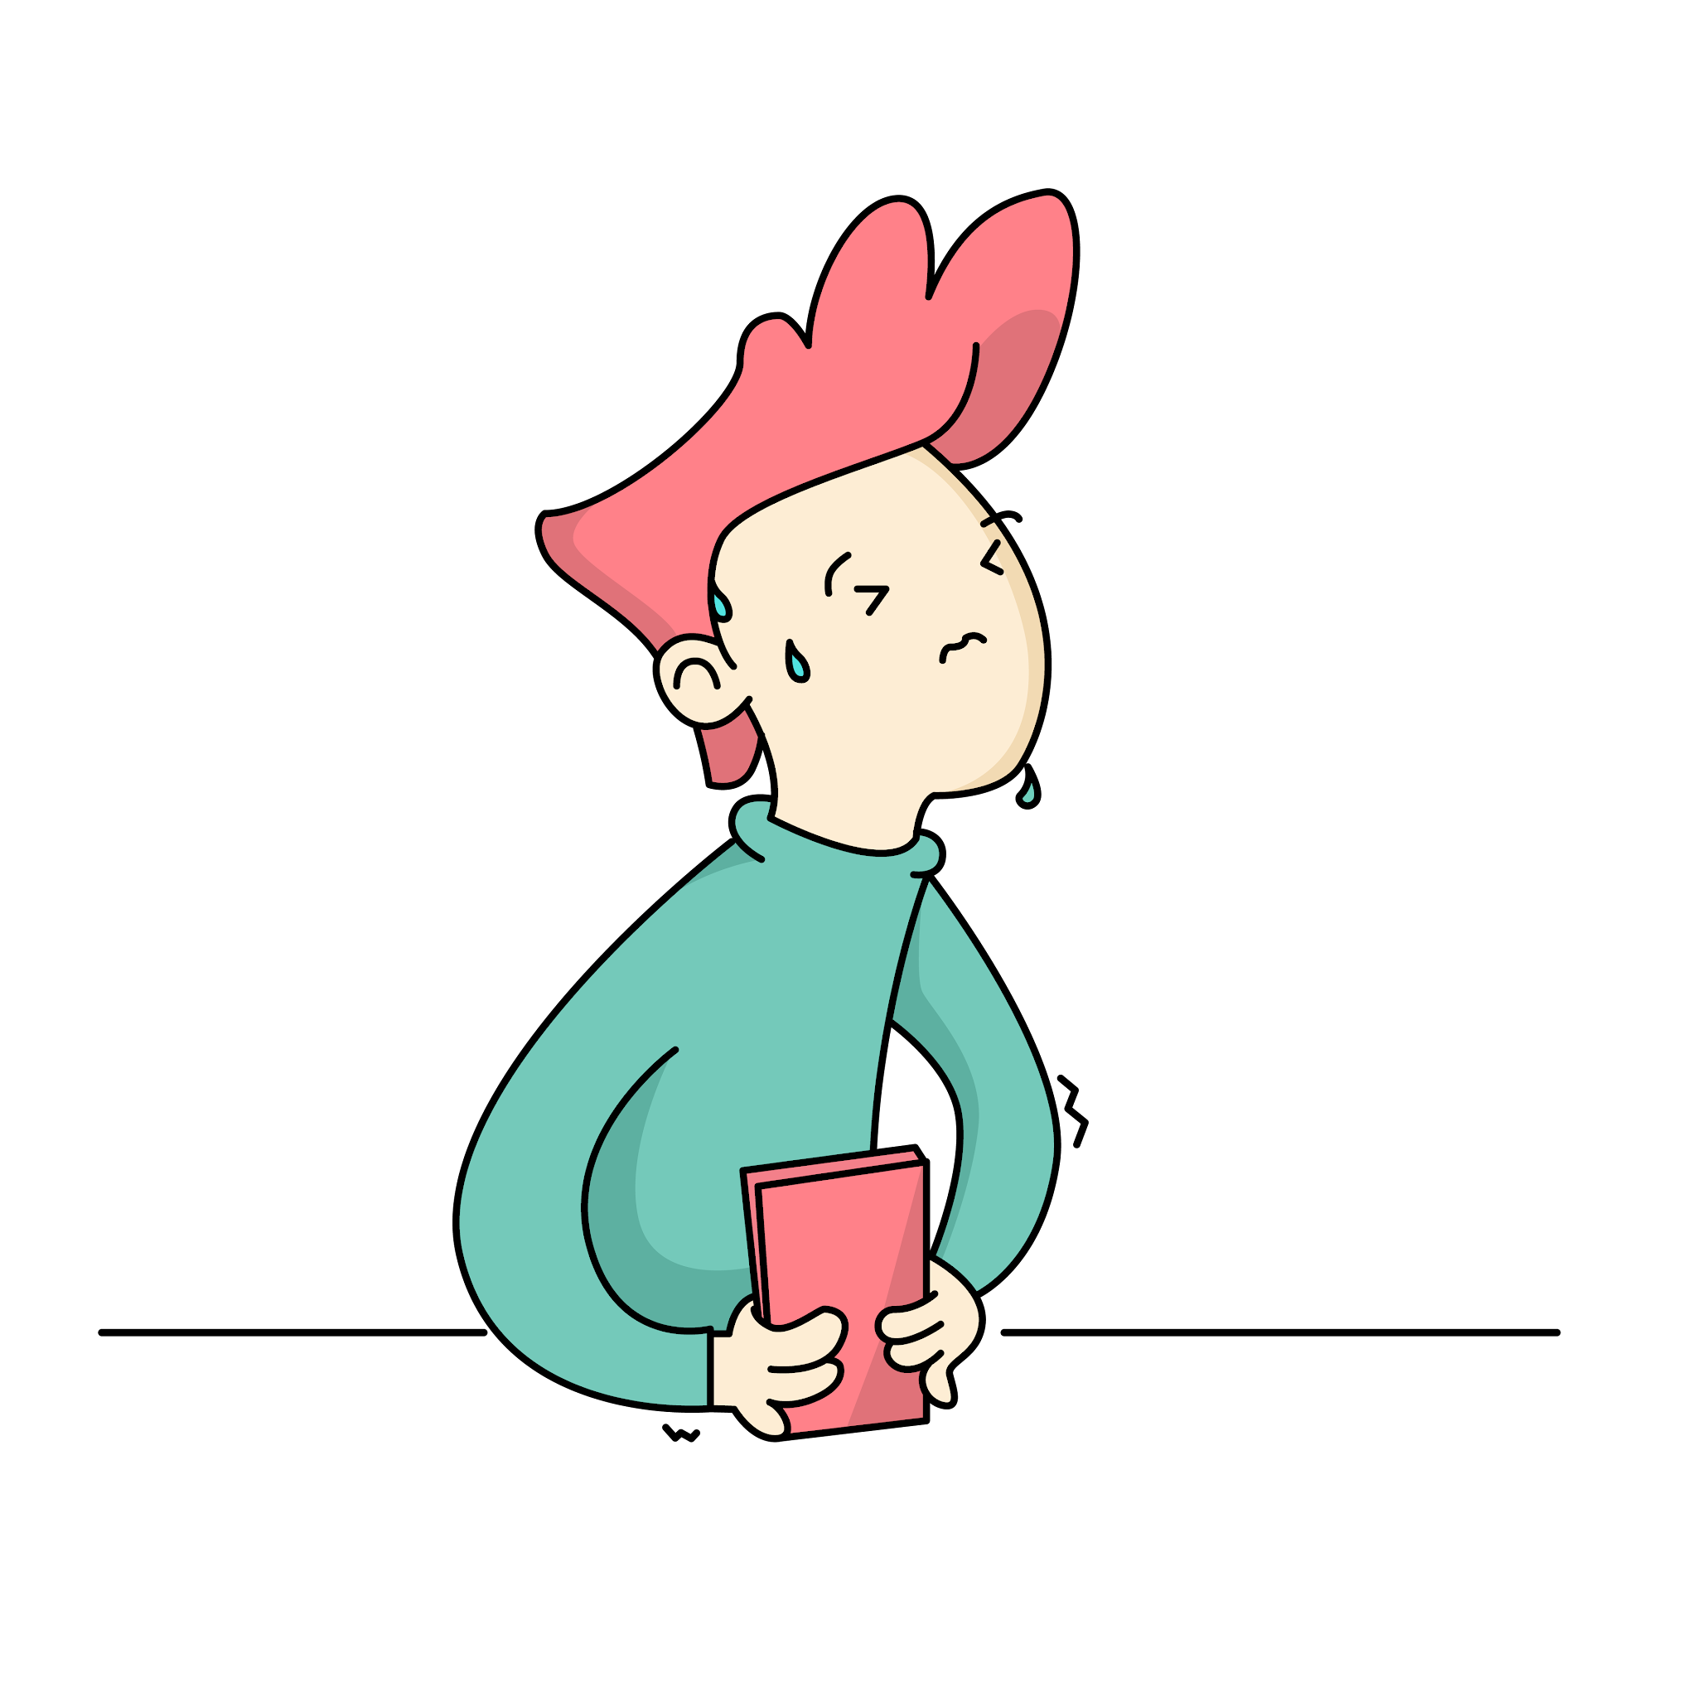
Looks like:
Difficulty starting
Hesitant to jump into tasks
Needs reassurance.
Task Initiation

Slide 5
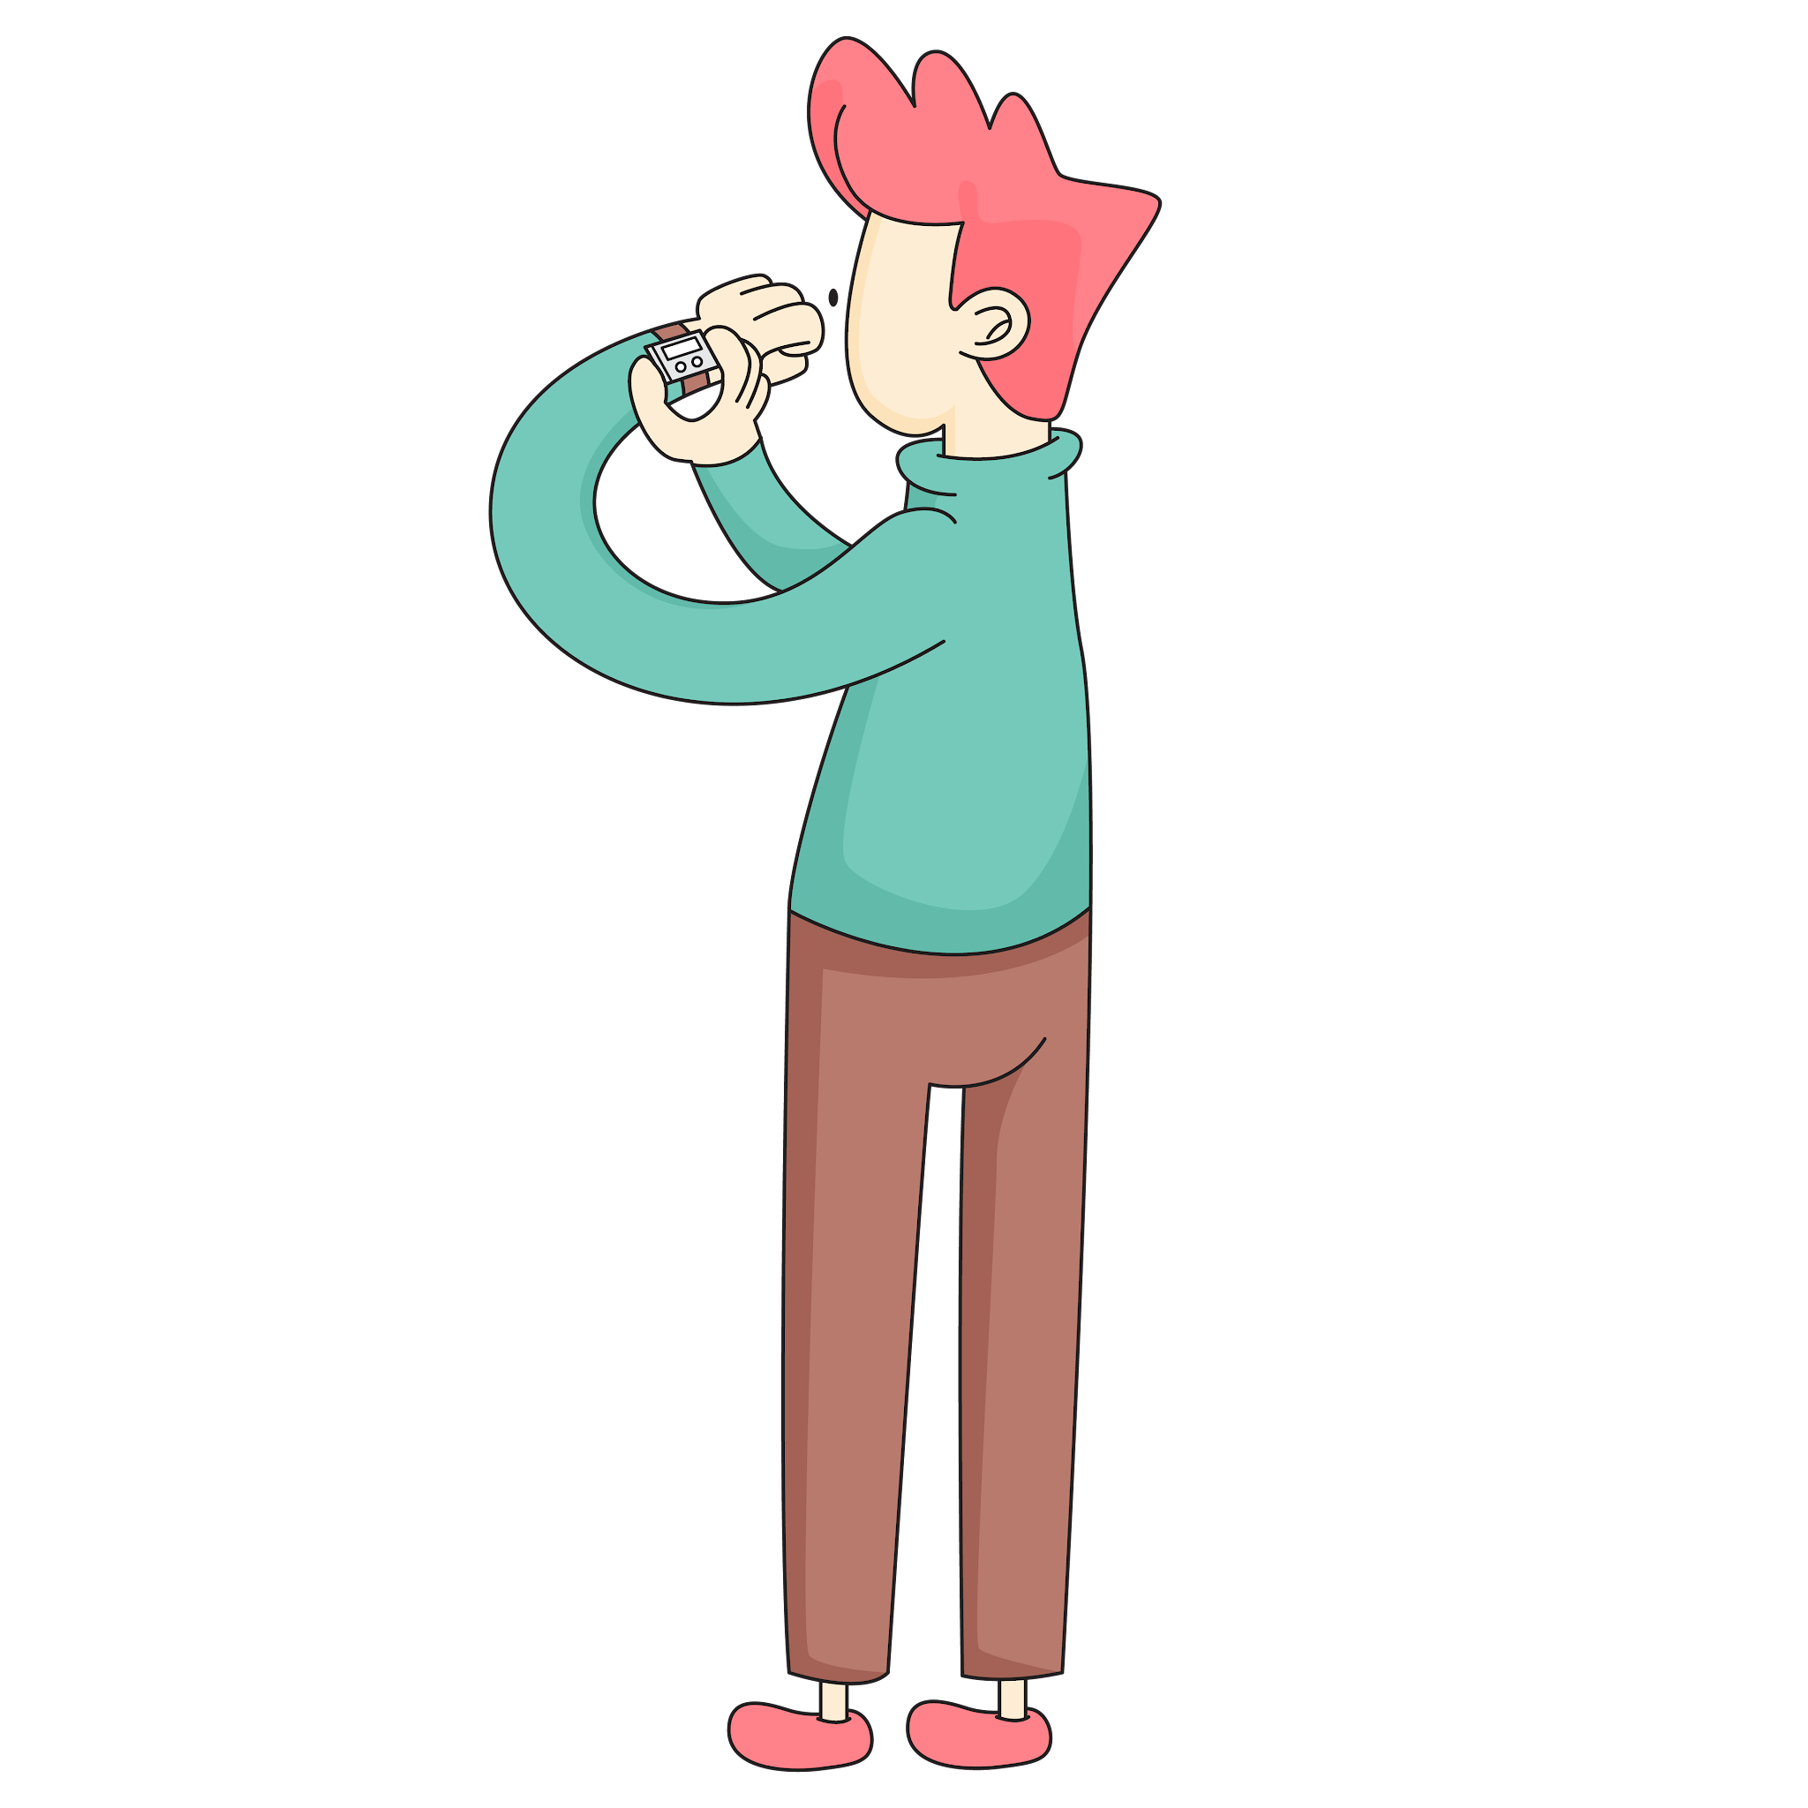
Strategies to try:
Set a timer
Rough first draft
Break it down into steps
Task Initiation

Slide 7
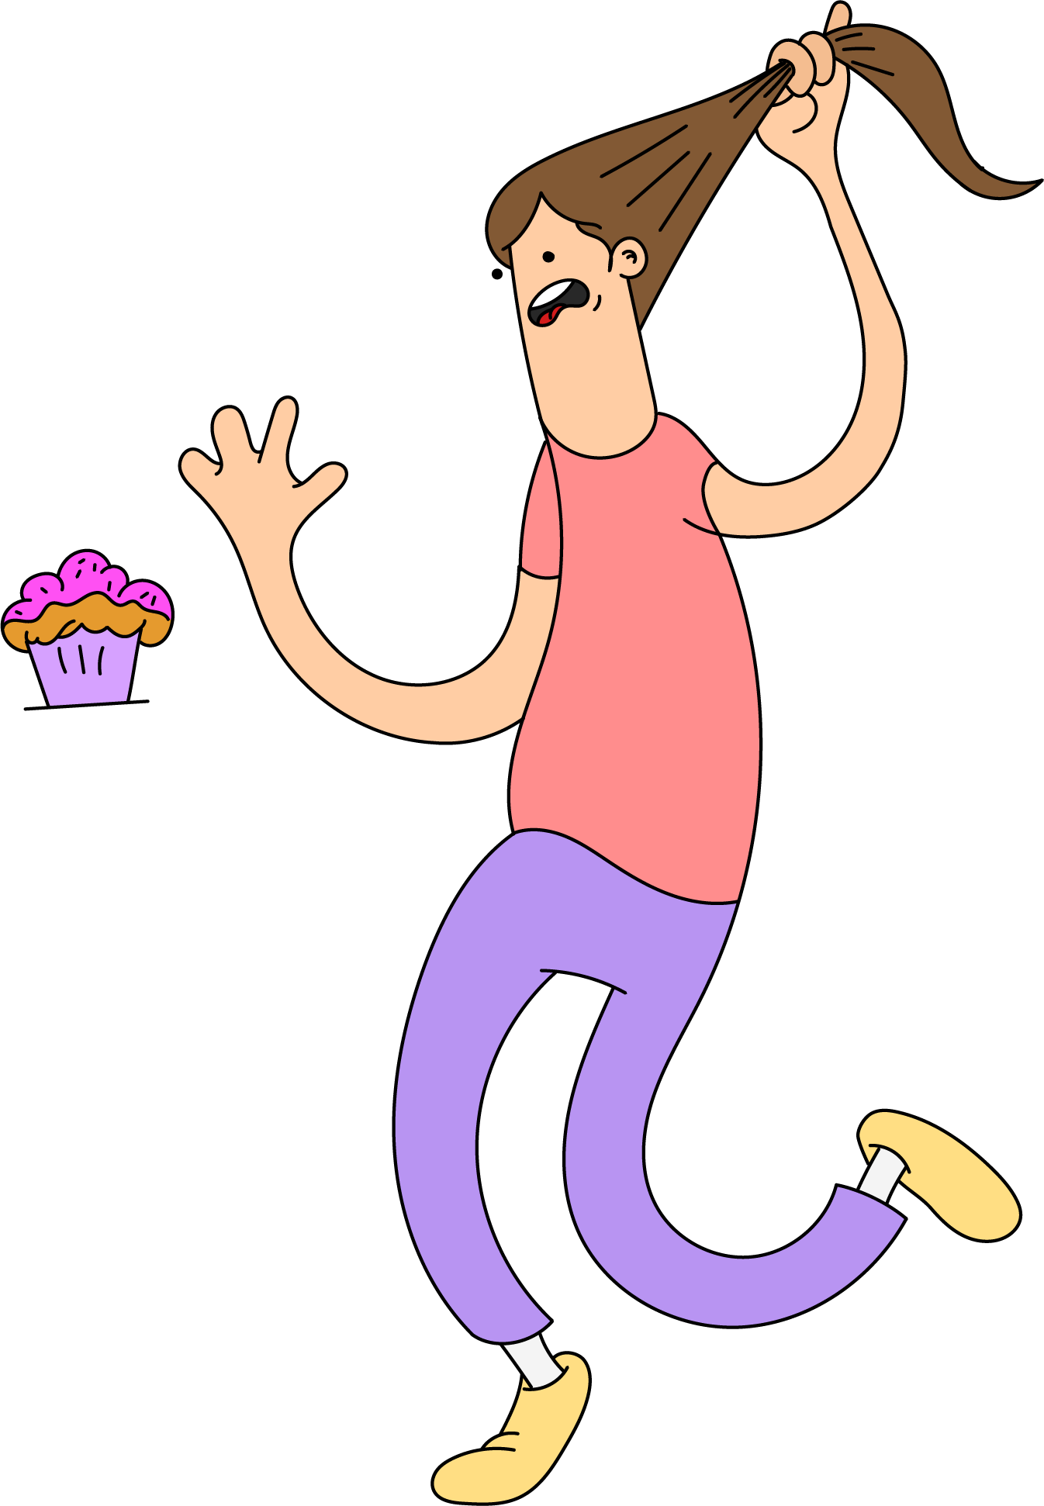
Looks like:
Calling out in class.
Needing to go first.
Snatching.
Response Inhibition

Slide 8
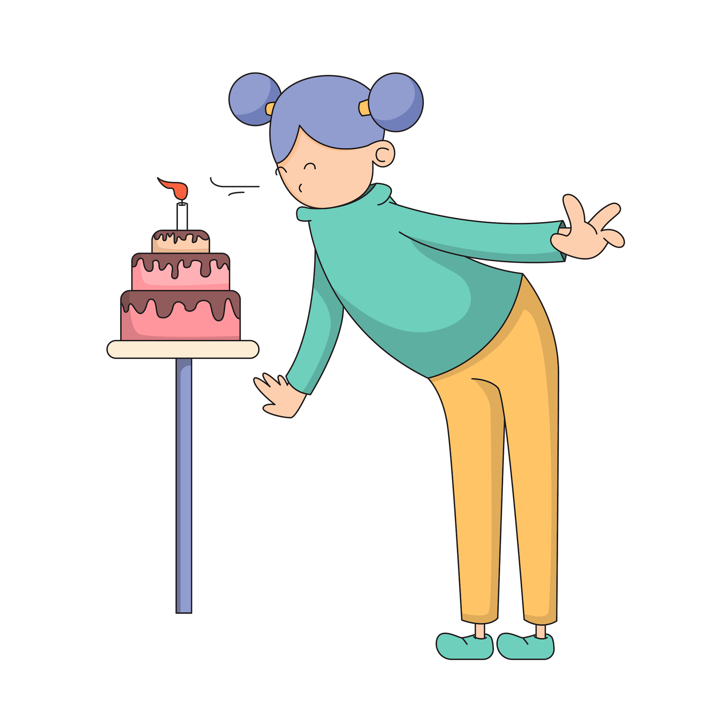
Strategies to try:
3 second pause
Take a breath
Mindful movement
Response Inhibition

Slide 10

Looks like:
Difficulty with transitions.
Struggles to see other points of view.
Struggles to adjust to changes in routine.
Flexibility

Slide 11

Strategies to try:
Routines
Now and next boards
Normalise difficulties with change or uncertainty.
Flexibility

Slide 12
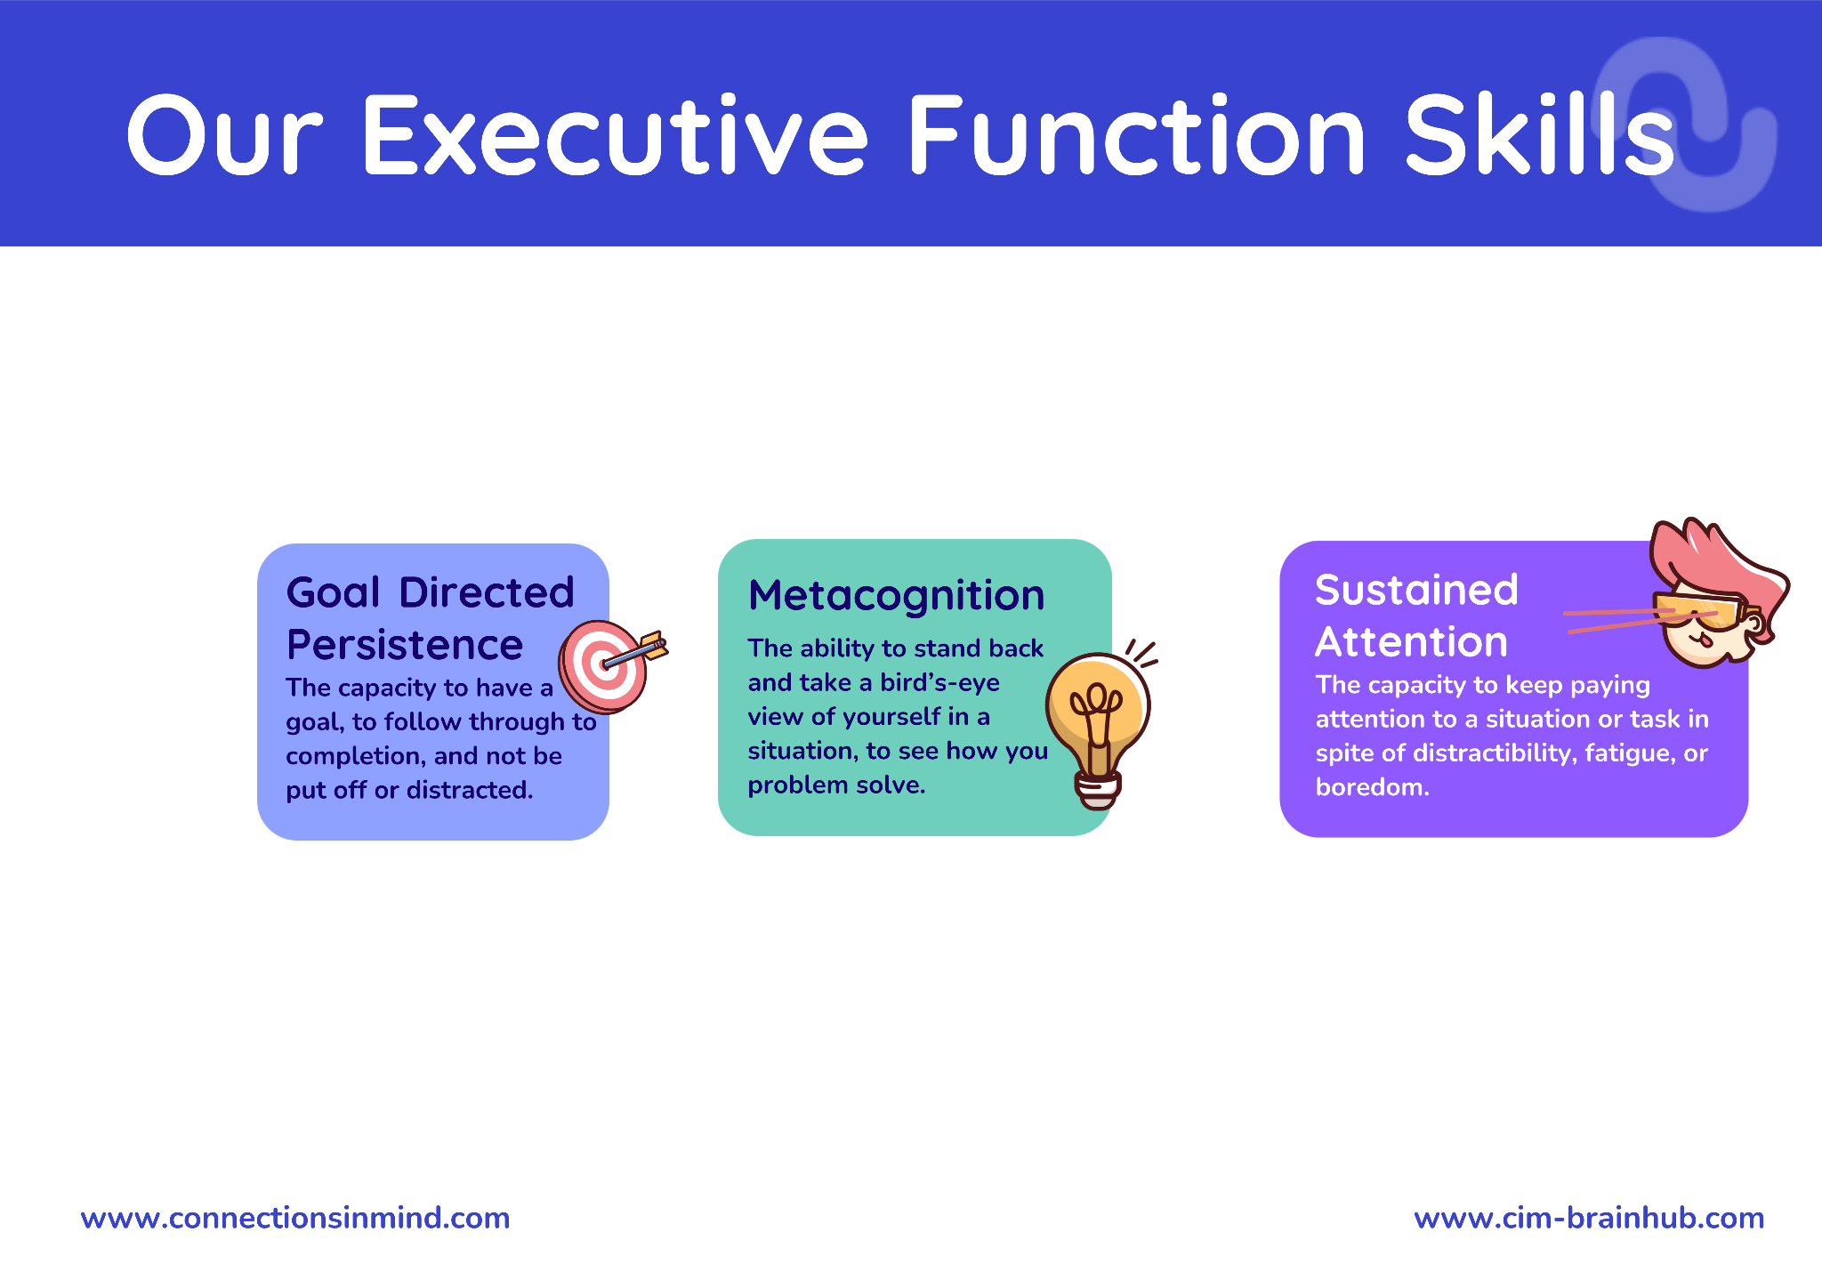

Slide 13
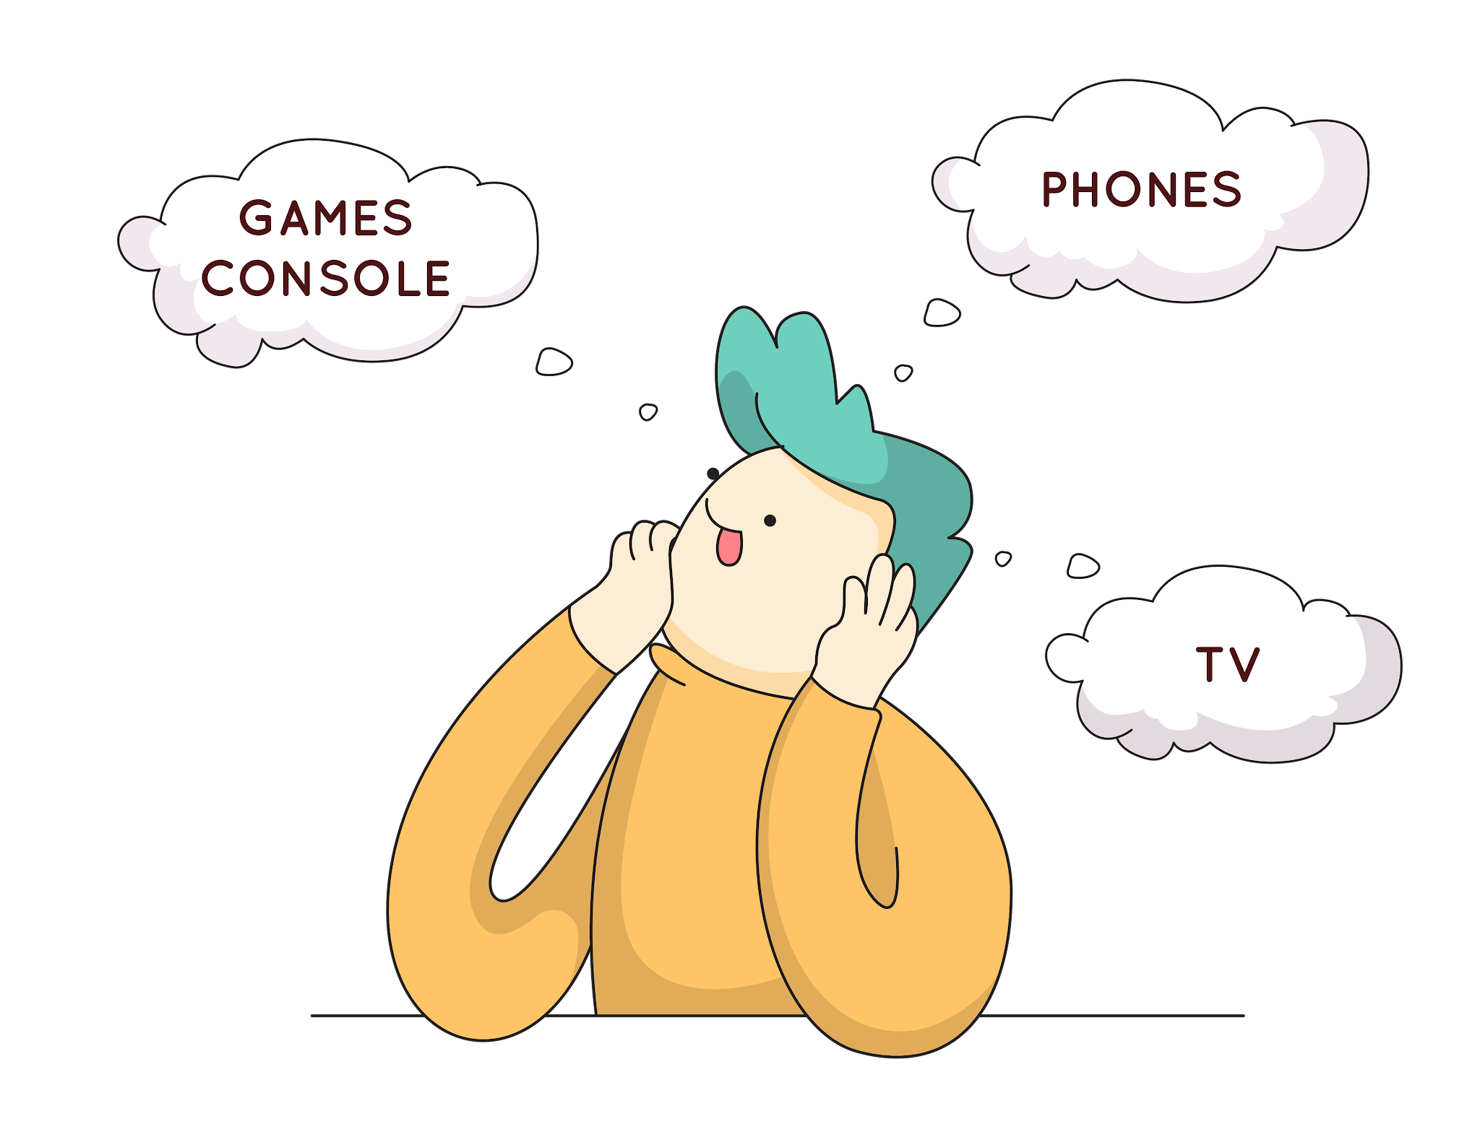
Looks like:
Easily distracted.
Prefers to focus on personal interests.
Goes off on tangents.
Sustained Attention

Slide 14
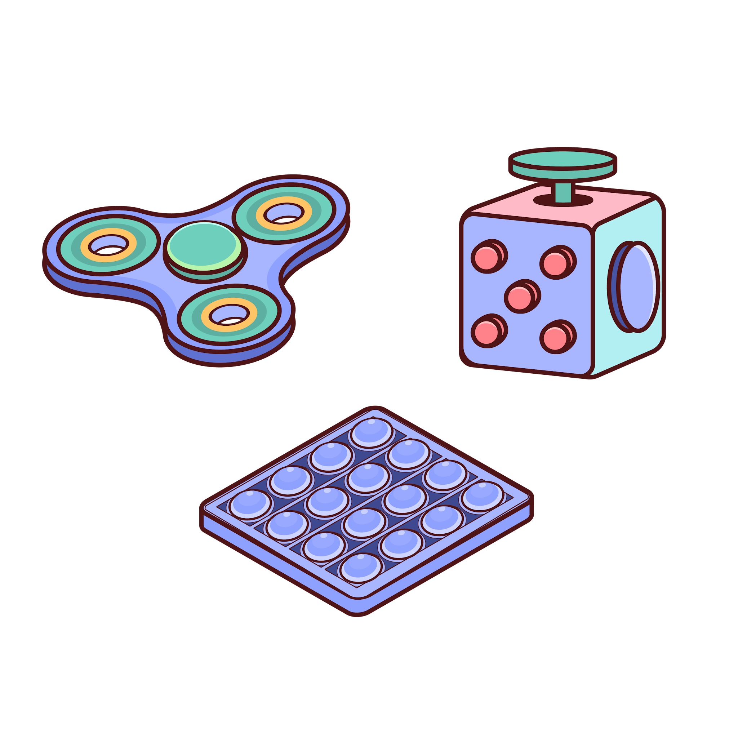
Strategies to try:
Find a quiet place to work
Movement breaks
Encourage fidgets and doodling
Sustained Attention

Slide 16

Looks like:
Repeats same mistakes.
Resistant to feedback.
Unaware that things aren’t going well.
Metacognition

Slide 17
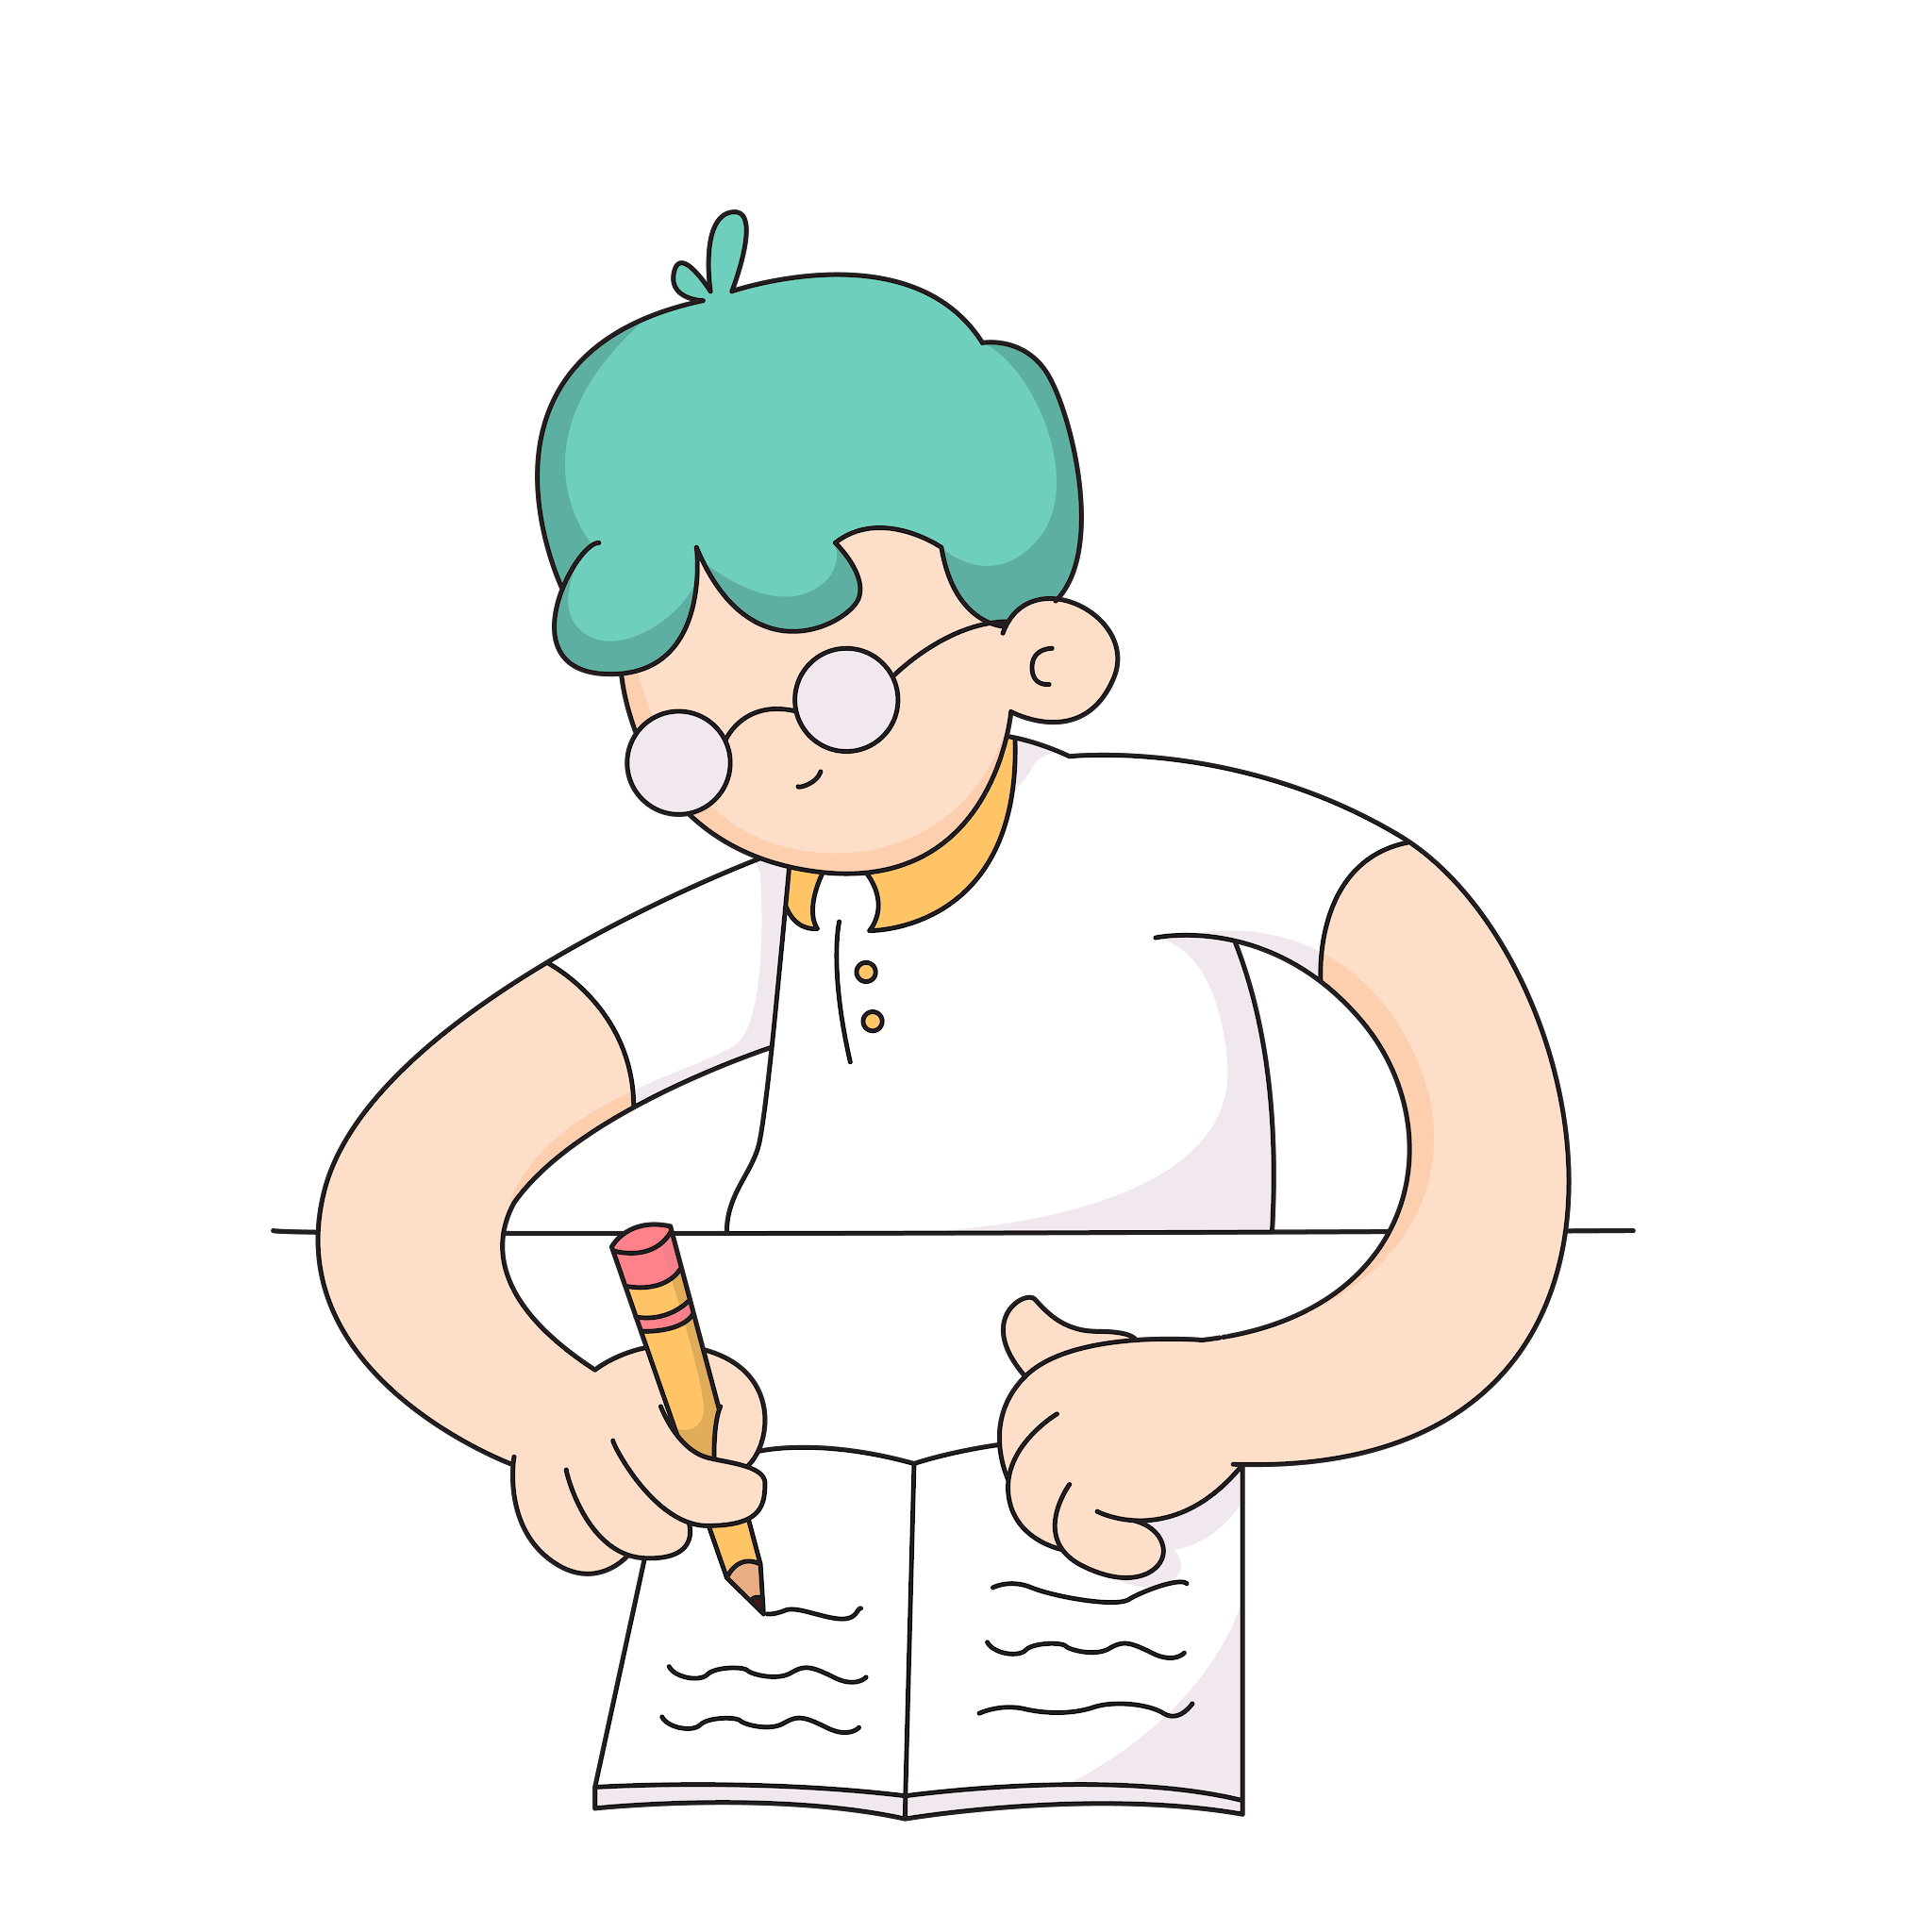
Strategies to try:
Journaling
Ask “what went well” WWW and “even better if” EBI
Practice asking for and using feedback
Metacognition

Slide 19
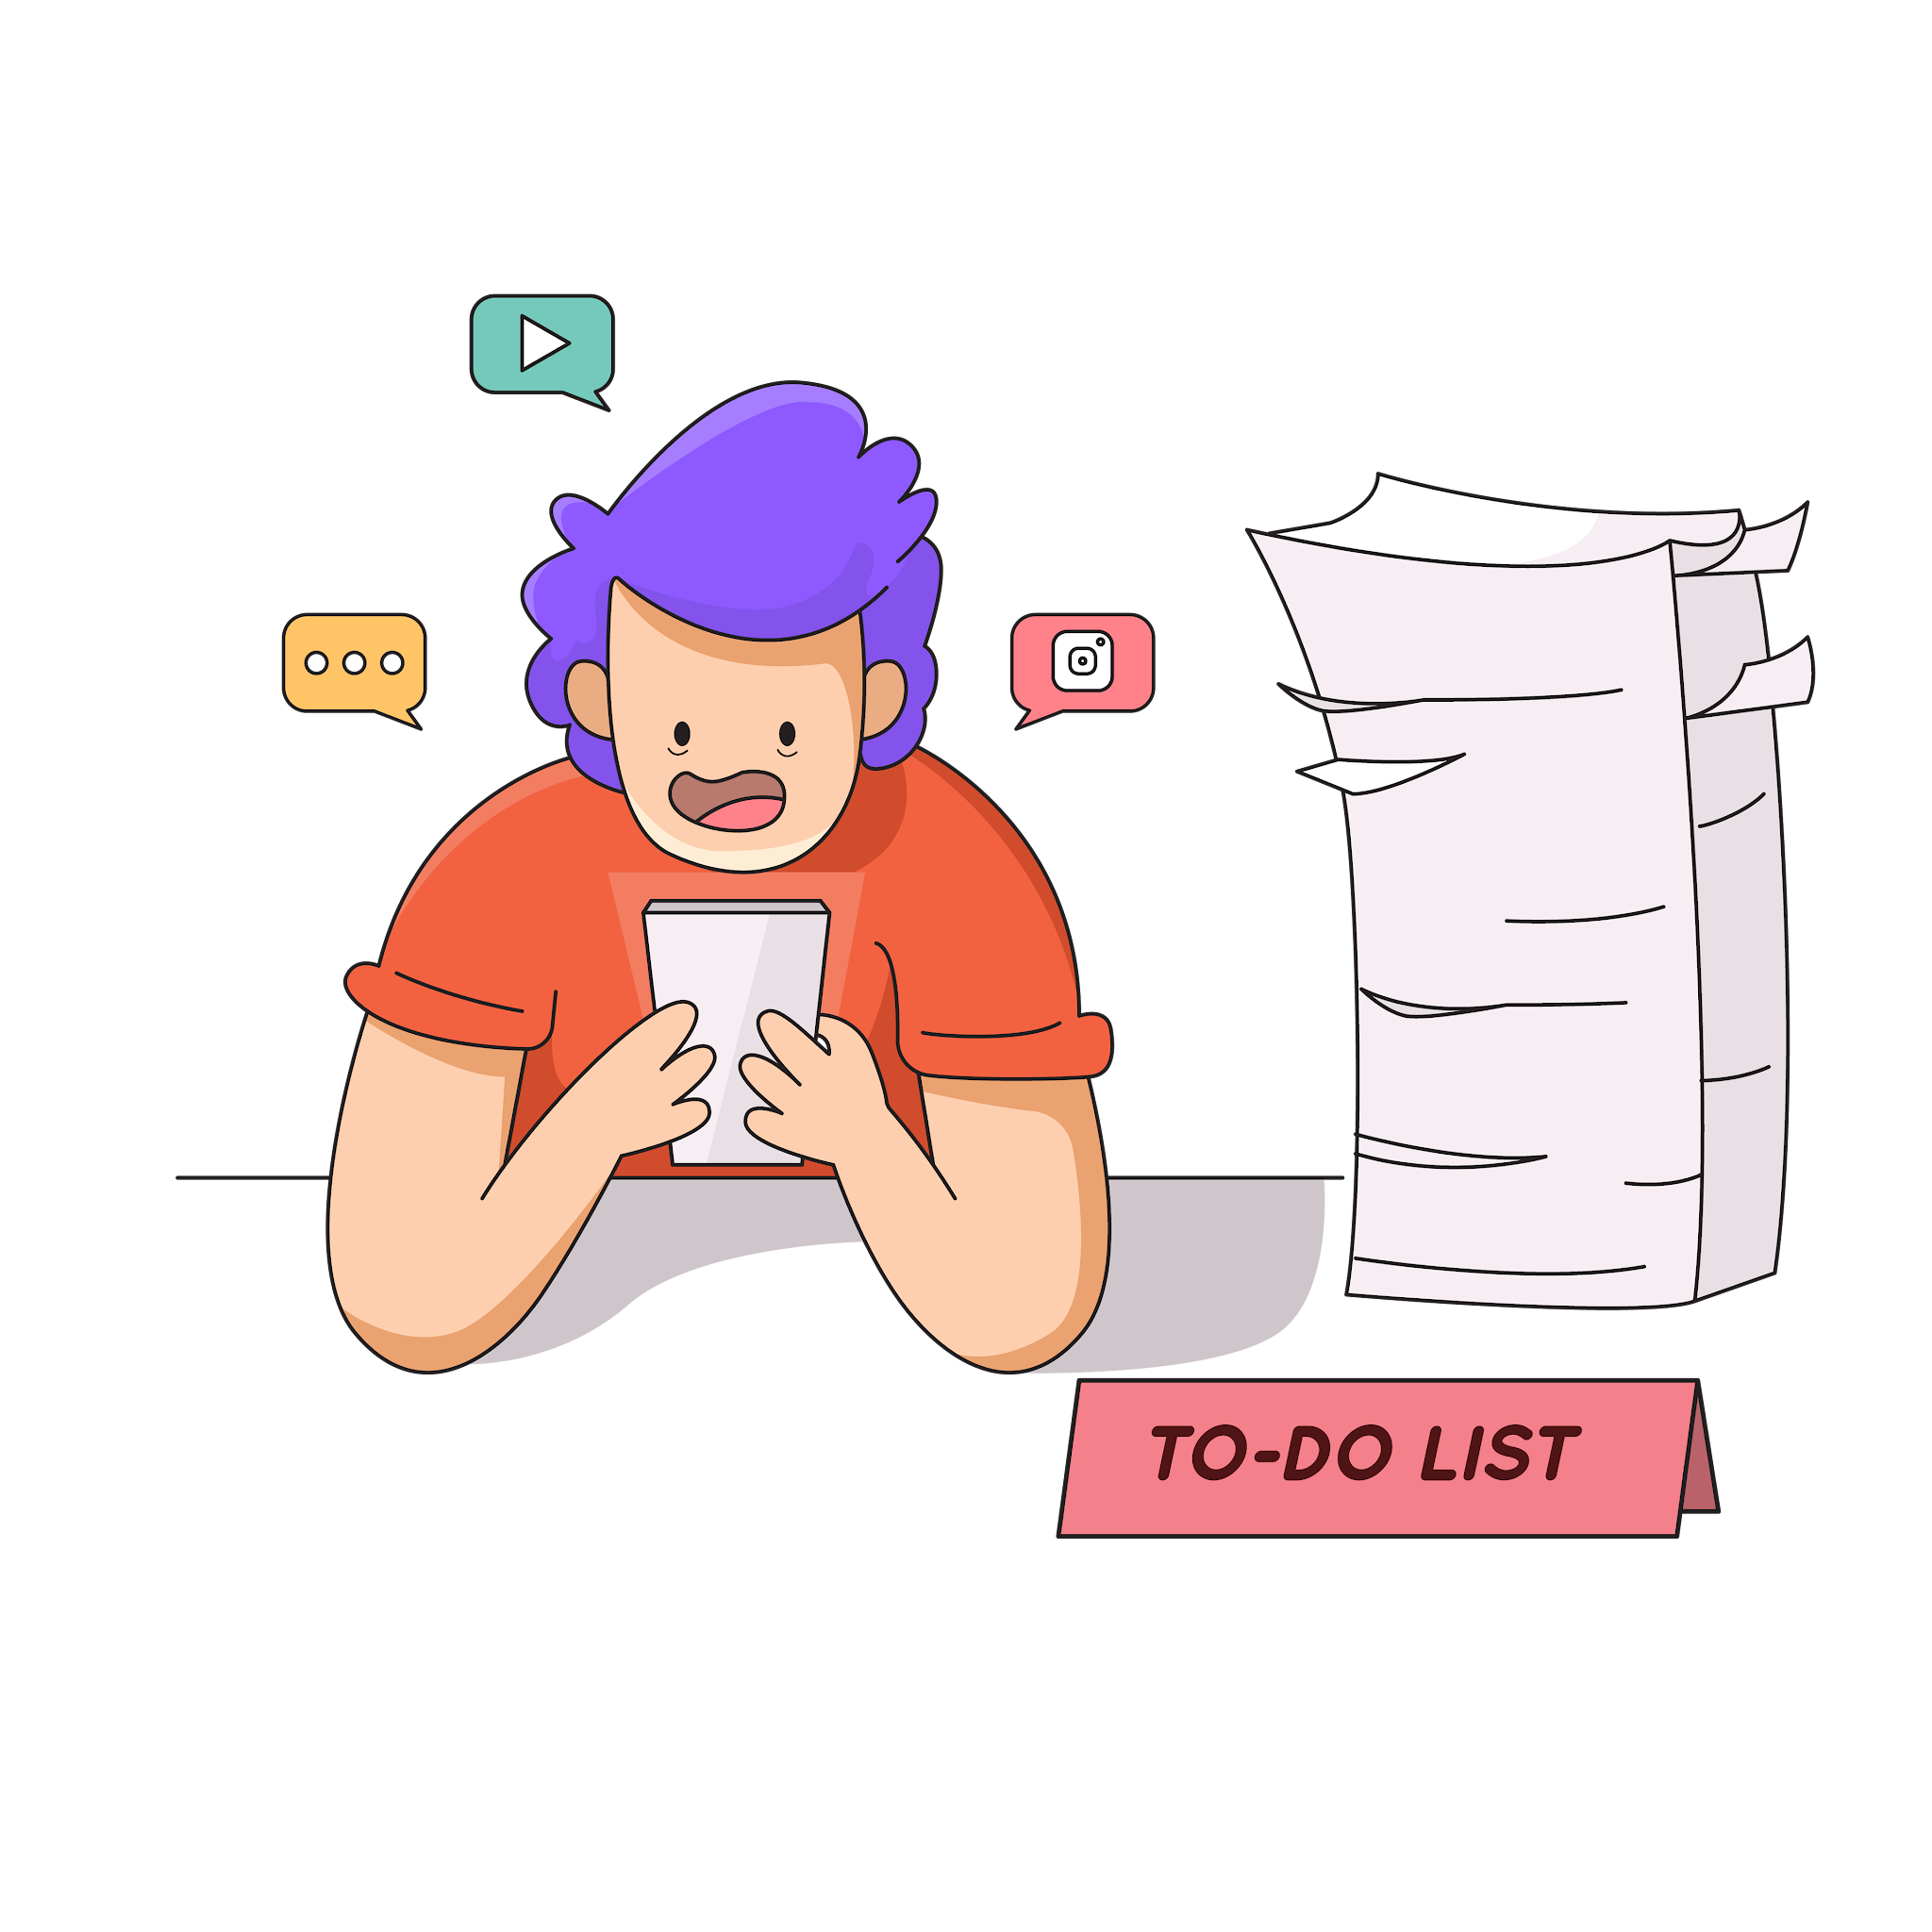
Looks like:
Struggles to finish.
Gives up when a task gets hard.
Starts many things but doesn’t follow through.
Goal Directed Persistence

Slide 20
Strategies to try:
Break long project down into chunks.
Social stories over- coming challenges.
Checklist
Goal Directed Persistence

Slide 22
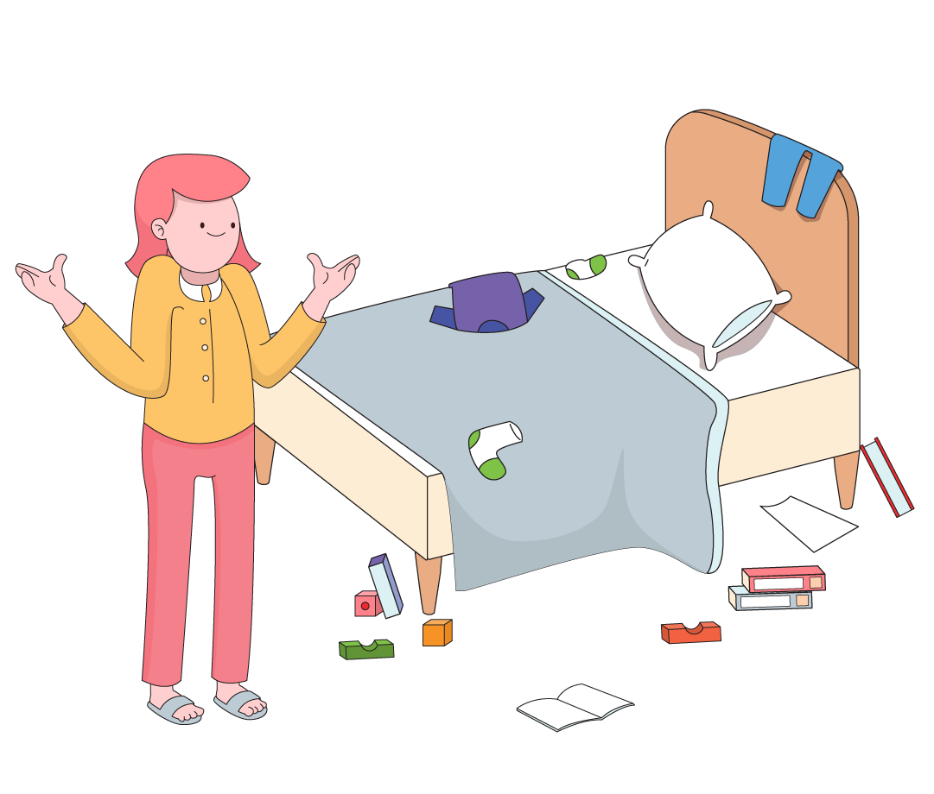
Looks like:
Messy desk/bag/locker.
Loses belongings.
Disorganised files.
Organisation

Slide 23

Strategies to try:
Mise en place
Tidy up time
Break it down into steps
Organisation

Slide 24
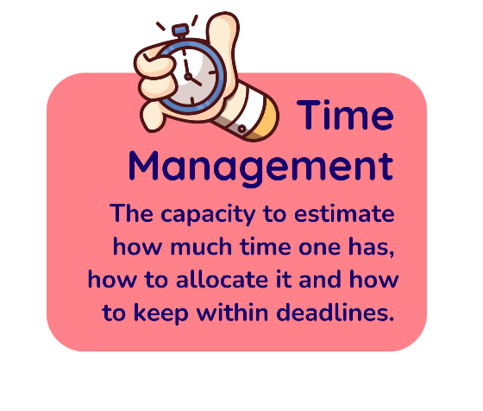

Slide 25
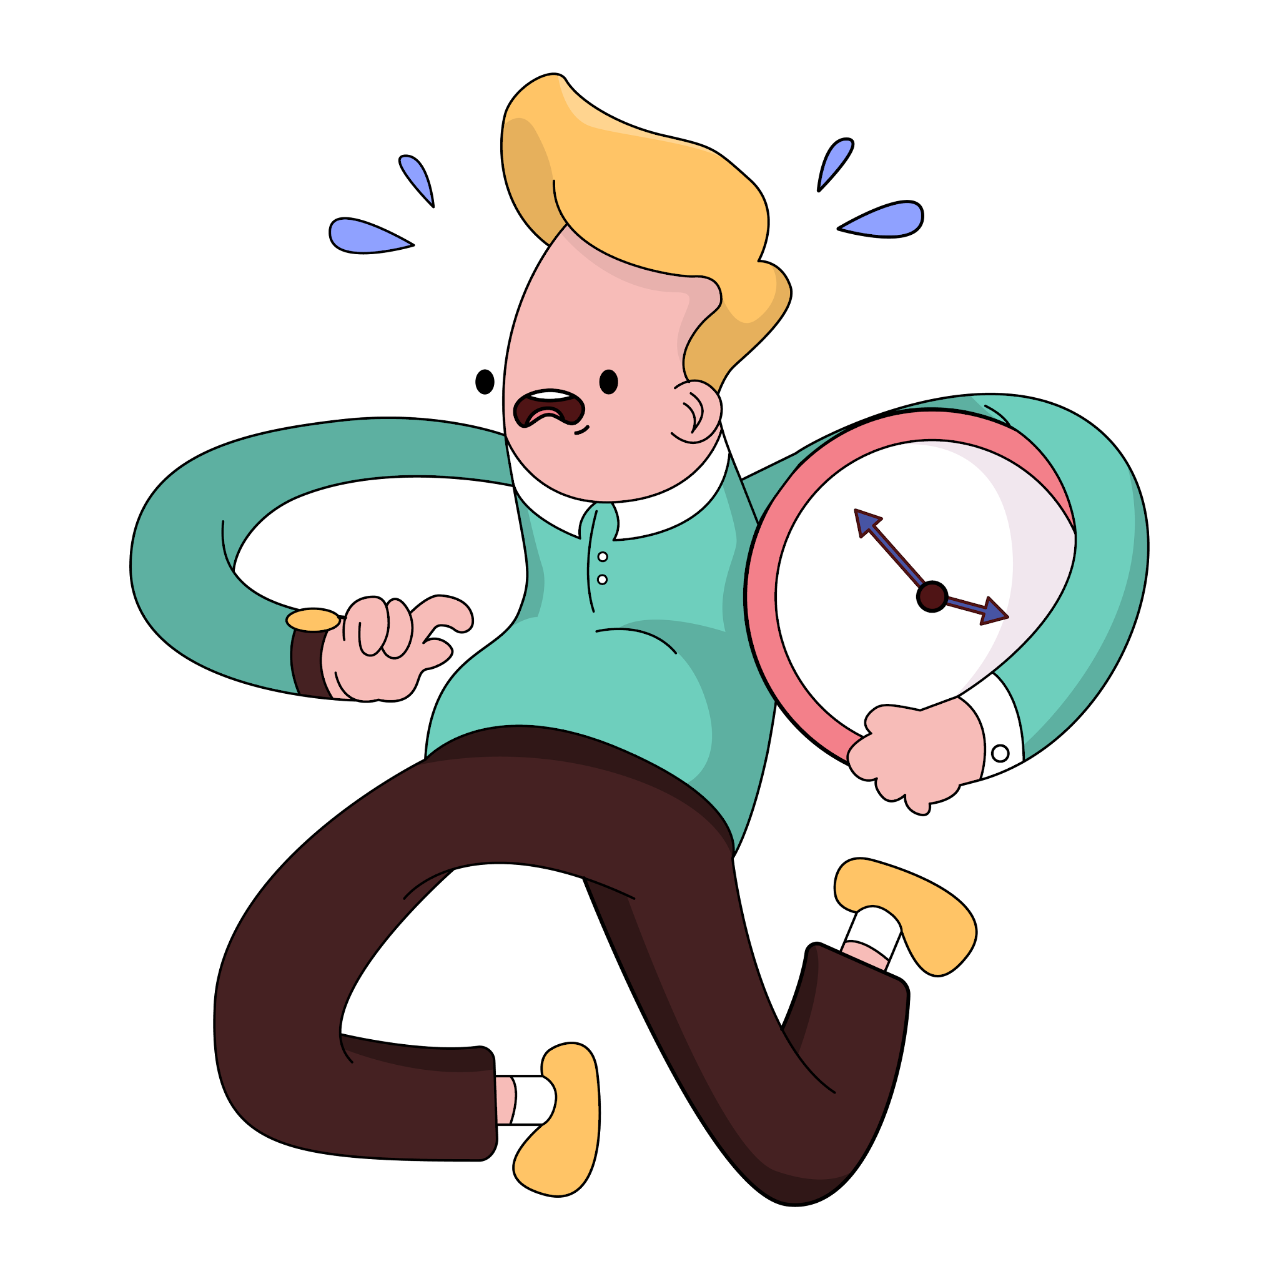
Looks like:
Late to school/lessons.
Runs out of time in tests.
Struggles to sense time passing.
Time Management

Slide 26
Strategies to try:
Timers.
Estimate and check.
Accurate time checks.
Time Management

Slide 28

Looks like:
Forgetting instructions.
Losing train of thought.
Struggles to complete multi-step tasks.
Working Memory

Slide 29

Strategies to try:
Break it down into steps
Visual Aids
Notes (written or voice)
Working Memory

Slide 31

Looks like:
Outbursts.
Shut downs.
Holds grudges and struggles to move on.
Emotional Regulation

Slide 32

Strategies to try:
Fire drills (practice strategies before needed)
Co-regulation
Mindful activities
Breathing exercises
Emotional Regulation

Slide 34

Looks like:
Feels overwhelmed by workload.
Struggles to decide what do to first.
Difficulty deciding what is important.
Planning & Prioritisation

Slide 35
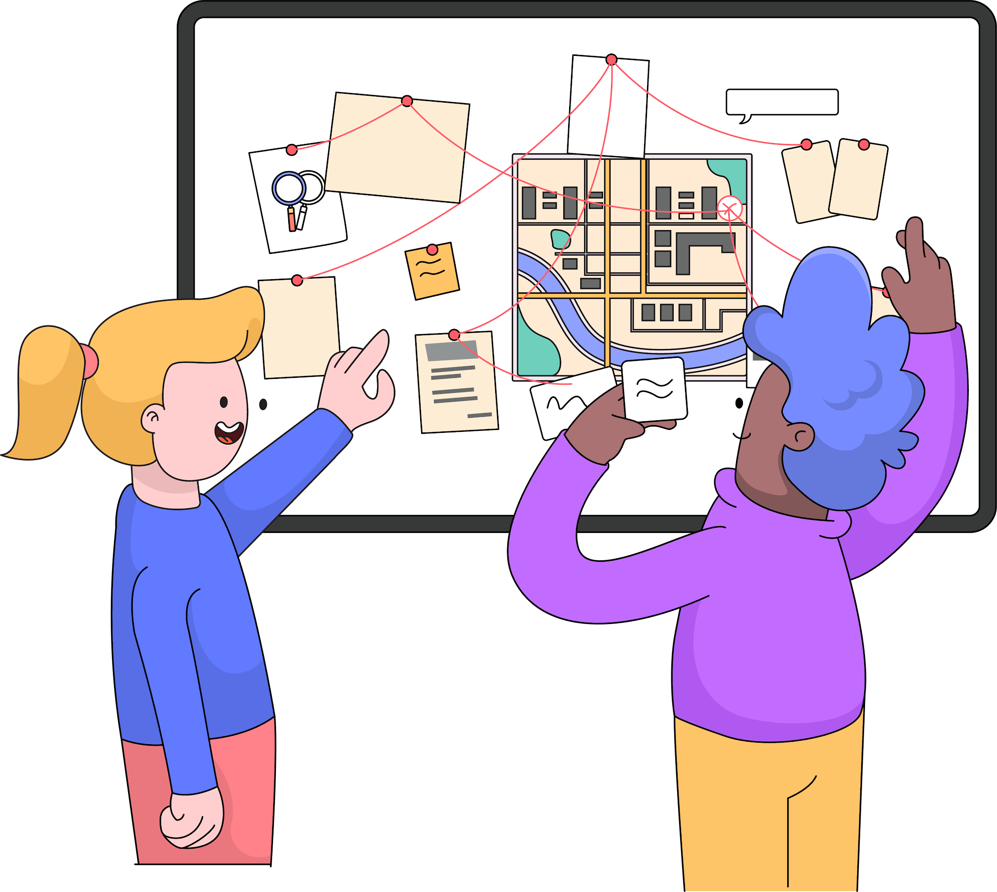
Strategies to try:
Kaban Board
Eisenhower Matrix
Post it note plan (reorder chunks)
Planning & Prioritisation

Slide 36
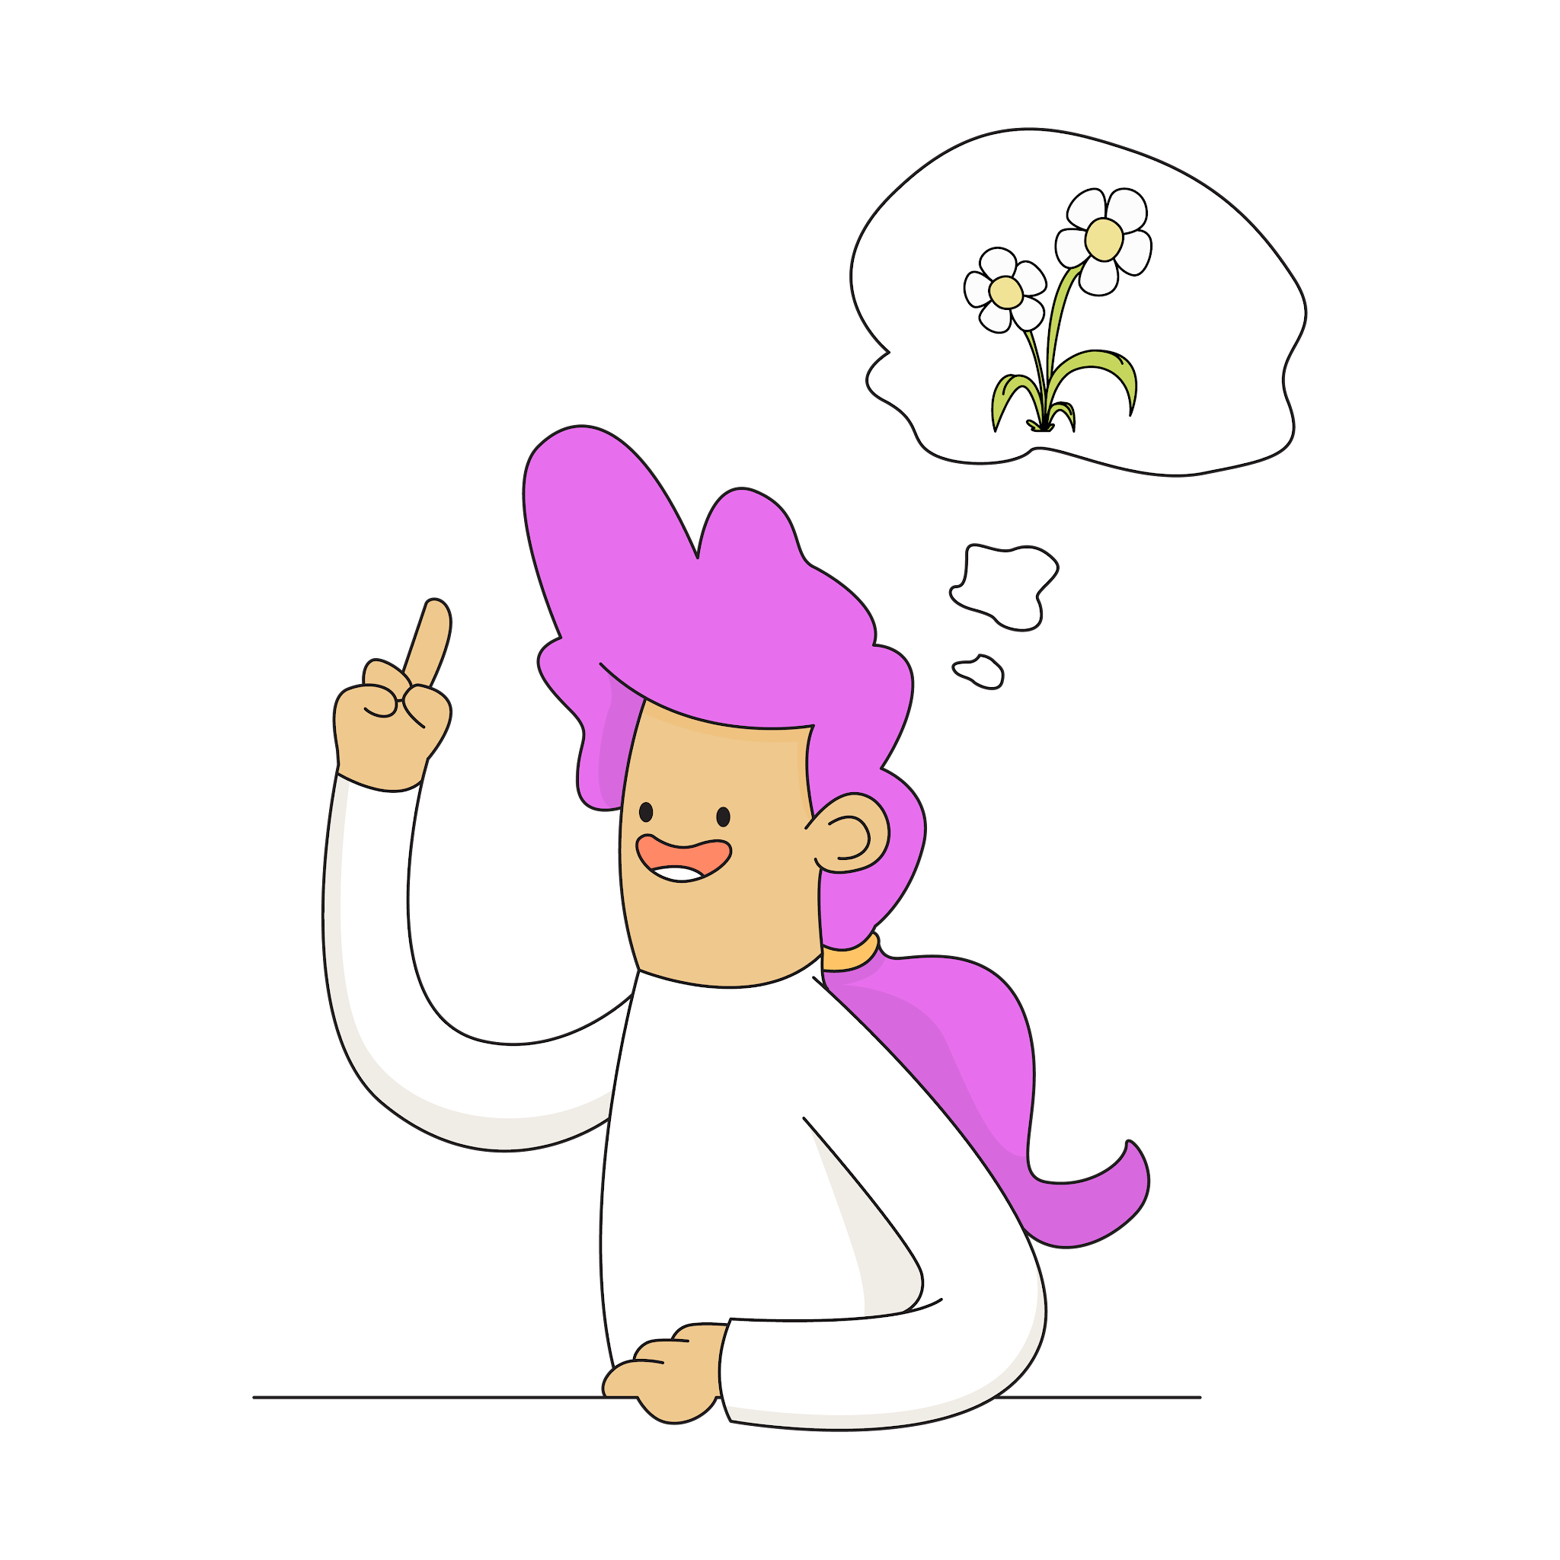
Everyone benefits from developing their executive function skills.
Having a skill does not always mean being able to access it in the moment.
Remember

Slide 37

Connections in Mind
The world’s leading executive function training provider.

